Slide 1
TMSA Member Meeting
June 13, 2023

Slide 2
Agenda
TMSA Vision and Mission (Jennifer Karpus-Romain)
Opening Comments with TMSA President Mark Derks
TMSA Board of Directors Slate, including new President Elect/Treasurer (David Hoppens)
Bylaw Update and Vote (Jahan Byrne)
A look ahead at the future of TMSA as it nears 100 years (Jennifer Karpus-Romain)
Announcing the 2024 ELEVATE Conference (Jennifer Karpus-Romain)
Meeting adjourned

Slide 3
Vision & Mission
VISION
TMSA's vision is to be the pre-eminent non-profit sales and marketing association that transportation and logistics professionals turn to for industry-specific education, connections and resources.
MISSION
TMSA’s mission is to enable sales and marketing professionals to learn and give back to the transportation and logistics industry through education, connections and resources, ultimately strengthening their individual development, their businesses and the industry-at-large.

Slide 4
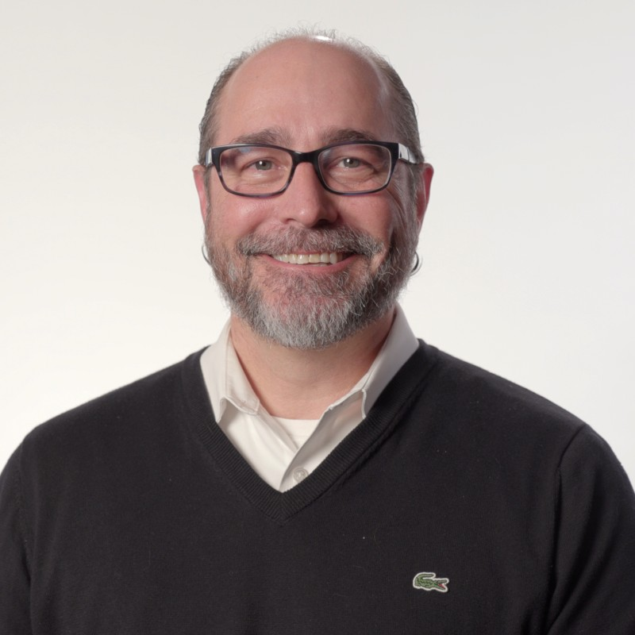
TMSA Presidential Update
Mark Derks,
President, TMSA
CMO, BlueGrace Logistics

Slide 5

Notes:
Thank you:
-HQ
-Board
-Committee Members

Slide 6
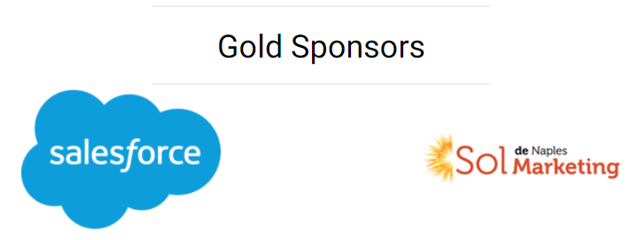

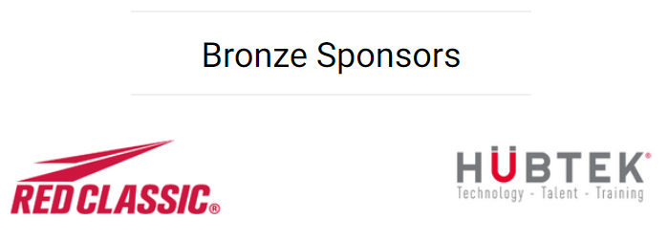


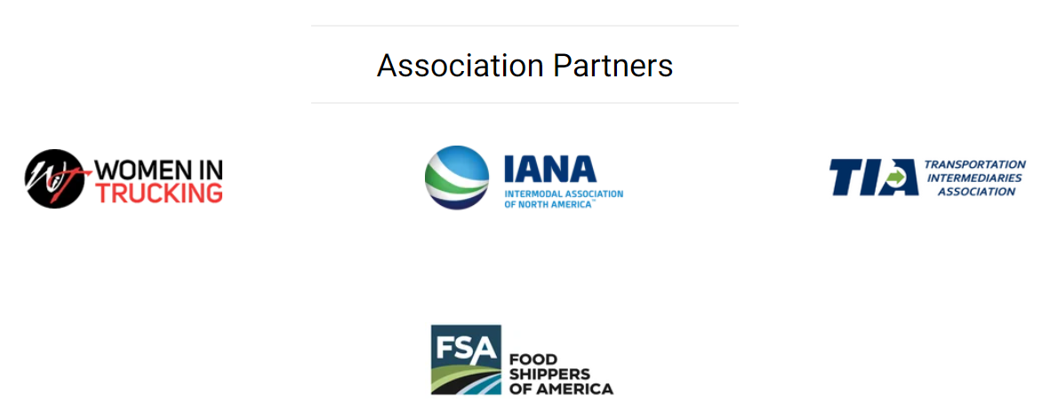

Slide 7
TMSA Updates
Since the last time we met in June, TMSA has…
…held its first Executive Summit.
…launched its new website and member portal.
…established a support of diversity, equity, and inclusion initiatives by creating the DEI Taskforce.
…created new branding for this event.

Slide 8
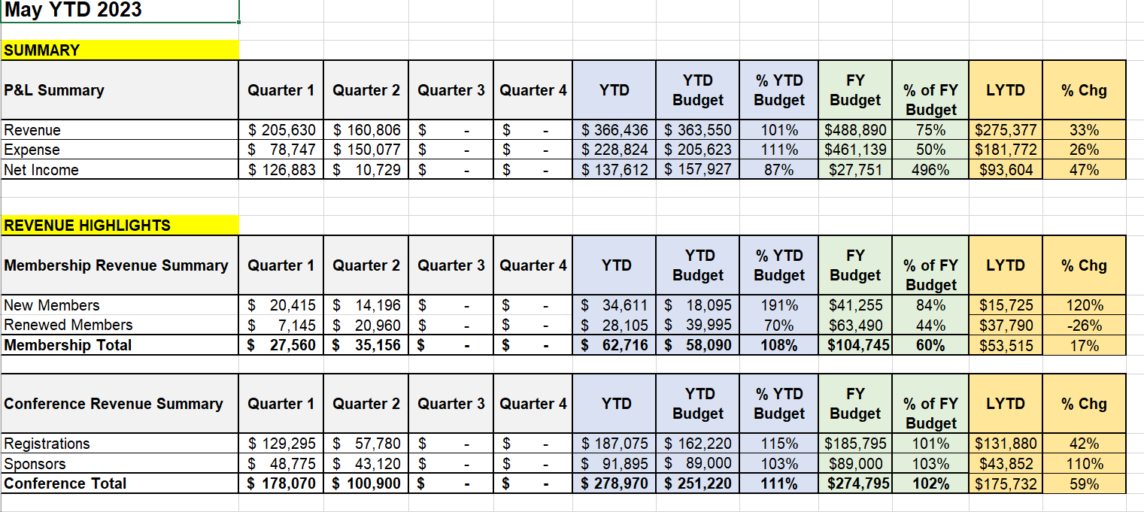
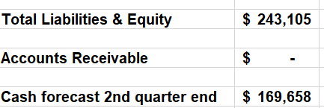
TMSA Financials

Slide 9
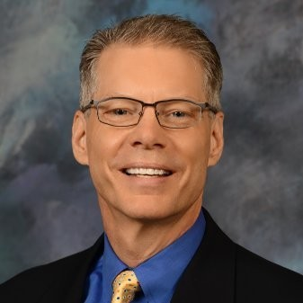
TMSA Board Slate
David Hoppens
Vice President Sales & Marketing Momentum Transportation - Landstar Agent
TMSA Succession Chair
Notes:
David goes over the Board Slate. Highlighting the most of Beth and Leigh as they take their new roles on the Exec Team.

Slide 10
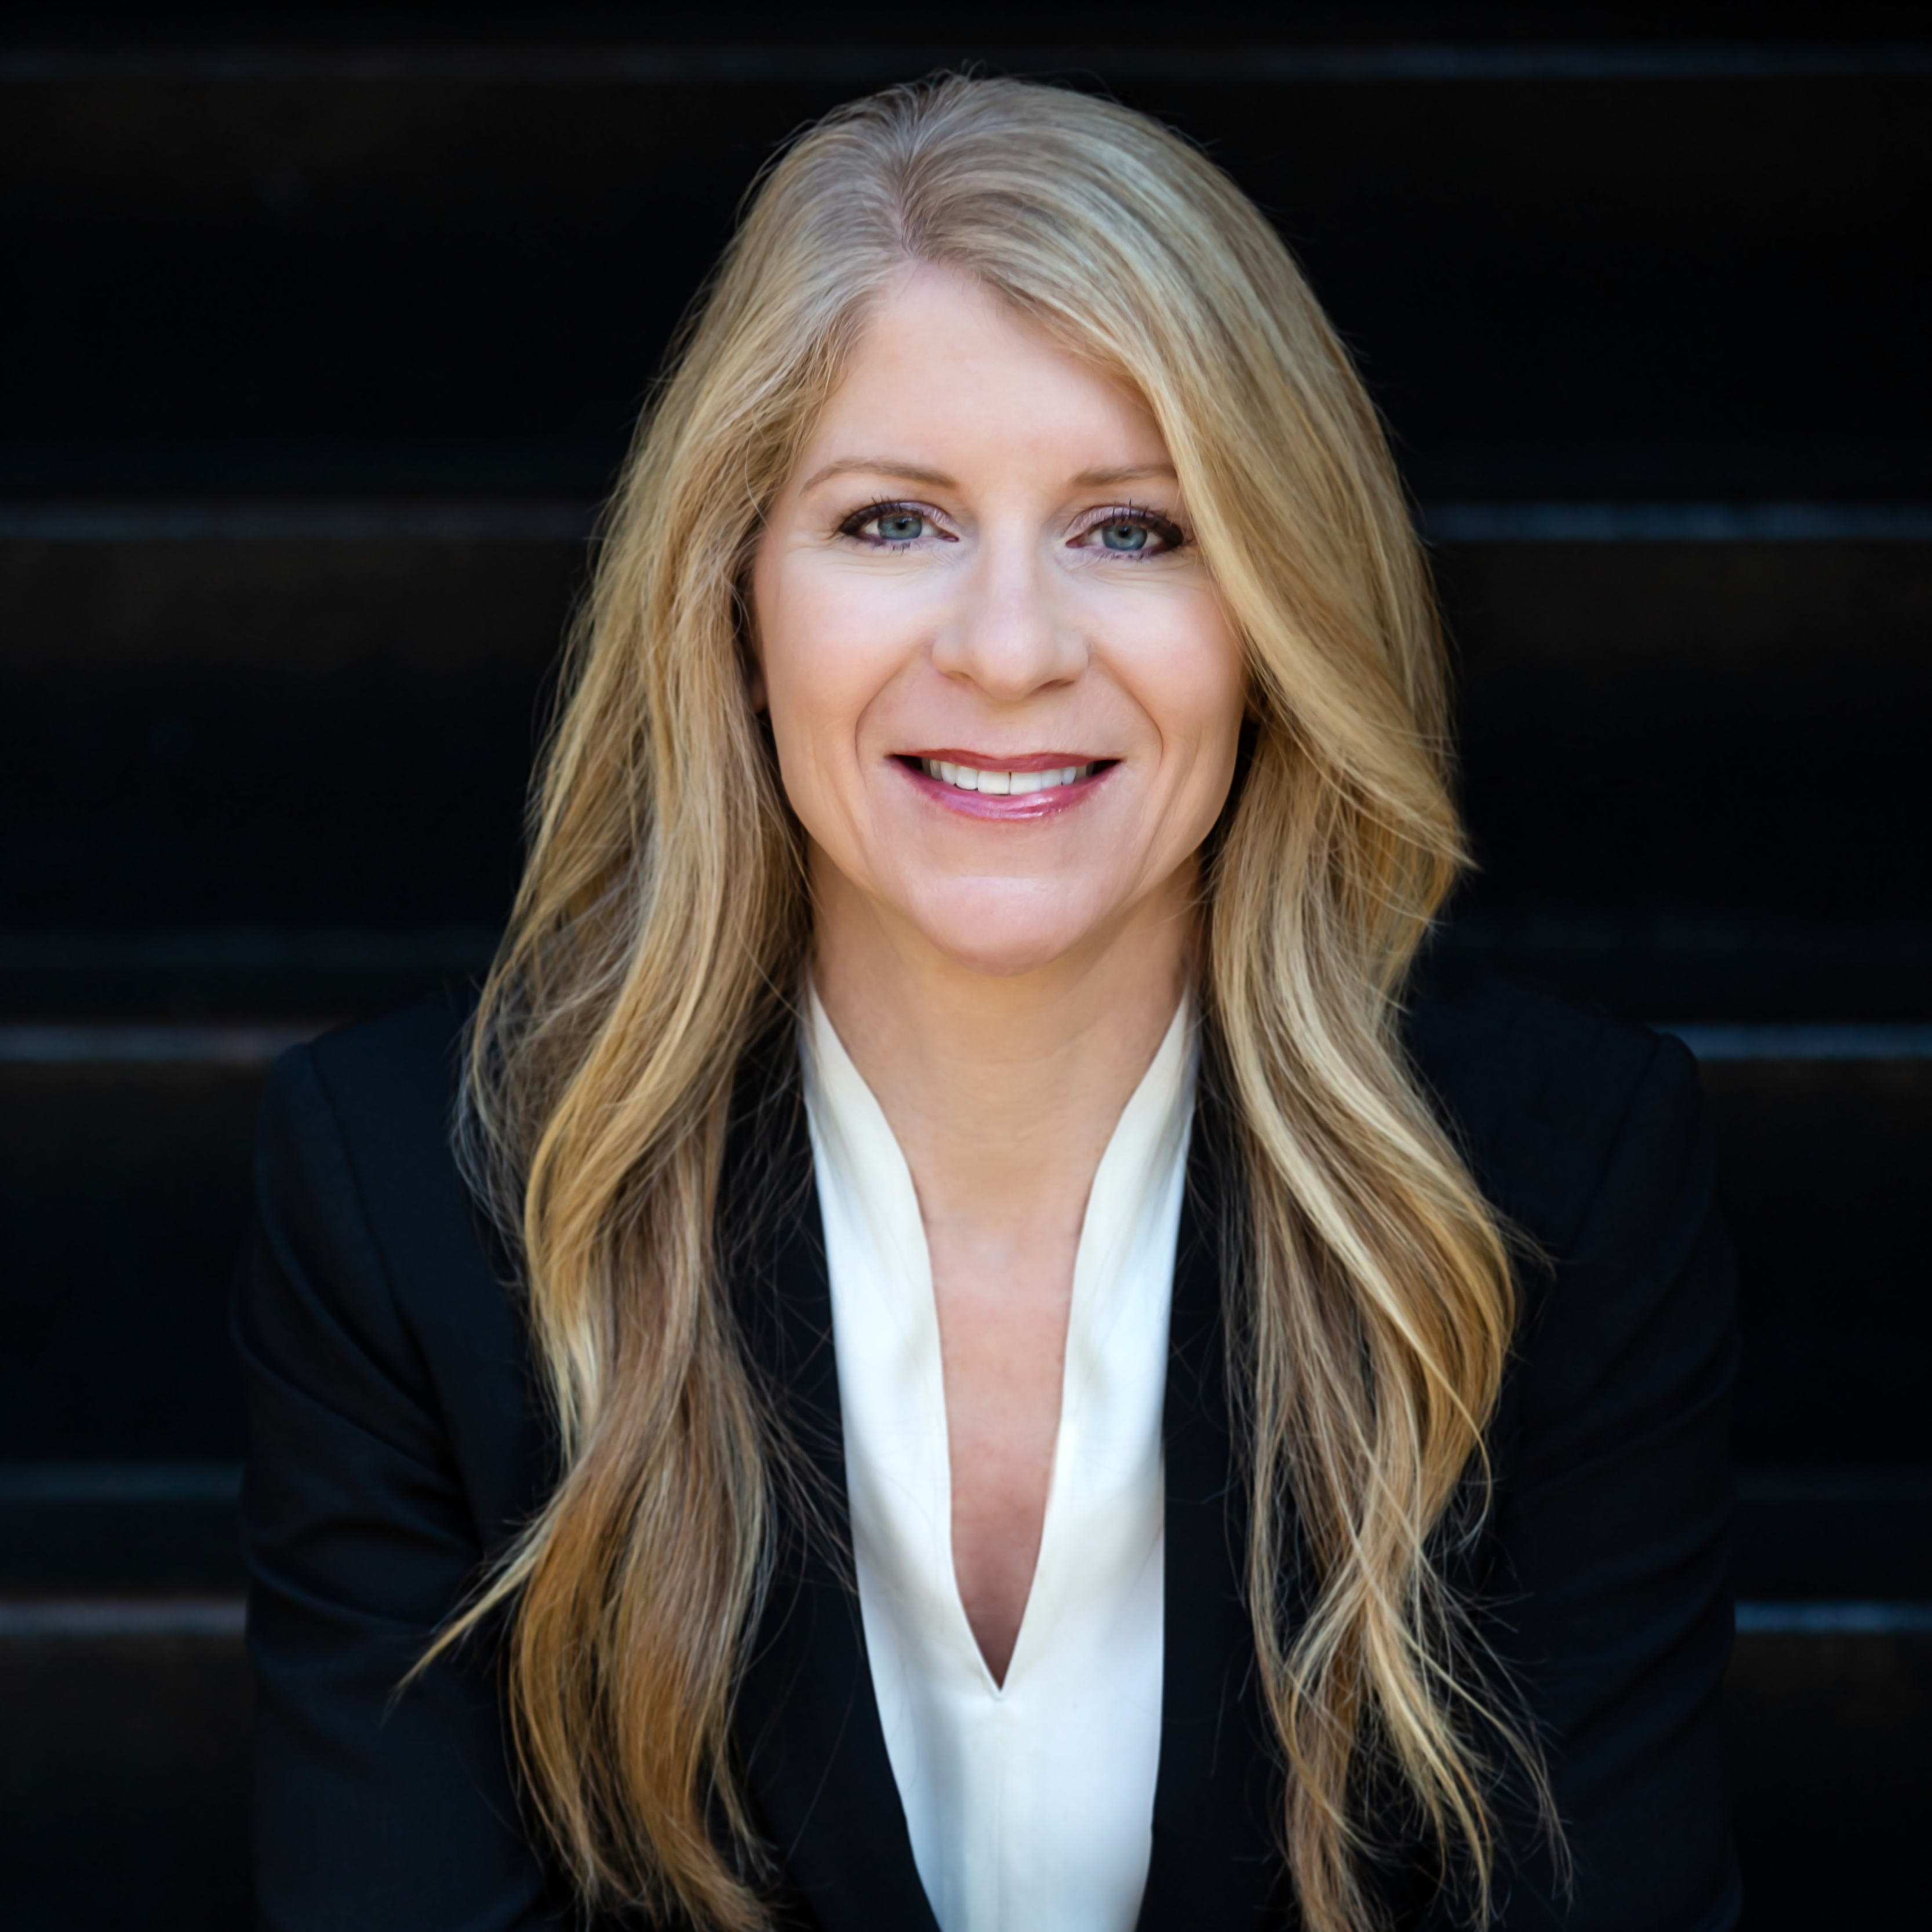
Beth Malik
Senior Director, Marketing & PR
SMC³
Current TMSA Treasurer
To Move to President Elect

Slide 11
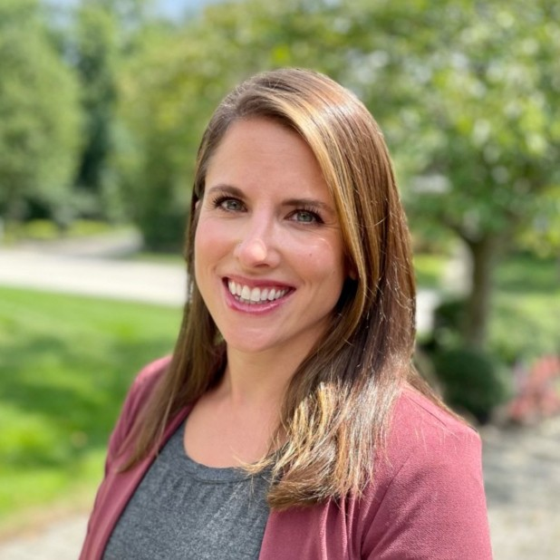
Leigh Sauter
Director of Operations and Strategy
Virago Marketing
Current TMSA Finance Director
To Move to TMSA Treasurer

Slide 12
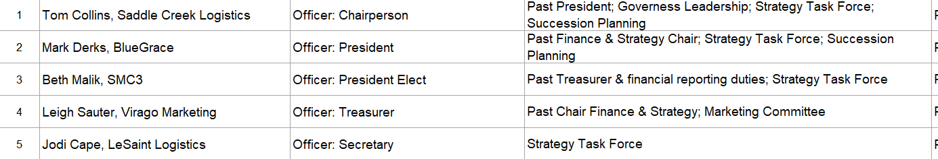
TMSA Board: Executive Board & Committees

Slide 13
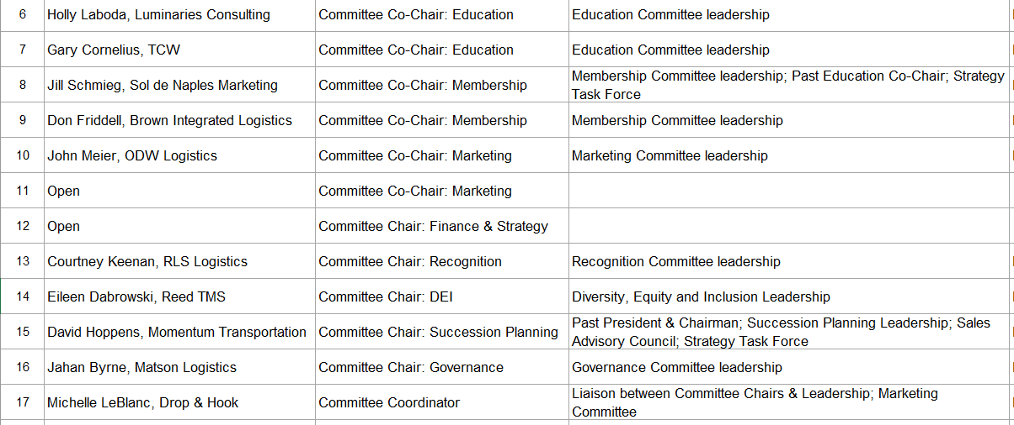
TMSA Board: Committee Chairpersons

Slide 14
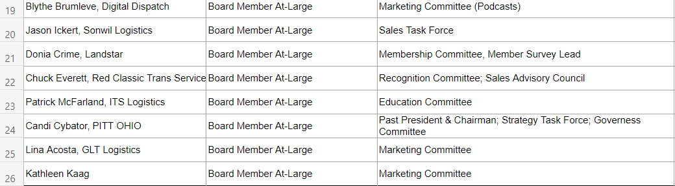
TMSA Board: At-Large Positions

Slide 15
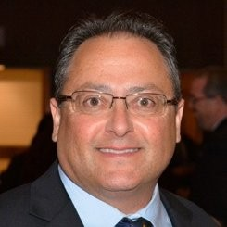
TMSA Bylaws
Jahan Byrne
Director of Corporate Marketing
Matson Logistics
TMSA Governance Chair

Slide 16
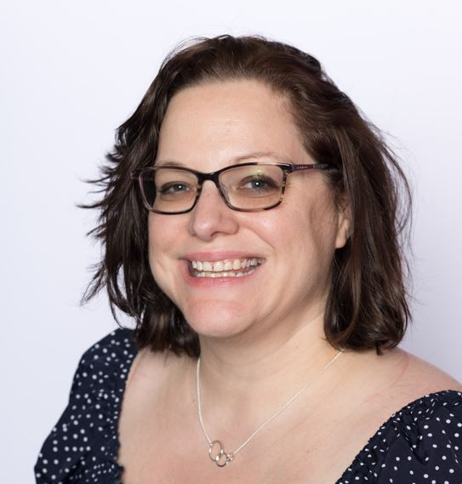
TMSA: An Update
Jennifer Karpus-Romain
Executive Director
TMSA

Slide 17
TMSA: A Look Ahead
TMSA Executive Summit: Registration Open!
TMSA is headed to Chicago, Oct. 11-12, 2023.
As the ultimate source for where sales and marketing professionals go to grow, TMSA’s Executive Summit brings together the smartest, most modern growth agents for a 1-day power-packed event at the Intercontinental Magnificent Mile.
Register here: www.tmsatoday.org/tmsa-executive-summit
Notes:
Since this time last year when we all came together for the member meeting, a lot has happened
Manifest Partnership
Cision Partnership
Webinars
And working on two local networking events in the Fall. Stay tuned! TMSA will also be at the IANA and Women in Trucking shows this fall.

Slide 18
TMSA: A Look Ahead
Looking for a training opportunity for your mid-managers too?
In partnership with TMSA, Luminaries Consulting is hosting a Situational Leadership training that is a high-impact 1-day development program offered alongside the Executive Summit on June, 11. Take advantage of this opportunity to learn leading-edge leadership skills with your logistics peers.
Learn more at www.tmsatoday.org/situational-leadership-2023.

Slide 19
TMSA: Let’s Celebrate 100 Years Together

