Slide 1
Getting Started
with Account-based Marketing
in Manufacturing, Logistics, and Supply Chain
Presented by ODW Logistics and LeadCoverage
October 11, 2024

Slide 2


Today’s Speakers
Crawford McCarty
John Meier
VP, Marketing
LeadCoverage
Director of Marketing
ODW Logistics

Slide 3

We are the premier supply chain go-to-market consulting group focused on revenue, building GTM motions using data-backed strategies and math models. Our proven expertise makes our clients market leaders.

Slide 4











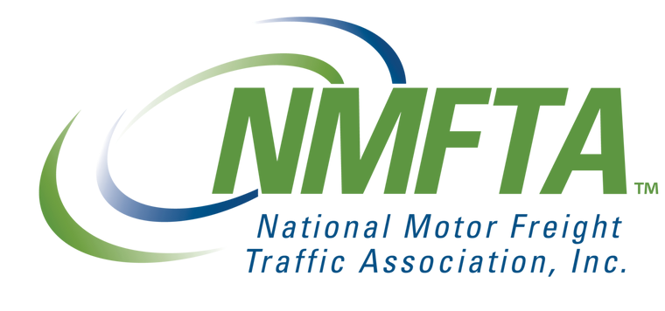





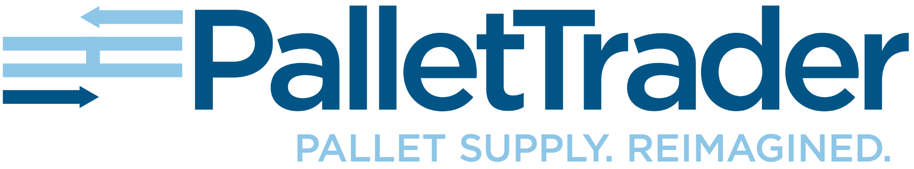


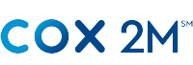


Our Expertise

Slide 5

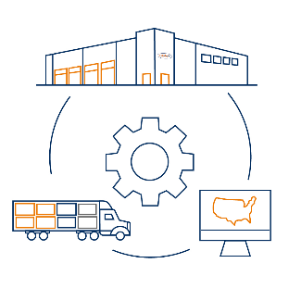
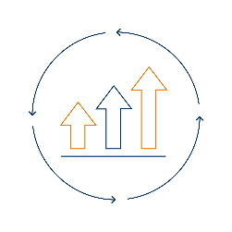
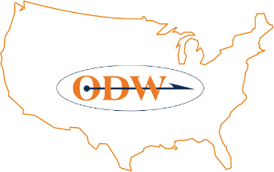

ODW Logistics
Integrated
Logistics
31 DCs
+9.0M sq ft
Target
Market
Company
Growth
Warehousing + Distribution
Transportation Management
Retail Consolidation
Dedicated / Shared Warehouse
Nationwide Distribution
+2,200 associates
Middle Market
Multi-Distribution Node
Omnichannel Fulfillment
+50 Years Privately Held
Annual Revenue +$400M
10 years double-digit growth

Slide 6
Today’s Agenda
Getting Started with Account-based Marketing for Manufacturing, Logistics, and Supply Chain
1
ABM + Intent
2
Macroeconomics
3
Examples
4
Q&A

Slide 7
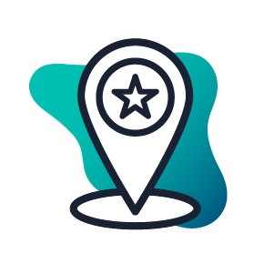



Intent tells you
When
Who
How
What
When accounts are “in-market”
If it’s a good account for you
Who is on the buying team
Who to contact next
How to contact them
What they care about
What to say
And even say it for you!

Slide 8


A Lead-based Approach NO LONGER WORKS
70%
of the client’s journey is done anonymously
3%
of website visitors fill out forms
10%
of your targets are in-market to buy
10+
people are involved in B2B buying groups
UNKNOWN DEMAND
POOR TIMING
Buyers anonymously research
Missed RFP cycles and contracting windows
NOT SUSTAINABLE
LIMITED RESOURCES
Team Burnout
Creating Inefficiency

Slide 9
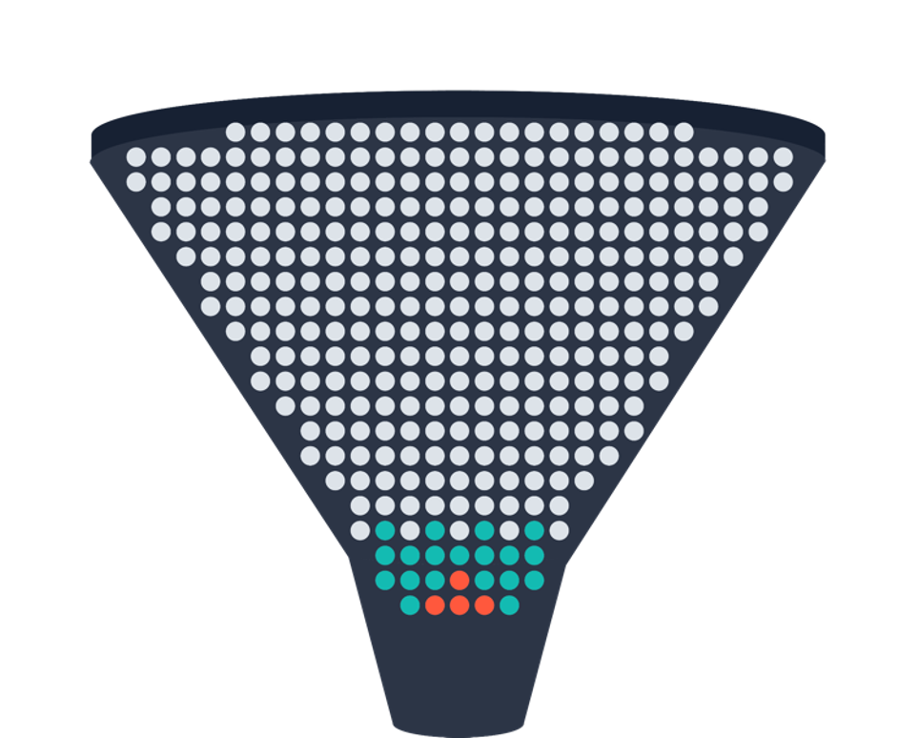
Focus Resources on Accounts Ready to Engage
If we just knew when buyers were In-market (looking for solutions), sales and marketing would be so much easier…
An account-based approach focuses on a defined target account list instead of individual leads, typically using Ai and intent data to inform an account’s affinity to buy. 6sense enables users to adopt ABM by…
Revealing anonymous in-market accounts
Which products they’re interested in
Who to contact
How to contact them
Total In-market Clients
Known In-market Clients

Slide 10

The Macro Economics of Supply Chain
Target
Aware
Consider
Decide
Purchase
When it’s time to engage
Sweet Spot
Too Late
Sep 2024
Dec 2024
Dec 2025
Oct 2026
Apple finalizes vendor list
Apple BoD gives efficiency direction after tariff policy
Apple tiger team surging on 30 Intent Signals
Tim Cook announces verticalized supply chain

Slide 11
Getting buy-in for Account-Based Marketing
Communicate early and often
Engage key stakeholders to champion the initiative
Answer any ABM misunderstandings with 1:1’s and recurring team meetings
Set expectations around timeline and use cases
Establish shared goals
Ensure cross-team efforts have agreed upon a target account list that will focus on driving toward the same metric (i.e., $X of contract renewals over a certain time frame)
Implement routine and optimize
Celebrate and spotlight early wins to encourage adoption
Establish a feedback loop to fine tune the approach

Slide 12





Setting up a “1-1” plan
Identify Topic, Identify Targets, Push Segments to MAP and CRM, Engage
Based on the success of a Wine Distribution Customer with ODW Logistics, we recognized an opportunity to expand our market share in a niche space.
The Segment we’ve built is Target Accounts in our ICP in the Wine Industry that have shown intent related to our best sales opportunity recently.
This is a lot of consulting buzzword bingo. To simplify:
Identify Targets
Listen to
Signals
Pair Messaging
Record Engagement
Celebrate
Wins
Notes:
Opportunity where we had customer buy-in to expand our wine fulfillment solution. Shared with us what is important in the industry and what wine subscription companies would respond to. Built prospecting list together (hyper targeted)

Slide 13
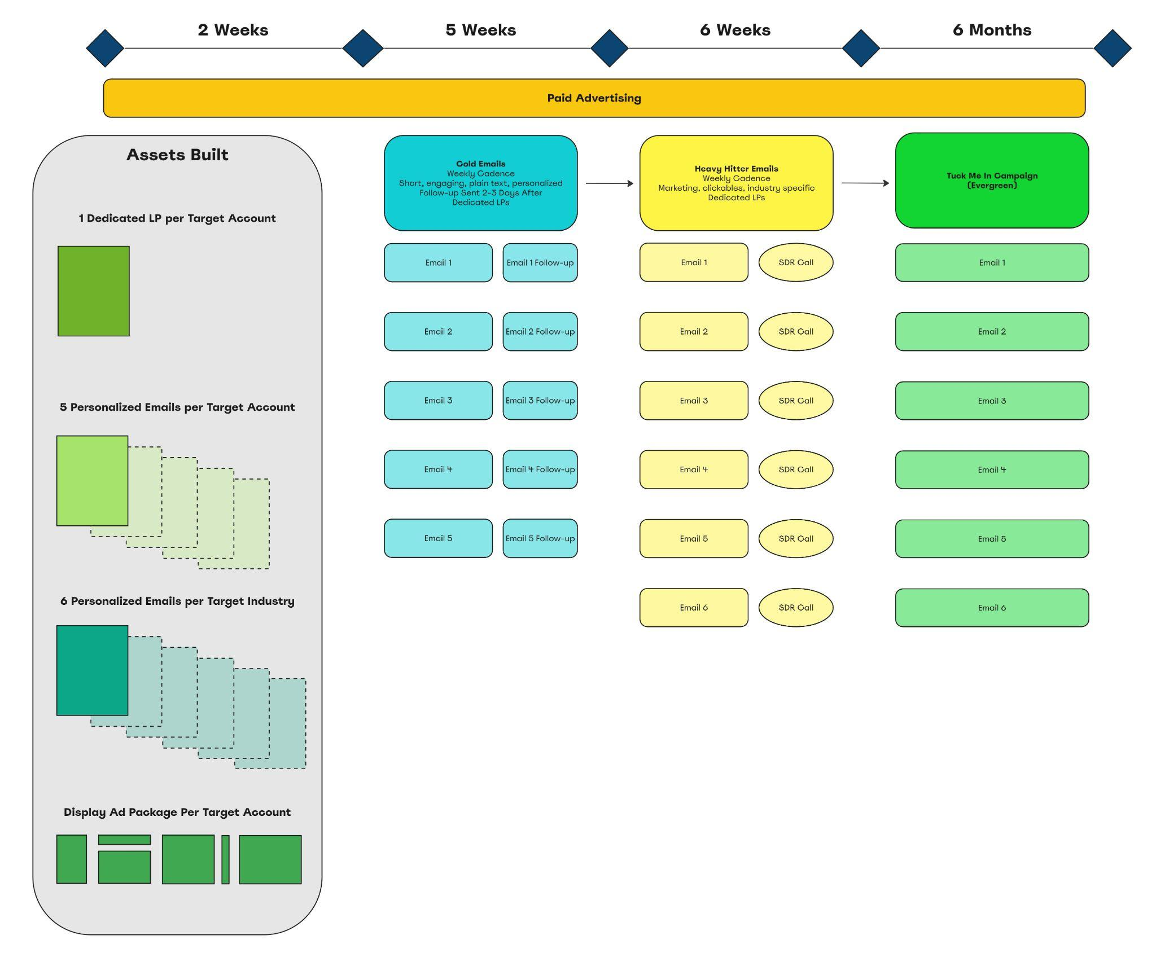
The Method
1:1 Wine Fulfillment ABM Plan
We identified the customer success story
We identified 17 ‘look-a-like’ Target Accounts
To fully flesh out our plan, we created a series of personalized touches, specifically based on the target account including:
- Personalized Landing Pages
- Personalized email sequences
- Personalized Ad packages

Slide 14
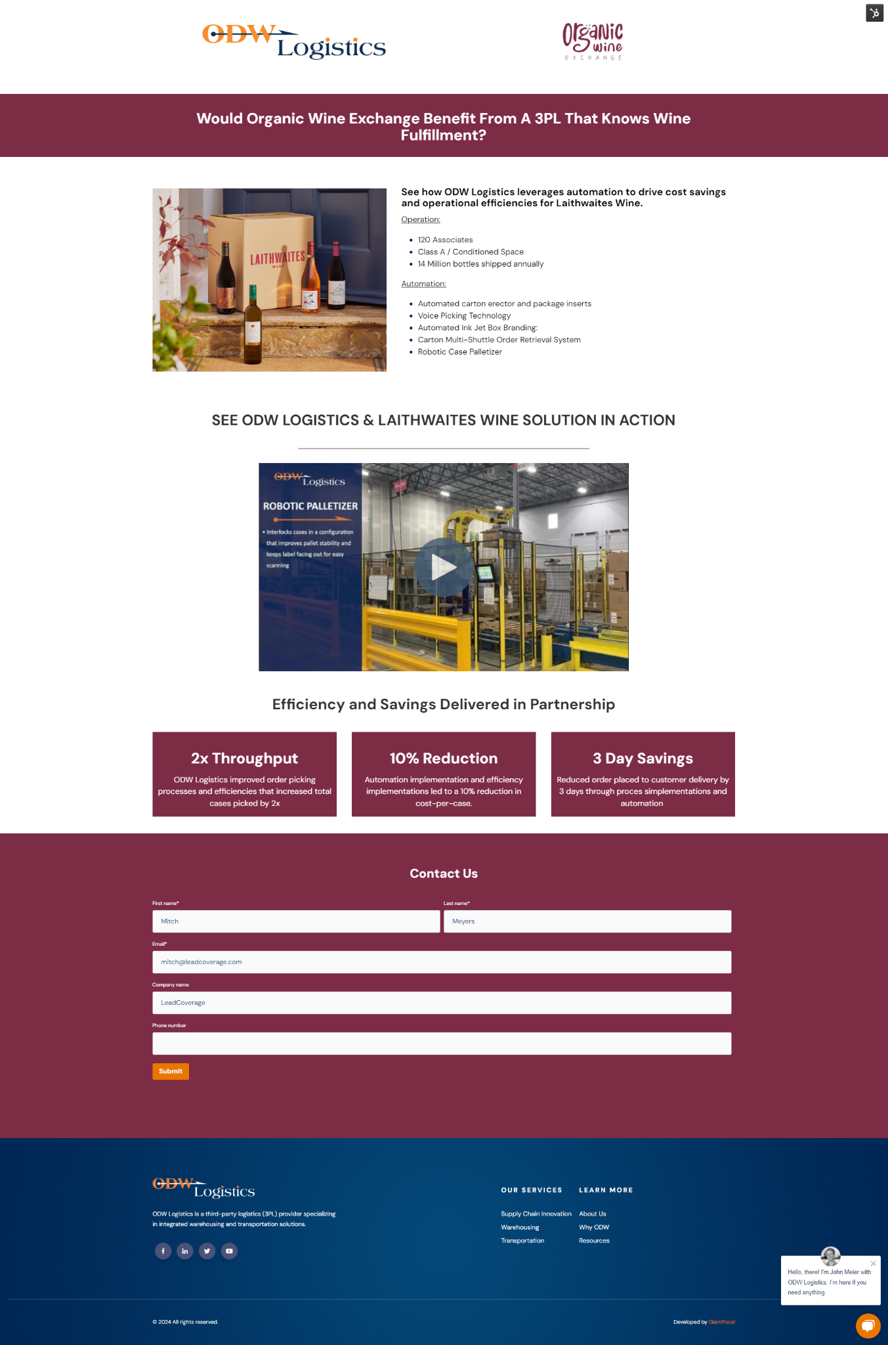

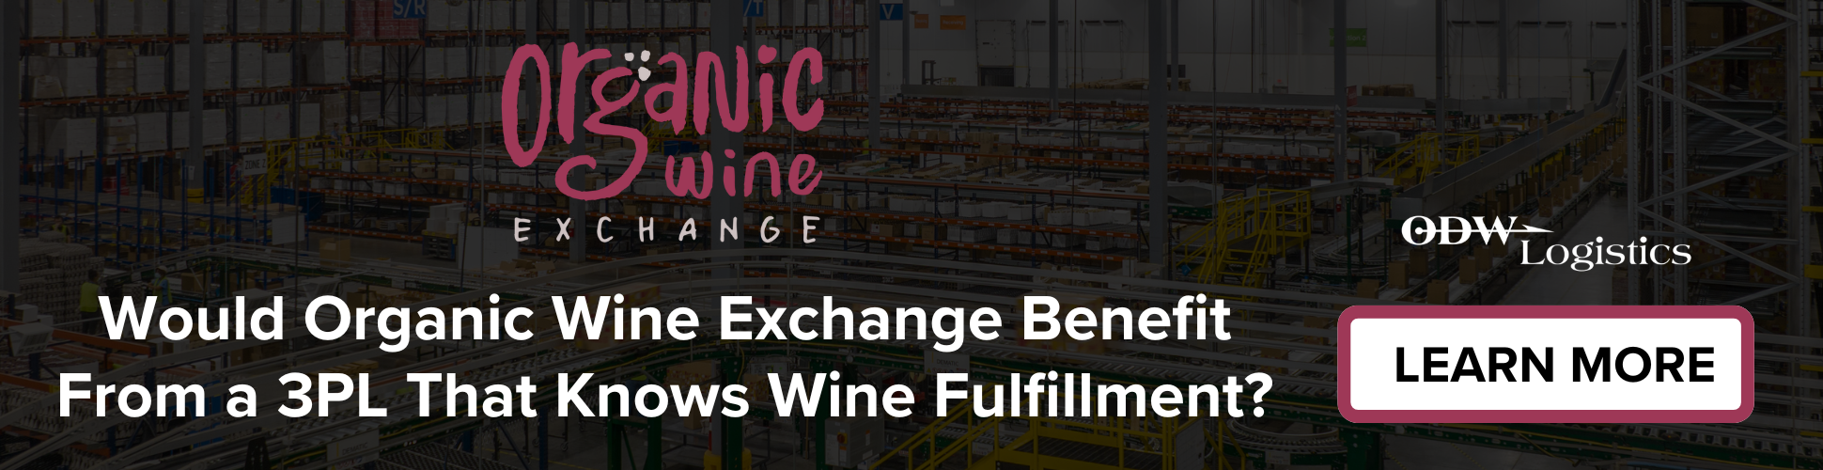
The Bespoke Experience
Intent-Driven Personalization
Utilizing Intent Data, we identified the key areas of interest for each account and built out a bespoke experience for each, ensuring the decision makers trusted we knew and could resolve their challenges.
Notes:
Digital campaign launched first followed by Email sequences.

Slide 15



Account Reach and Engagement
At the highest level, Account-Based Marketing is best measured as a tool to reach and engage accounts without previous activity.
Accounts Reached
Account Engagement
Net-New
Accounts Engaged
17
14
14
An account is labeled “reached” when they have exposure to (company) via ad visibility and delivered emails.
An account becomes “engaged” via clicks, website visits, and email interaction.
A net-new engagement comes from an account that has no prior interaction with (company).
ODW’s ABM 1:1 motion drove results through hyper-personalization and intent knowledge.

Slide 16

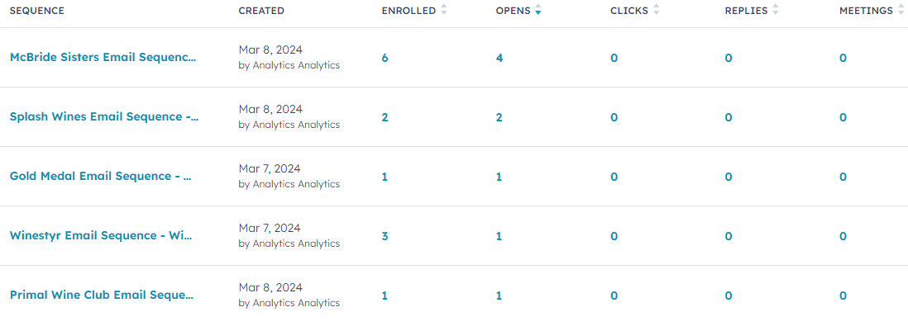
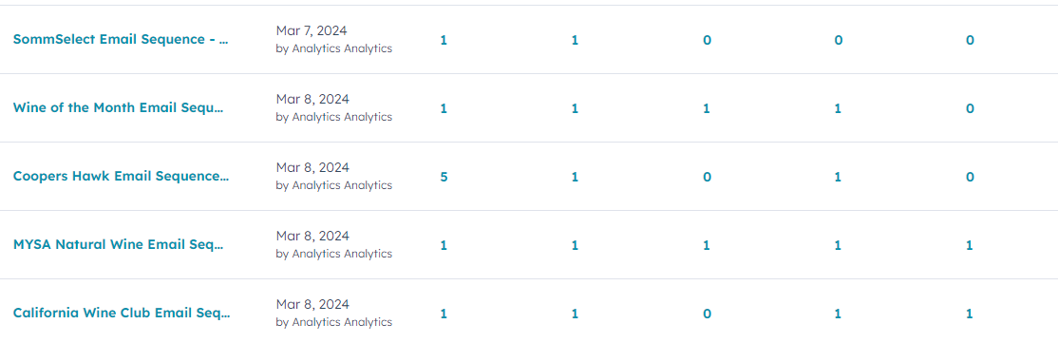
Account Reach and Engagement
By tracking engagement meticulously, we reached out in the opportune moment to connect with prospects while they were actively engaged with our content.
Meeting Booking Rate
(per companies enrolled)
Reply Rate
(per companies enrolled)
14.8%
41.1%
71% of replies requested a meeting
or additional information
ODW’s ABM 1:1 motion drove results through hyper-personalization and intent knowledge.

Slide 17


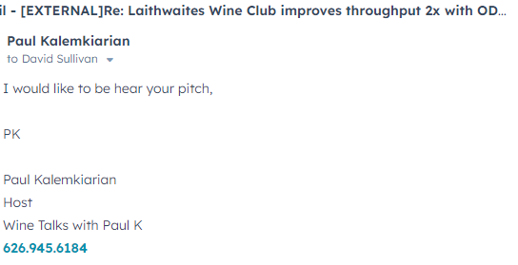
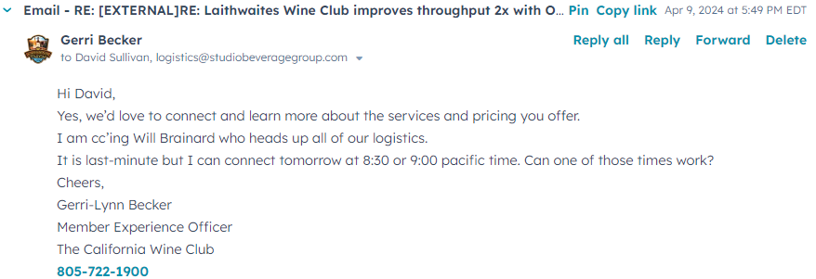

Account Reach and Engagement
When tracking a reply rate, we disqualified anything that didn’t move the account forward. Here, we see two examples of positive replies.

Slide 18



Setting up a “1:few” playbook
Example: Identify the Niche, Push Segments to MAP and CRM, Engage
In June 2024, we identified a need to drive pipeline - Frozen Foods Pipeline was $0
The List we built is Target Accounts in our ICP in the F&B vertical, specifically with Frozen Foods, Pizza, Veggies, Meats & Seafoods that have shown intent related to our niche pain in the last 45 days and are in the Consideration stage.
The consulting buzzwords strike again. To simplify:
Identify Targets
Identify Niche Pain
Marry Messaging
Include Niche Solution
Celebrate
Wins
Notes:
Started out logically and identified companies that we knew were frozen food providers. We use data aggregators (Zoominfo, D&B, Thomasnet). But don’t discount store walks.

Slide 19
The Method
Frozen Foods Plan
We identified targeted accounts for Frozen Foods, specifically:
- Frozen Veggies
- Frozen Meat & Seafood
- Frozen Pizza
We created a series of personalized touches, specifically based on the target account including:
- Personalized email sequences
- Personalized ad packages
- An ABM-backed Paid Media Blitz

Slide 20
Paid Media Summary
We used a ‘blanket’ approach to increase awareness and engagement of our target sequences - driving additional success later in the campaign.
 | Google | LinkedIn | Total
Clicks | 8,017 | 1,815 | 9,832
Impressions | 163,457 | 59,148 | 222,605
CTR | 4.90% | 3.07% | 4.41%
Conversions | 231 conversions | 1 lead | 232 success stories
Other | 176 phone calls / 55 form fills | 537 social actions; 4.14% engagement rate | Deals Created: 4

Slide 21
Account Reach and Engagement
At the highest level, Account-Based Marketing is best measured as a tool to reach and engage accounts without previous activity.
Accounts Reached
Account Engagement
Net-New
Accounts Engaged
731
424
261
An account is labeled “reached” when they have exposure to (company) via ad visibility and delivered emails.
An account becomes “engaged” via clicks, website visits, and email interaction.
A net-new engagement comes from an account that has no prior interaction with (company).
ODW’s niche expertise drove results through strategic messaging and intent knowledge.

Slide 22
Frozen Food Results
Tracking and optimizing our messaging as we saw conversions ensured we continued to see success - utilizing the wins as a formula for modifying the target criteria and GTM strategy
Awareness Generated
Companies Reached
731
Conversations
Companies Engaged
424
144
Demand Generated
Total Pipeline
$40MM
Pipeline Generated
144 Target Accounts replied to our sequence efforts
Active Pipeline
$28MM

Slide 23
Adopting an Account-based Approach- Takeaways
Achieve Team Buy-in
Communicate early and often
Establish shared goals
Implement routine and optimize
Crawl Plan
Understand your ICP and optimize toward account reach and engagement
Walk Plan
Expand your account-based approach to include programmatic engagement and optimize

Slide 24
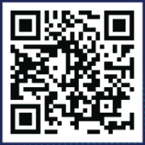
Getting Started with Account-Based Marketing
in Manufacturing, Logistics, and Supply Chain
Thank you!
Continue Learning
Questions?

