Slide 1
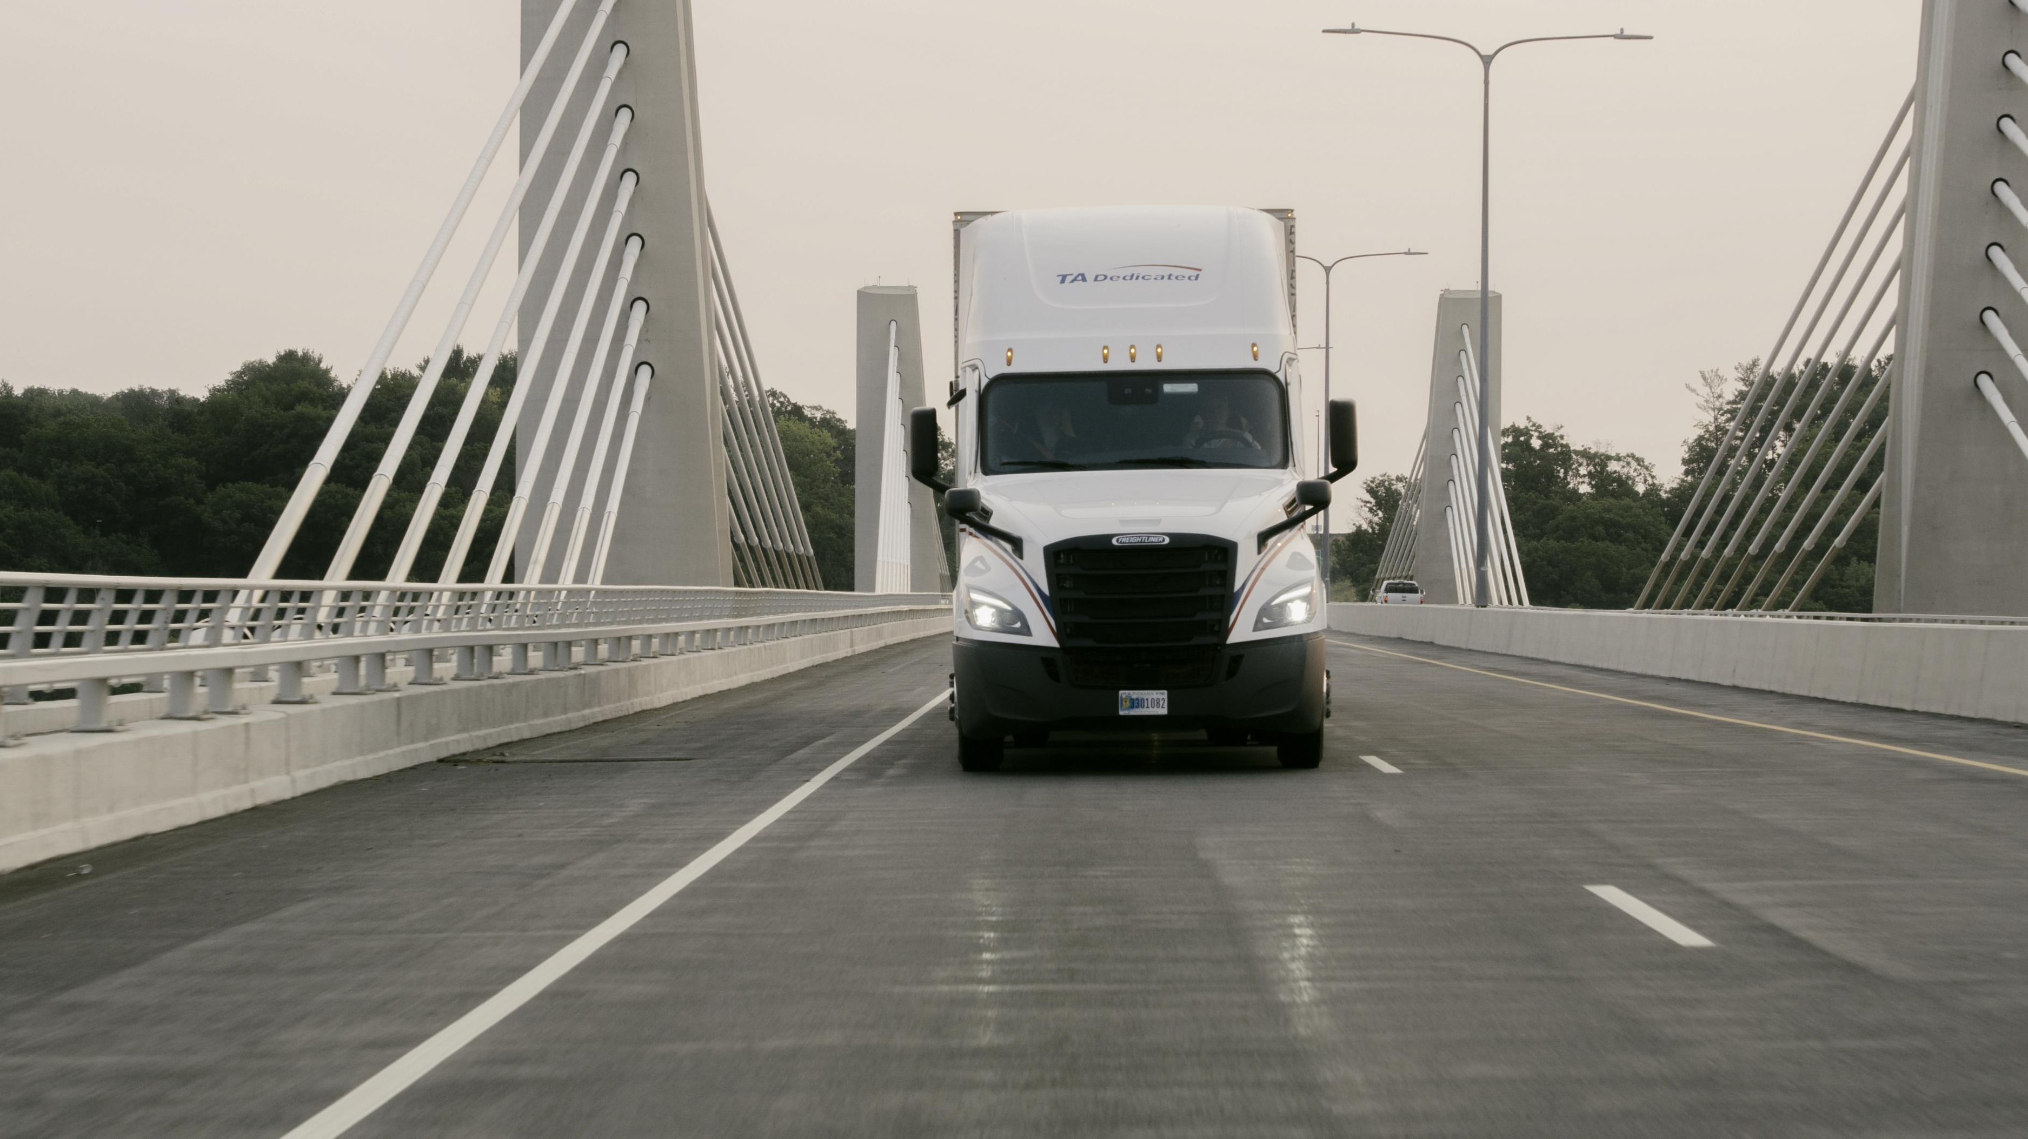

SUSTAINABILITY STRATEGIES THAT DEEPEN CUSTOMER RELATIONSHIPS
Rob McNeil
TMSA
October 11th 2024 – Hoboken, NJ

Slide 2
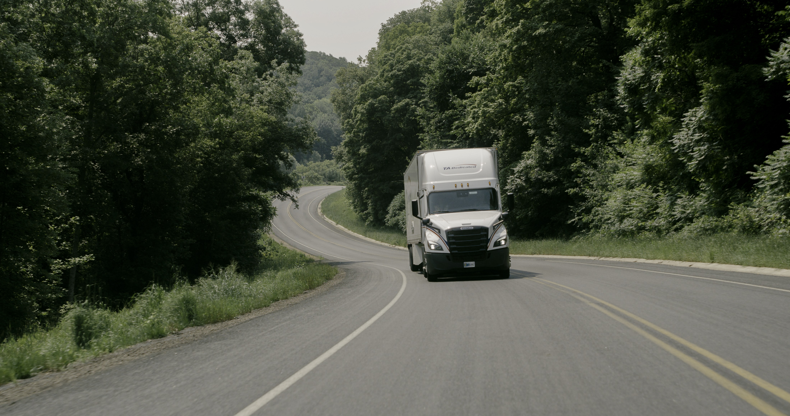
DISCUSSION TOPICS
Who is TA Dedicated?
Does Sustainability even matter to our customers?
How does Sustainability tie into our GTM strategy?
How did TA Dedicated develop expertise?
How do we determine success?
Notes:
Just like the overall topic itself, my Agenda is full of QUESTIONS. Might be more questions than answers in our discussion today, but that pretty much sums up Sustainability within our industry…A LOT of Questions
DISCLAIMER
I am not a Sustainability expert and TAD is not the expert.
In fact, with how quickly things change and how rapidly things develop, there are VERY FEW experts in this space. to meet these challenges head on and not bury our heads in the sand.
This is how we have thought about it and these are a few things that have worked for our business and our customers that I am going to share w/you today.
We are all learning, we need to collectively work together as an industry

Slide 3
WHO
IS TA DEDICATED?

Slide 4
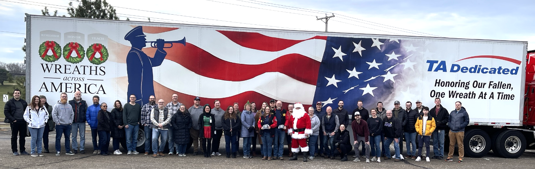
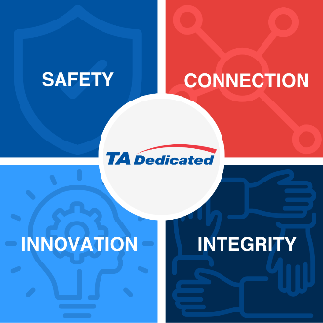
TA DEDICATED
WHO WE ARE
WHAT WE’RE BUILDING
HOW WE WILL GET THERE
“Pure-Play” Dedicated Carrier
Experienced teams from UPS and Transport America
Strong Safety Culture
Leading “large class carrier”
Stability
Leveraging financial stability of TFI
  Build upon our brand as a trusted provider in the Dedicated space
Guided and driven forward by our Core Values + Core Themes
DIVERSITY, EQUITY & INCLUSION
  “Dedicated-centric” with complimentary services
  Launched…
  TA Logistics
  In Progress…
  Port Services (Bulldog)
  Warehousing (Lonestar + Bulldog)
SUSTAINABILITY
TRAINING & DEVELOPMENT
SYSTEMS & TECH
Notes:
We are a $350M Dedicated Carrier based in Eagan MN, and part of TFI International’s Specialty Truckload division
Transport America has become TA Dedicated over last 2 years
Combined UPS Dedicated and TA’s Dedicated to become TA Dedicated
As 2 year old company, rebranded with 2 rich histories, have opportunity to re-examine who we are in the market and what we represent to our customers
NEW BRAND – as a room full of marketers can appreciate, this is a challenge!
Also, exciting growth as we build out our service offerings
As a Pure Play Dedicated provider, Sustainability is a key tenet of our strategic plan, as well as establishing brand equity as a partner who strives to have customer intimacy and knowledge

Slide 5
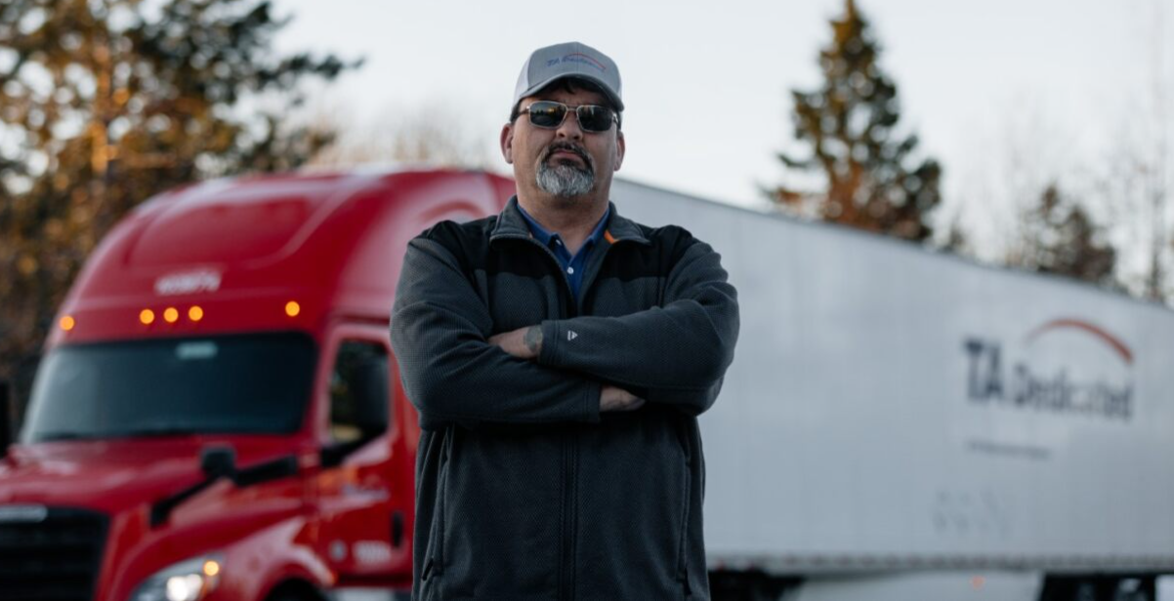
TA DEDICATED
OPERATIONAL STATS
Drivers: 1,100+
Trailers: 1,900+
Fleets: 70
Customers: 30
Miles per Week: 1.7M
Tractors: 1,025+
Notes:
Breakout of our operation
Corporate functions based in Eagan MN
very decentralized operational model where most of our operations associates are onsite or embedded in our customer operations

Slide 6





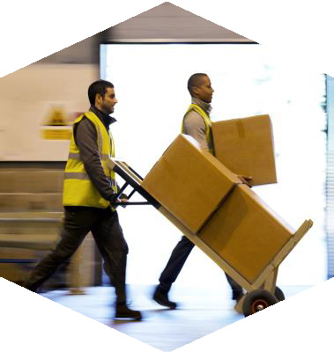
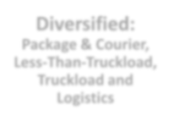
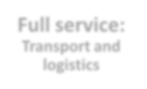


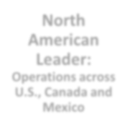
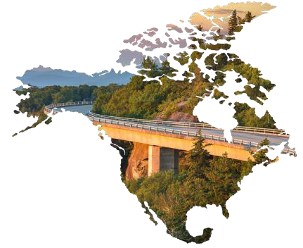
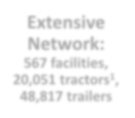



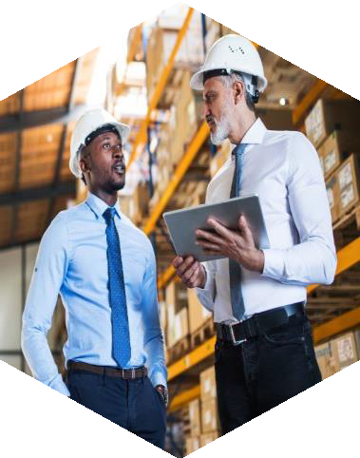



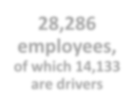
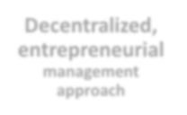
TFI OVERVIEW
TFI is a North American transportation and logistics leader, powered by over100operating companies and more than 28,000 employees working together across a wide range of verticals: from retail and energy, to food and beverage and much more.
Diversified:
Package & Courier, Less-Than-Truckload, Truckload and Logistics
Full service:
Transport and logistics
North American Leader:
Operations across U.S., Canada and Mexico
Extensive Network:
567 facilities,
20,051 tractors,
48,817 trailers
TFI is #4 on the Transport Topics Top 100 Carriers list
28,286
employees,
of which 14,133
are drivers
Decentralized,
entrepreneurial
management approach
Notes:
Part of TFI, also a bit of an unknown – show of hands..
TFI is 4th largest North American carrier, behind UPS, FedEx and JB Hunt
3 Main Business Orgs – Truckload, LTL, Logistics
M&A – 134 acquisitions in North America since 2008. Part of our DNA
TAD would be Top 80 Carrier for size

Slide 7
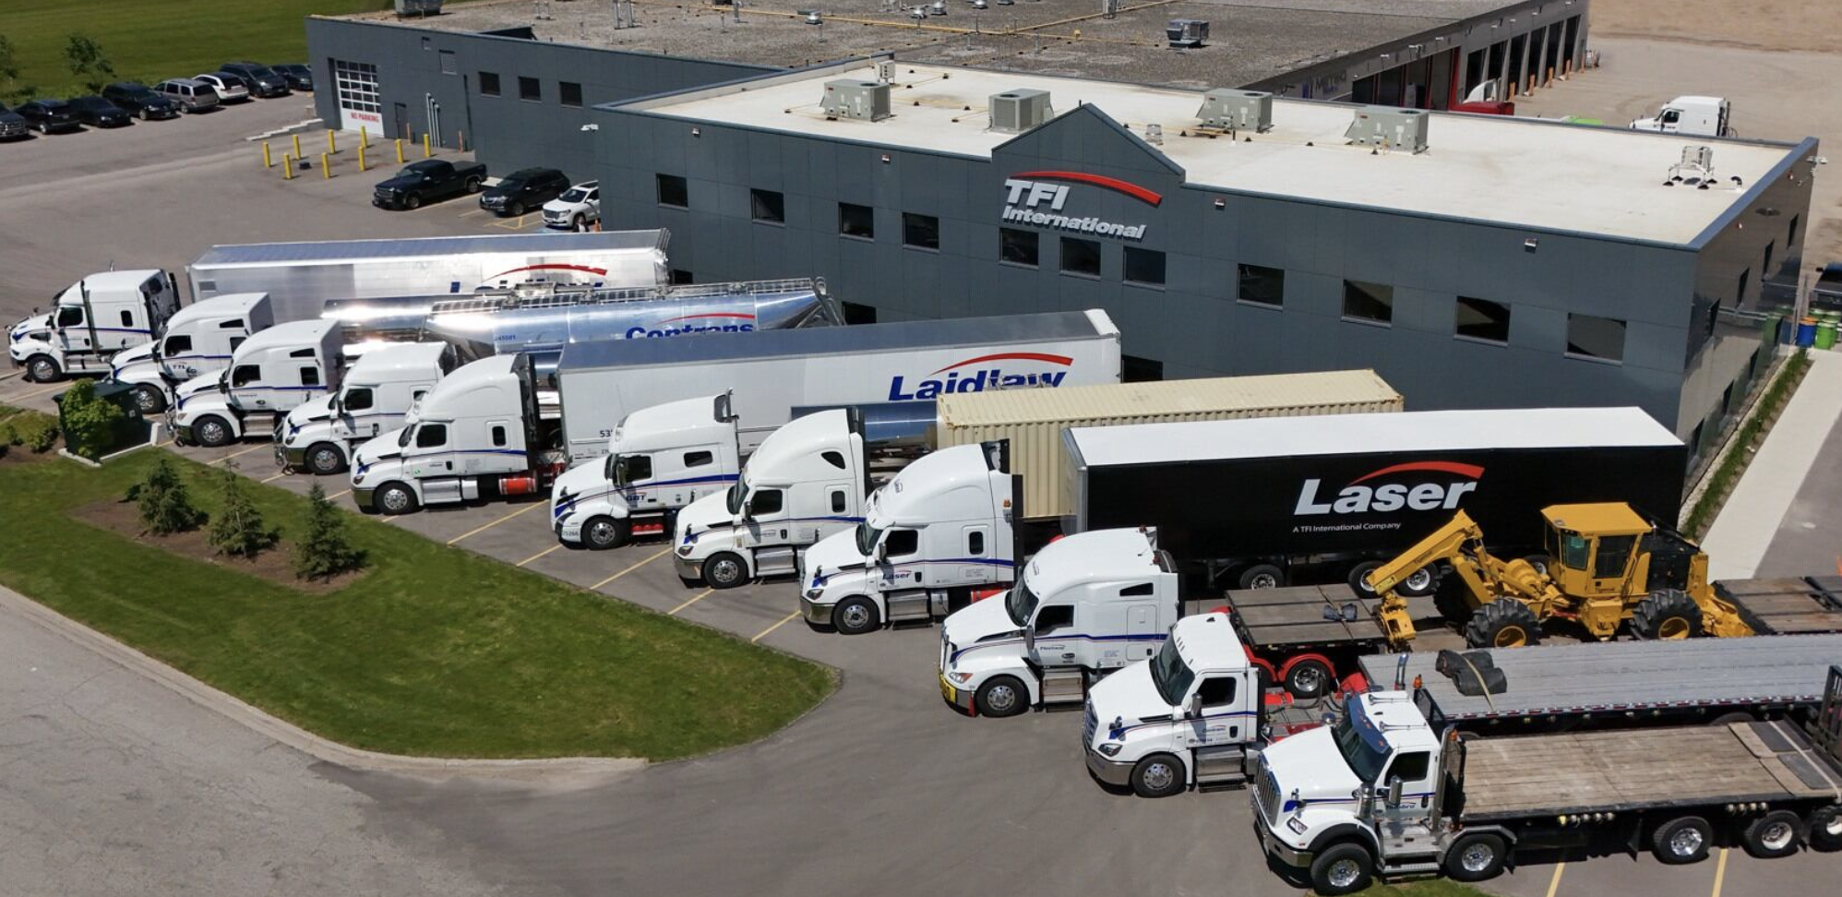
SPECIALIZED DIVISION
TFI is #4 on the Transport Topics Top 100 Carriers list
Notes:
Specialized division is comprised of 60 operating specialized and truckload service offerings throughout North America.
Divisions: Dry Van, Flatbed, Dedicated, Tank, Stainless Tank, Bulk

Slide 8
HOW
STEP #1 – ASK YOURSELF THE MOST IMPORTANT QUESTION
Notes:
First question about When was easy…lets look at HOW

Slide 9
WHAT
DOES SUSTAINABILITY MEAN TO OUR CUSTOMERS?
Notes:
How to get started, you have to ask lots of questions……
How does TAD view Sustainability
How do our Customers view Sustainability

Slide 10
82%
Notes:
82% of our Customers have a Sustainability Report published

Slide 11
59%
Notes:
59% of our Customers have an entity that is Ecovadis certified

Slide 12
YES!!!
Notes:
No Brainer for us. YOU have to ask yourself this question and answer for yourself

Slide 13
WHAT DOES SUSTAINABILITY MEAN TO OUR CUSTOMERS
It is important for most of our customers
  82% have published sustainability reports
  59% are associated with Ecovadis
But, it means something different to everyone. Each is unique, and that is where most of the work lies. Asking questions and developing a realistic assessment is key
Notes:
Based on our Sales Discovery, we have really narrowed down to 7 Key Customers. We keep engaged by…
Quarterly Sustainability Meetings (like QBR, but JUST sustainability)
Customer directed projects (Biodiesel study)
Demos – BEV Yardtrucks, Daycabs, Straight Trucks, CNG regional trucks,
Visits – Solution Vendor intros (Range Energy, Optimal biodiesel engines)
Important to keep going back and challenging your customers and our assumptions. Don’t take your eye off of Sustainability and importance to your customers. CHANGES A LOT!

Slide 14
WHAT
IS OUR SUSTAINABILITY and
GO-TO-MARKET STRATEGY

Slide 15
WHAT DOES SUSTAINABILITY MEAN TO TAD
As a Dedicated provider, we are in a UNIQUE position
“Out & Back” model lends itself to sustainable solutions
Truck ownership model – owned or leased by contract
Sustainability is a competitive advantage
  As a medium-sized provider, great niche for us to add value
  Opportunity to grow closer and deeper with our customers, learn more about supply chain, other parts of organization.
Notes:
Growing closer and deeper is what we strive for…… STICKY. What a great opportunity to achieve our goals

Slide 16
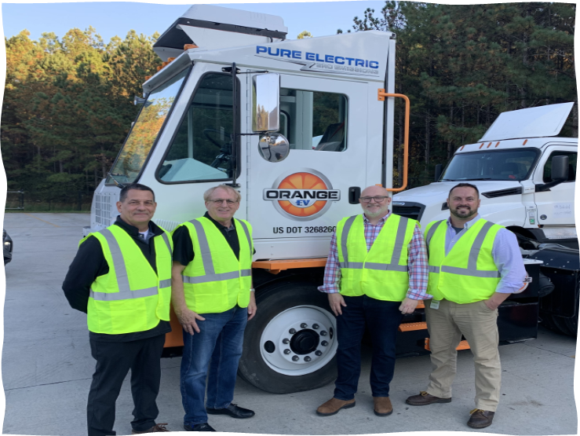

SUSTAINABILITY TEAM OVERVIEW
Sustainability Theme Team Mission
  We support TA Dedicated by providing expertise, insight and ideas and facilitating initiatives that improve our business as it relates to Sustainability.
Sustainability Theme Team Vision
  Learn how we can make TAD a trusted industry leader in the Sustainability space (Internal)
  Develop expertise and solutions that will help our customers realize their Sustainability goals (External)
Goals and Deliverables of Sustainability Theme Team
  Support Goal of Decreasing Carbon Footprint 5% by '25
    Develop Site Best Practices
    Support WIG setting process for Organization
  Complete Sustainability Strategy by 3/31/24
  Increase Ecovadis status from Bronze to Silver by 9/31/24
Sustainability Team
Rob McNeil, Daniel Button, Nick Lawrence, Derrick Fredrickson, Ted Lovely
Emilio Donnadieu, Bob Doxsee, Jeff Dwerlkotte, Matt O’Bryan, Lonnie Oermann, Dave Sprock, Tony Toter
Notes:
How we mobilized resources internally to collectively learn more quickly – went to our Front Lines
Asked who had interest in adding to their already heaping plate of work to help us move our business forward
Created somewhat of a Task Force to help guide us
Exec Sponsor
Chair / Vice Chair
Team
First action was to develop our Mission, Vision and Key Deliverables

Slide 17
SUSTAINABILITY - WINS + STRATEGY
2023 Accomplishments
Awarded EcoVadis 2023 Bronze Medal rating (within Top 18% in “Road Transport” category)
Recognized for SmartWay High Performer award (5th consecutive year)
Optimized supply chains to remove 685 tons of carbon for our customers
Proposed multiple Alt Fuel solutions and facilitated BEV demos for our customers
Mobilized Sustainability Steering Committee and Sustainability Operations Team
Leveraged Vendor and OEM relationships to learn and assist in developing strategy
Strategy for 2024 and Beyond
Actualize Sustainability Vision of making “TAD a trusted leader in the Sustainability space + helping our Customers realize their sustainability goals”
Reduce our organizational Scope 1 Carbon output by 5% per mile in 2024
Propose supply chain optimizations to allow our customers to eliminate 1,000 tons of carbon footprint
Replace all (TAD-owned) yard trucks with EV by 2025
Improve # of Alternative Fuel solutions presented to customers by 4x in 2024
Achieve Silver Medal rating from Ecovadis by 2025
Notes:
TAD Journey over last 2 years.
Mobilize at Exec level, then next level, finally out to front line participants
In ‘24 We have goals…improve Carbon output LBS/Mile by 5 %, (from 2.77 lbs/gal to 2.63 lbs/gal) part of our Org WIGs, down to the front line associates. Sales goals with # Sustianability focused meetings, pricing proposals and alt fuel trucks sold. Engineering goals to model non-productive miles out of supply chain routings

Slide 18
HOW
HAVE WE DEVELOPED EXPERTISE?
Notes:
First question about When was easy…lets look at HOW
How to get started, you have to ask lots of questions……
TO YOUR ORGANIZATION AS WELL AS YOUR CUSTOMERS
How does TAD view Sustainability
How do our Customers view Sustainability

Slide 19
GOAL SETTING FOR SUSTAINABILITY
Recognize the need to “Walk the Walk” if we “Talk the Talk”
  Set Internal WIGs (Wildly Important Goals)
  Jump in with both feet and start to learn NOW
  Enhance credibility through certifications

Slide 20
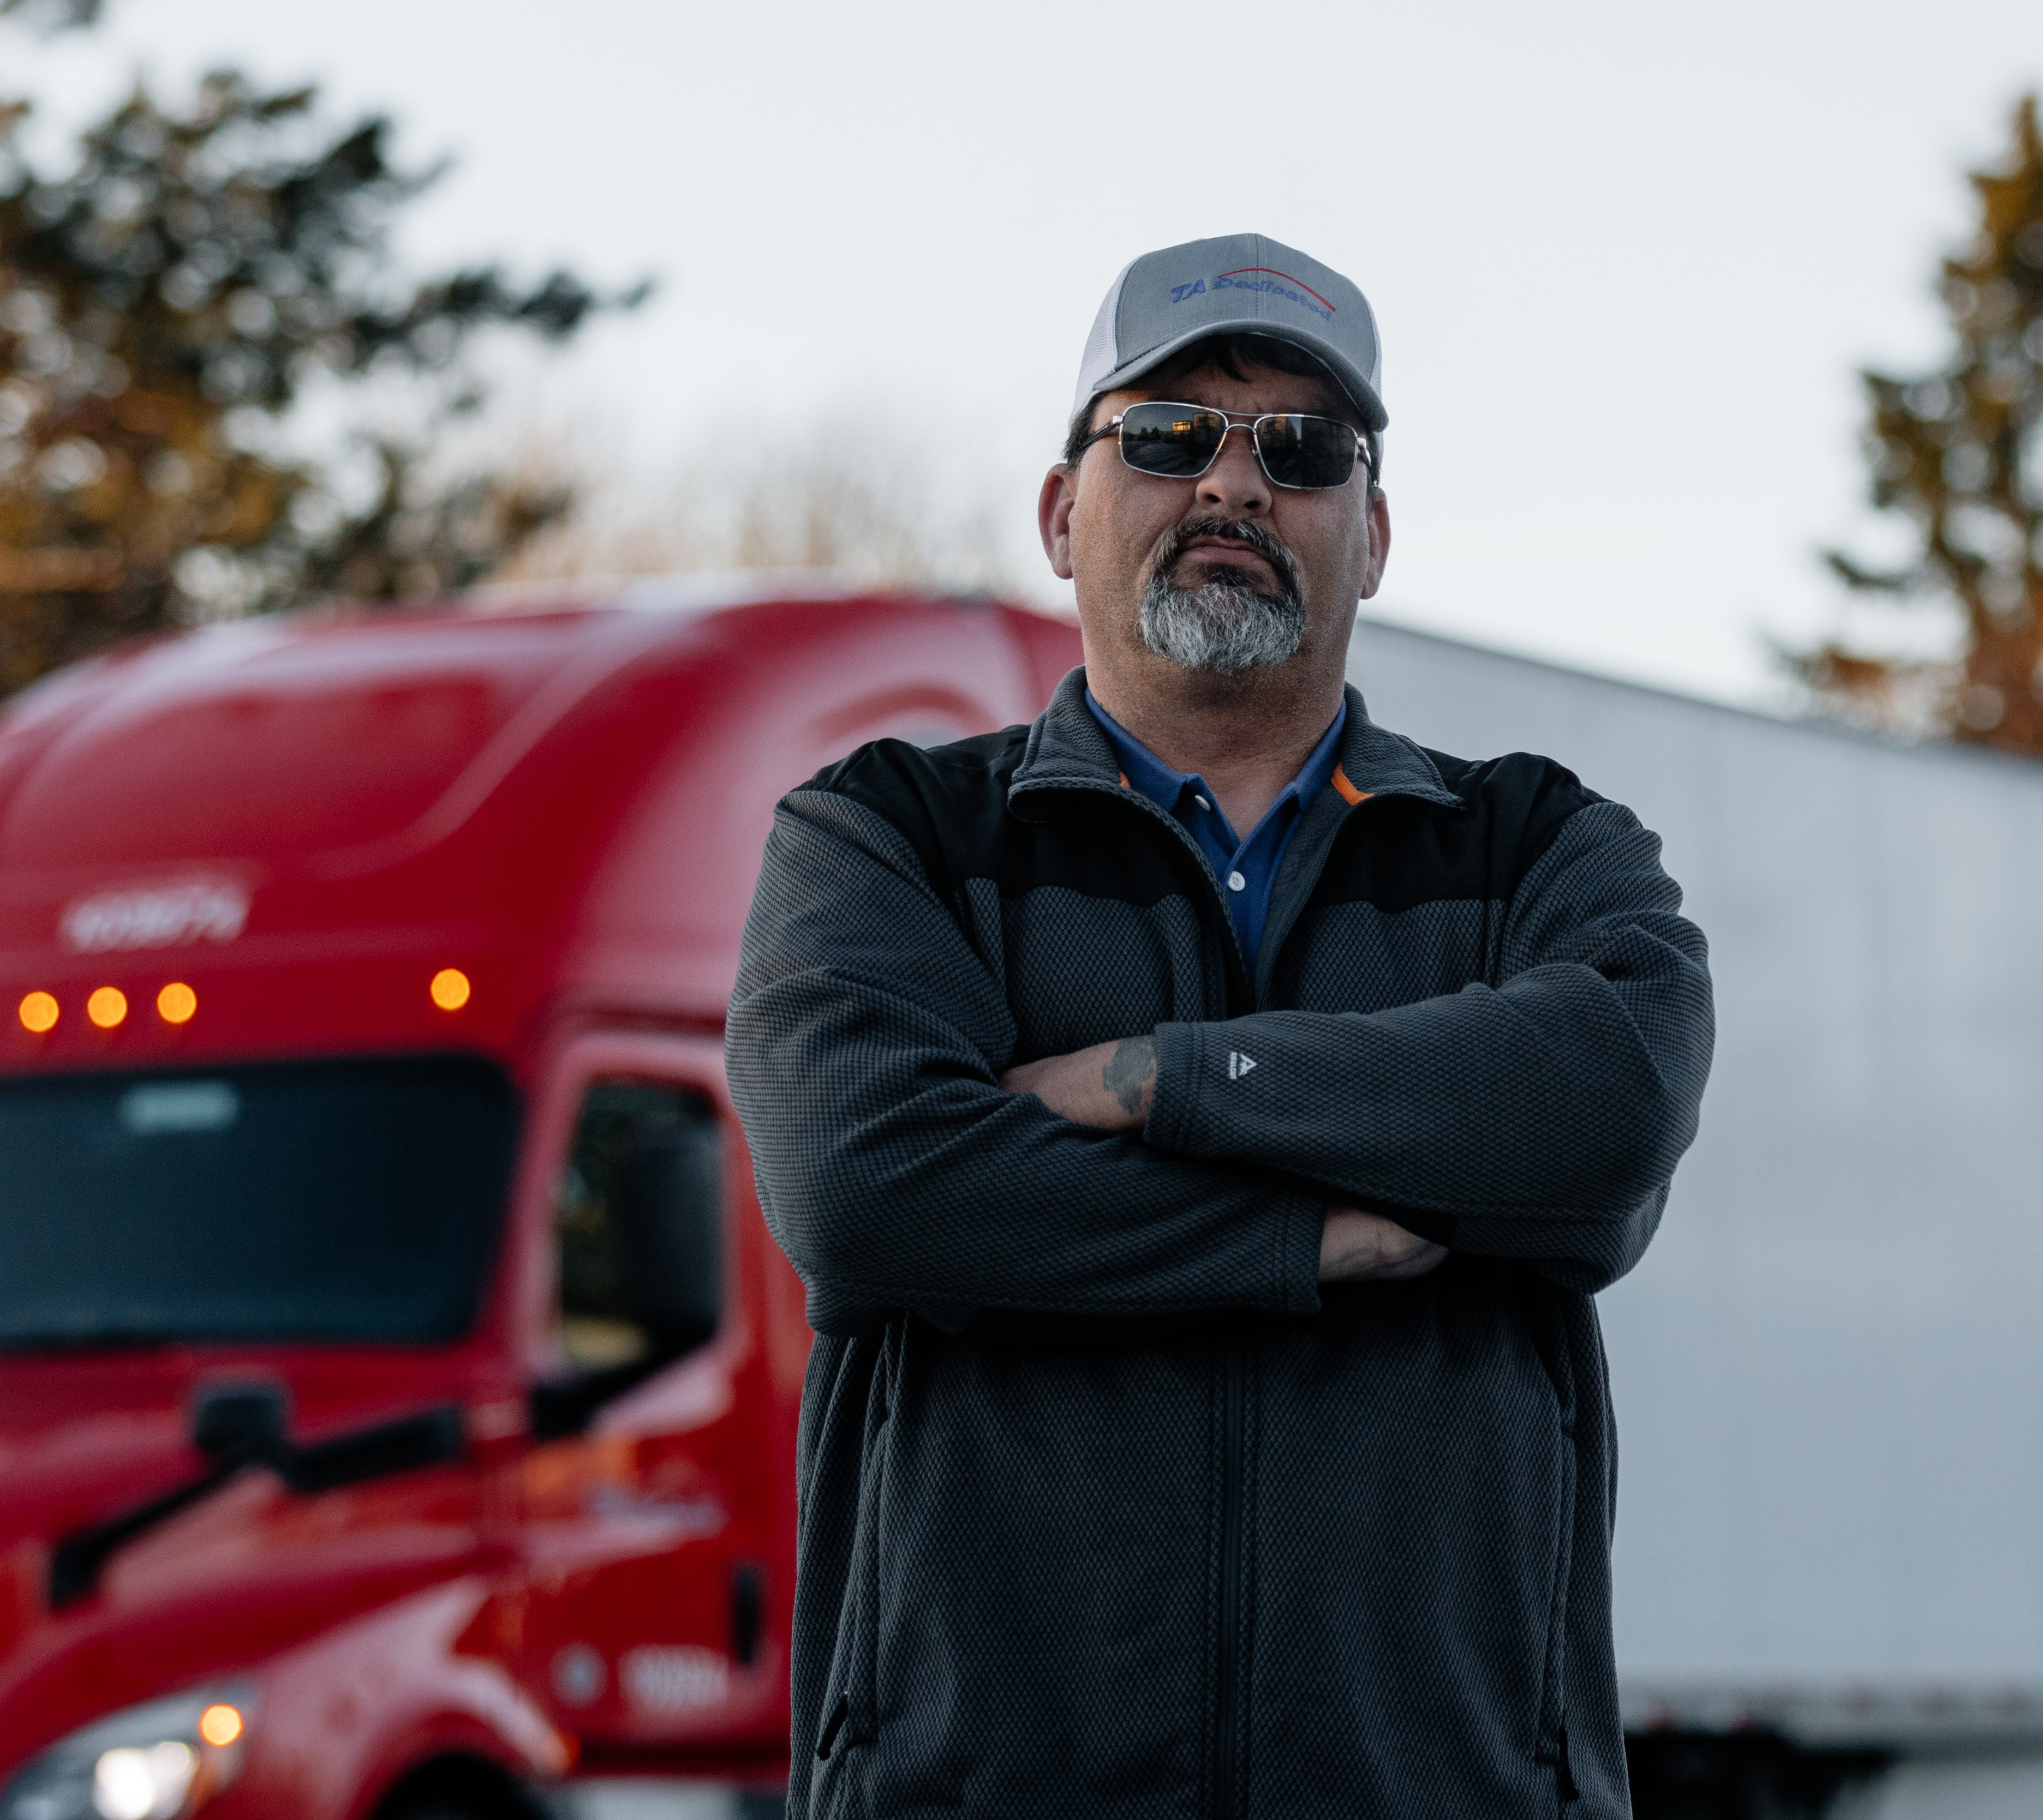
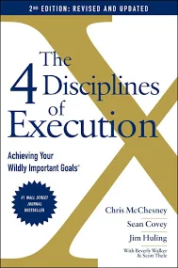
TAD WIGs (WILDLY IMPORTANT GOALS)
Deliver 7 Customer Marketing stories to be used as testimonials in ‘24
SALES WIG
Achieve # Alternative Fuel Vehicle Sales in ‘24
COMPANY SUSTAINABILITY WIG
Reduce Co2 emissions by 5% per mile (to 2.63 lbs/mile)
Complete 20 Sustainability Meetings with our Customers in ‘24
Provide pricing solutions for 10 Alt Fuel solutions in ‘24
Notes:
Sales Team – we have 2 main goals. WIGs, one for Sales and one for Sustainability
Whirlwind
Report on each week

Slide 21
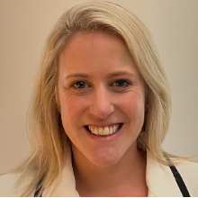
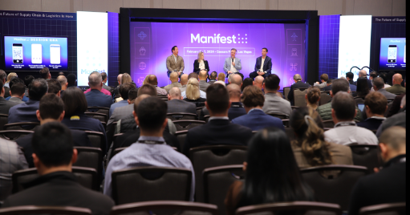
“START YOUR LEARNING PROCESS NOW”
Manifest Panel Session
  February 5th, “The Road to Net Zero”
  DHL and Diageo
“9 years ago, Diageo made the decision to start our learning process. It didn’t make financial sense, but we felt the obligation to help OEMs improve the technology. Piloting is important, as there is no roadmap to sustainability. The best advice I can give anyone here today is to start your learning process now”
Lucy Fishwick
VP Logistics
Diageo North America
Notes:
I attended Manifest session earlier this year. Really helped solidify it for me and bring this whole journey together.
Start small, pilot solutions. Returns wont be great, you are not going to get it right the first, second or 7th time
Important to have partners and customers to do this with. Start talking to them, ask questions, be curious
Talked about “Sparky 1”, Orange EV’s 1st yard truck
START SOMEWHERE and START NOW

Slide 22
LEARNING IDEAS FOR CARRIERS
BEGIN YOUR LEARNING NOW
Lean into relationships with OEMs to help speed learning
Demos can quickly build learning, engagement and excitement
Involve interested people within your companies, in addition to your fleet and maintenance groups
Seek out opportunities to learn - Conferences, Webinars, Podcasts, Websites
TALK – to customers, vendors, experts, competitors

Slide 23
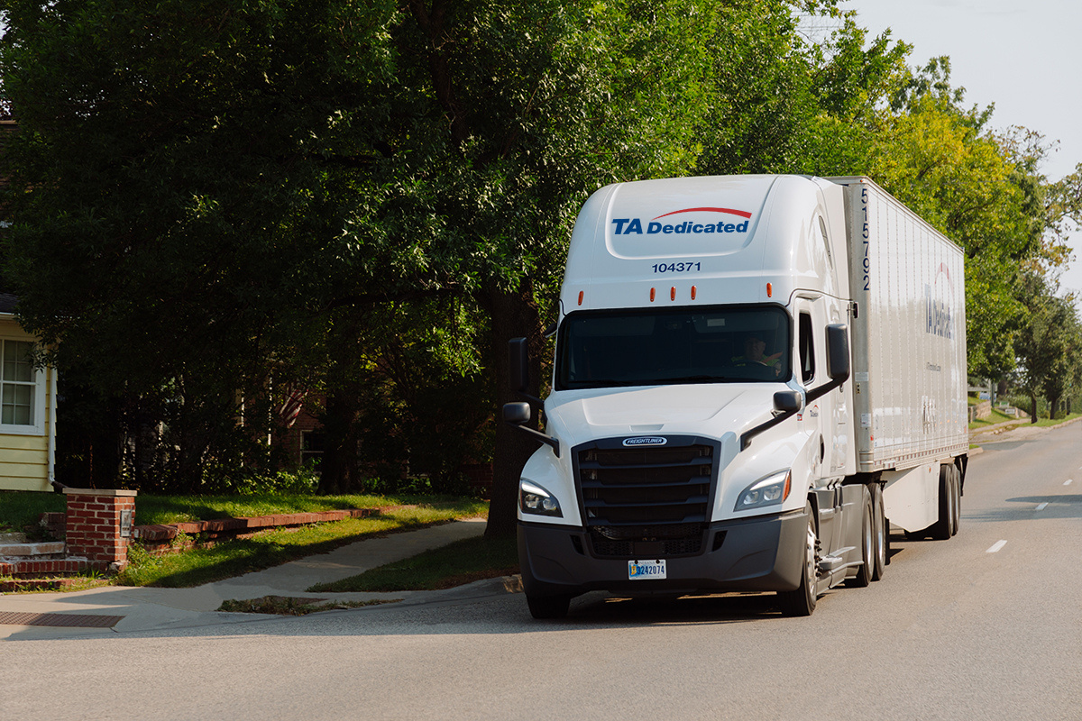


Notes:
50-60% of our customers are familiar and participate themselves.
The ones that are familiar, generates GREAT conversation and has opened many Sales prospecting doors for us that were previously closed.
We felt good about our efforts, but great to get 3rd party affirmation and assessment that we are doing the right things

Slide 24
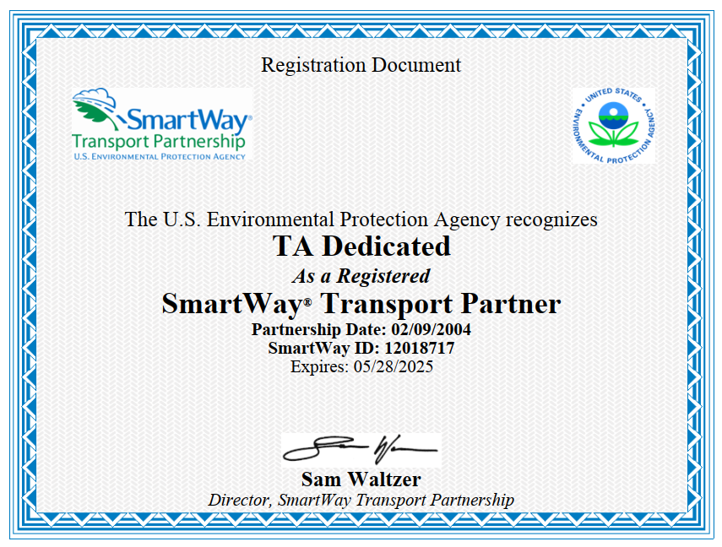
Notes:
Our customers are familiar and participate themselves.
The ones that are familiar, generates GREAT conversation and has opened many Sales prospecting doors for us that were previously closed.
We felt good about our efforts, but great to get 3rd party affirmation and assessment that we are doing the right things

Slide 25
HOW
DO WE MARKET SUSTAINABILITY?
Notes:
First question about When was easy…lets look at HOW
How to get started, you have to ask lots of questions……
TO YOUR ORGANIZATION AS WELL AS YOUR CUSTOMERS
How does TAD view Sustainability
How do our Customers view Sustainability

Slide 26
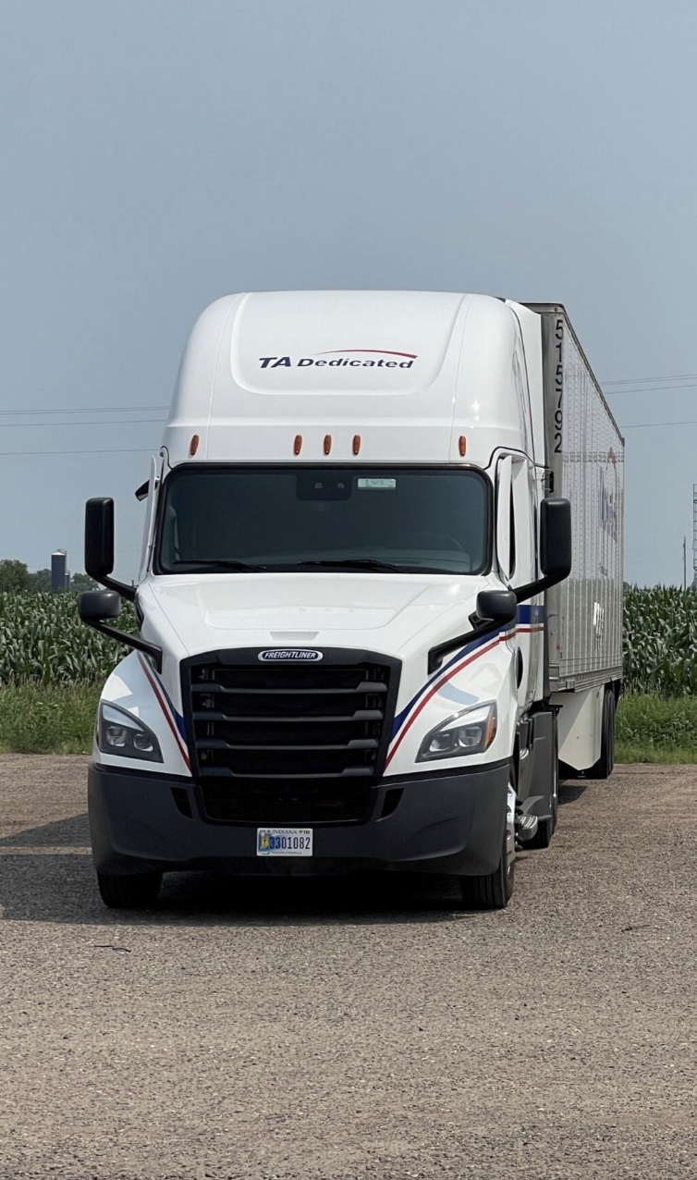
SUSTAINABILITY MARKETING
#1 highest engaging topic: Sustainability
Meet people where they are, which is curious and a bit cautious
Position your team as the value add without asking the customer for an investment beyond partnering with you
Notes:
Rough outline:
Storytelling
Meeting customers where they are
Showing up ready to share what we are doing to make customers more sustainable simply by our own operational commitments to Sust, is a key strategy for getting in the door, because we show up without asking them for anything and still add value. Customers can be weary of expensive investments on their behalf for Sust and in knowing this we took the approach of “What can we do, with what we have, where we are, right now” Self measurement, piloting EV and supply chain optimizations are a great place to start to bring in new sust partnerships.
Often times we find partners want us to help them achieve their own goals, our priority is to continue telling the story of what we do, how we do it and how that in turn makes our customers supply chains more sustainable from the jump is a great lead magnet.

Slide 27
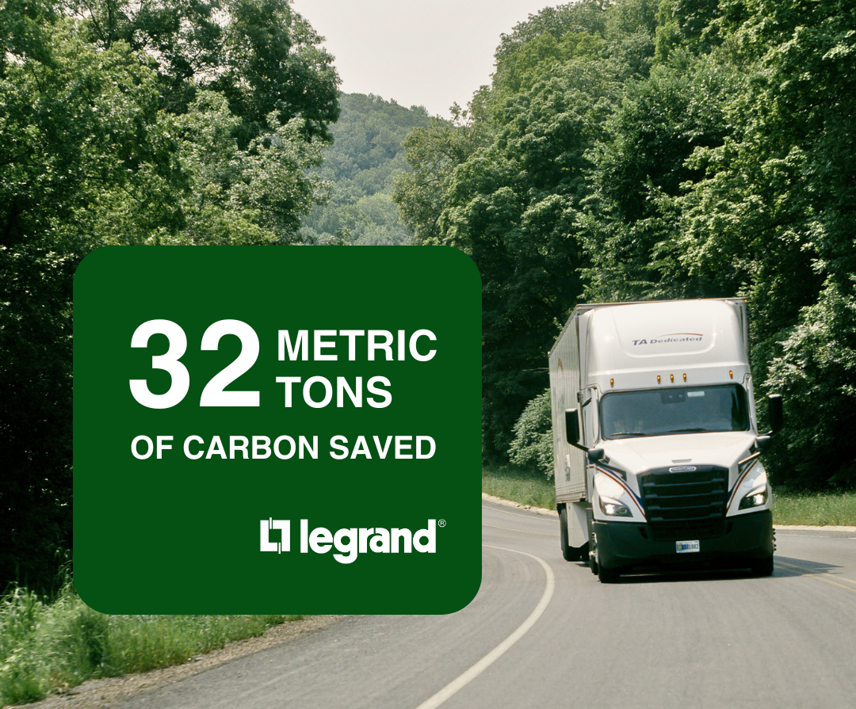
SUSTAINABILITY MARKETING
Paint the picture for your audience
Numbers matter
Branded testimonials are mutually beneficial
Notes:
Here is an example of Sustainbility Marketing:
Customer interview and success shared as a result of partnering with TA Dedicated. Huge win.
A customer willing to go on brand to not only advertise their sust efforts but their partnership with us as well
Metrics matter, that is what authenticates the message, drawing in your audience
Branded testimonials are beneficial beyond your sustainability marketing as well to support lead generation

Slide 28
WHAT
DOES SUCCESS LOOK LIKE?

Slide 29
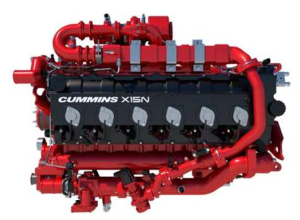
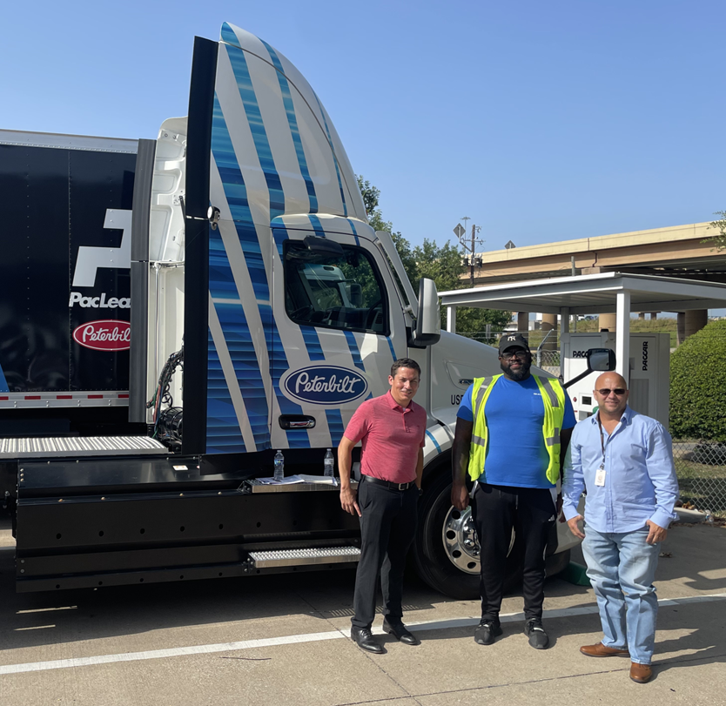
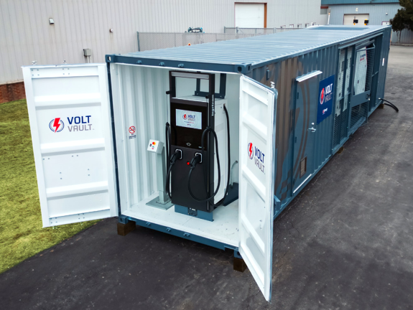
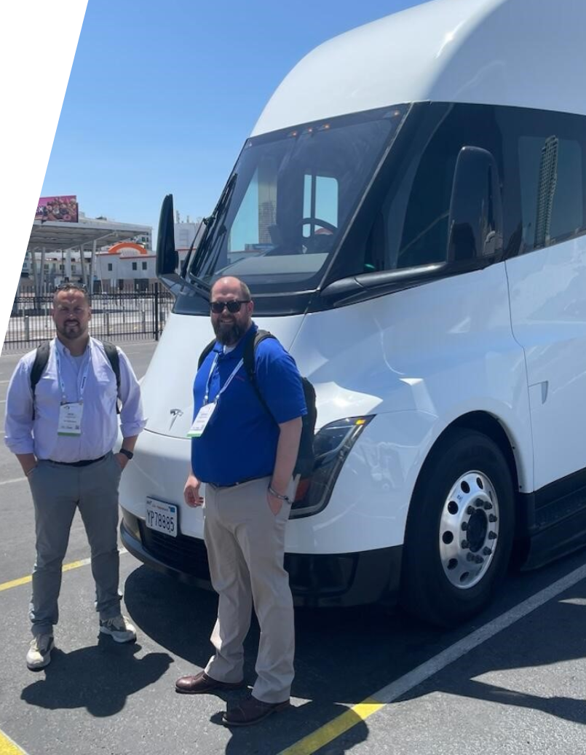
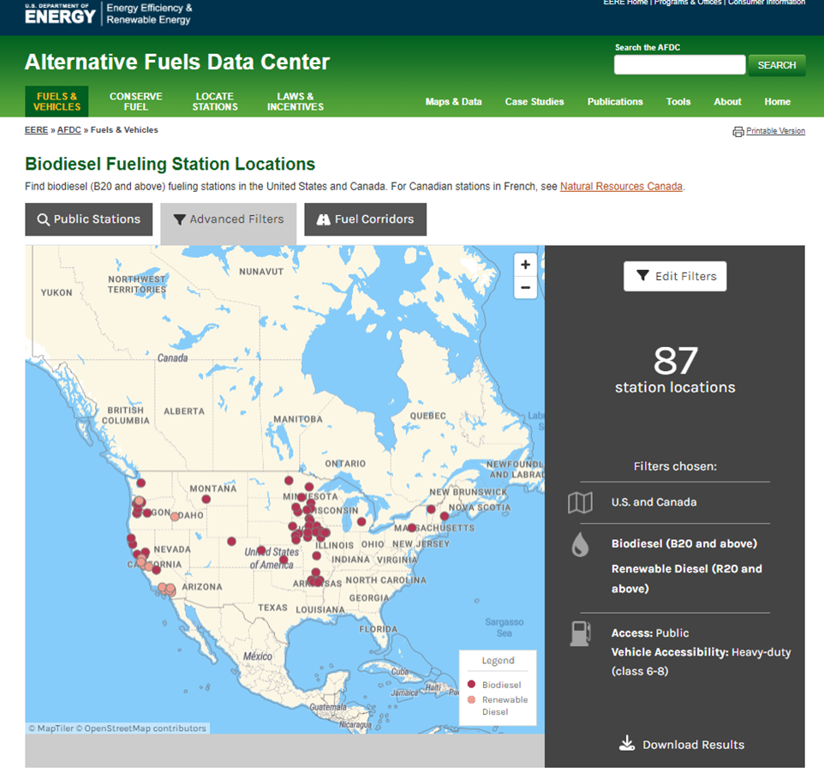
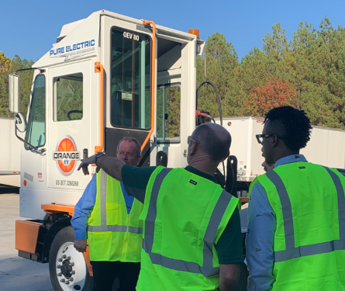
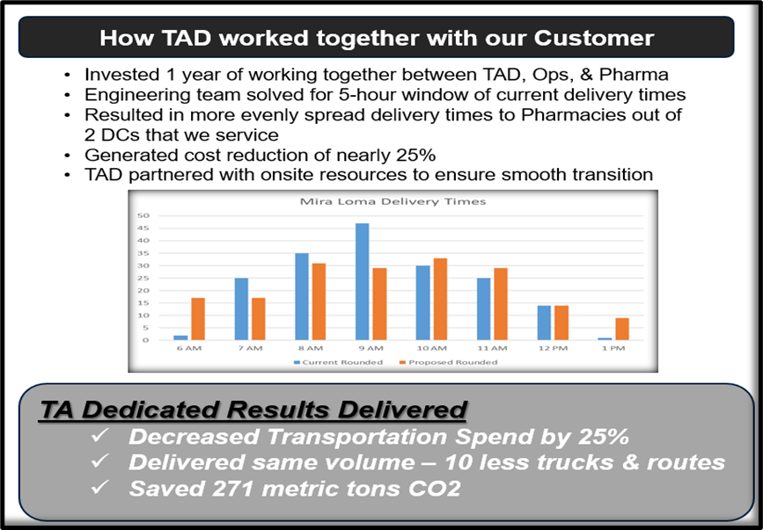
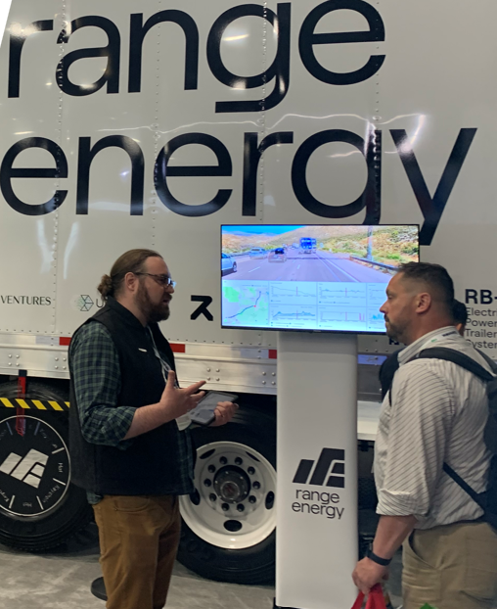
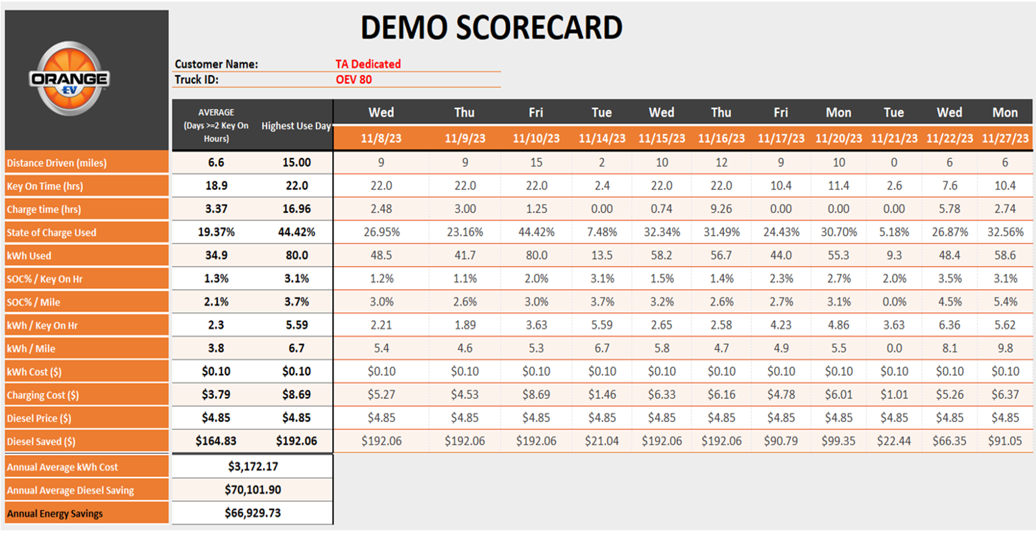
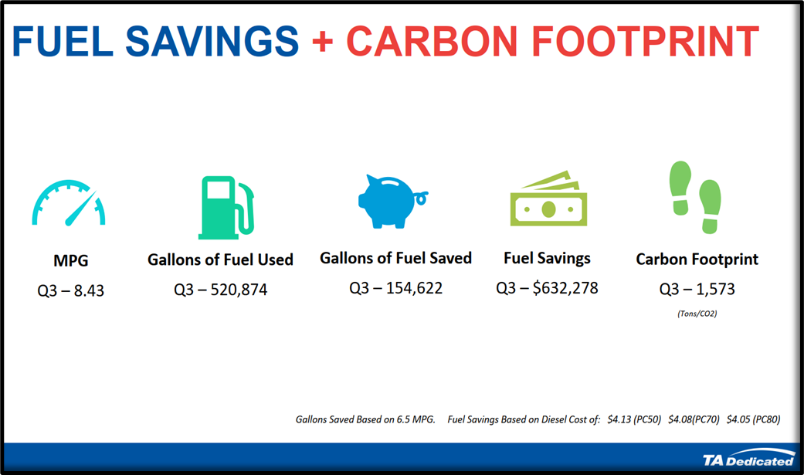
HOW TAD SUPPORTS OUR CUSTOMERS
Alt-Fuel truck Demos
Joint Learning Sessions
Biodiesel Studies
Charging Demos
Introduce New Technology
Develop Scorecards
Optimize 1,193 tons of carbon reduction YTD for our customers
Notes:
Busy slide…..
It matches TAD’s Sustainability efforts. WE HAVE BEEN VERY BUSY!
Examples of how we can add value to our customers in their sustainability journeys

Slide 30
WHAT SUCCESS LOOKS LIKE FOR TAD
Consistent messaging…not just expensive trucks, it’s really just “good truckin’”
  “Messy Middle” – think about truck specs, MPG improvement, driver behavior, engineering
Helping our customers in their sustainability journeys
Deepened our relationships with key customers (“stickier”)
Proved our worth as a valuable partner
Improved our financial results
Notes:
MOST IMPORTANTLY
We have helped our customers in their sustainability journey
We have deepend our relationship with our customers
Improved Revenue by 9+% in a challenging market in this subset of customers

Slide 31
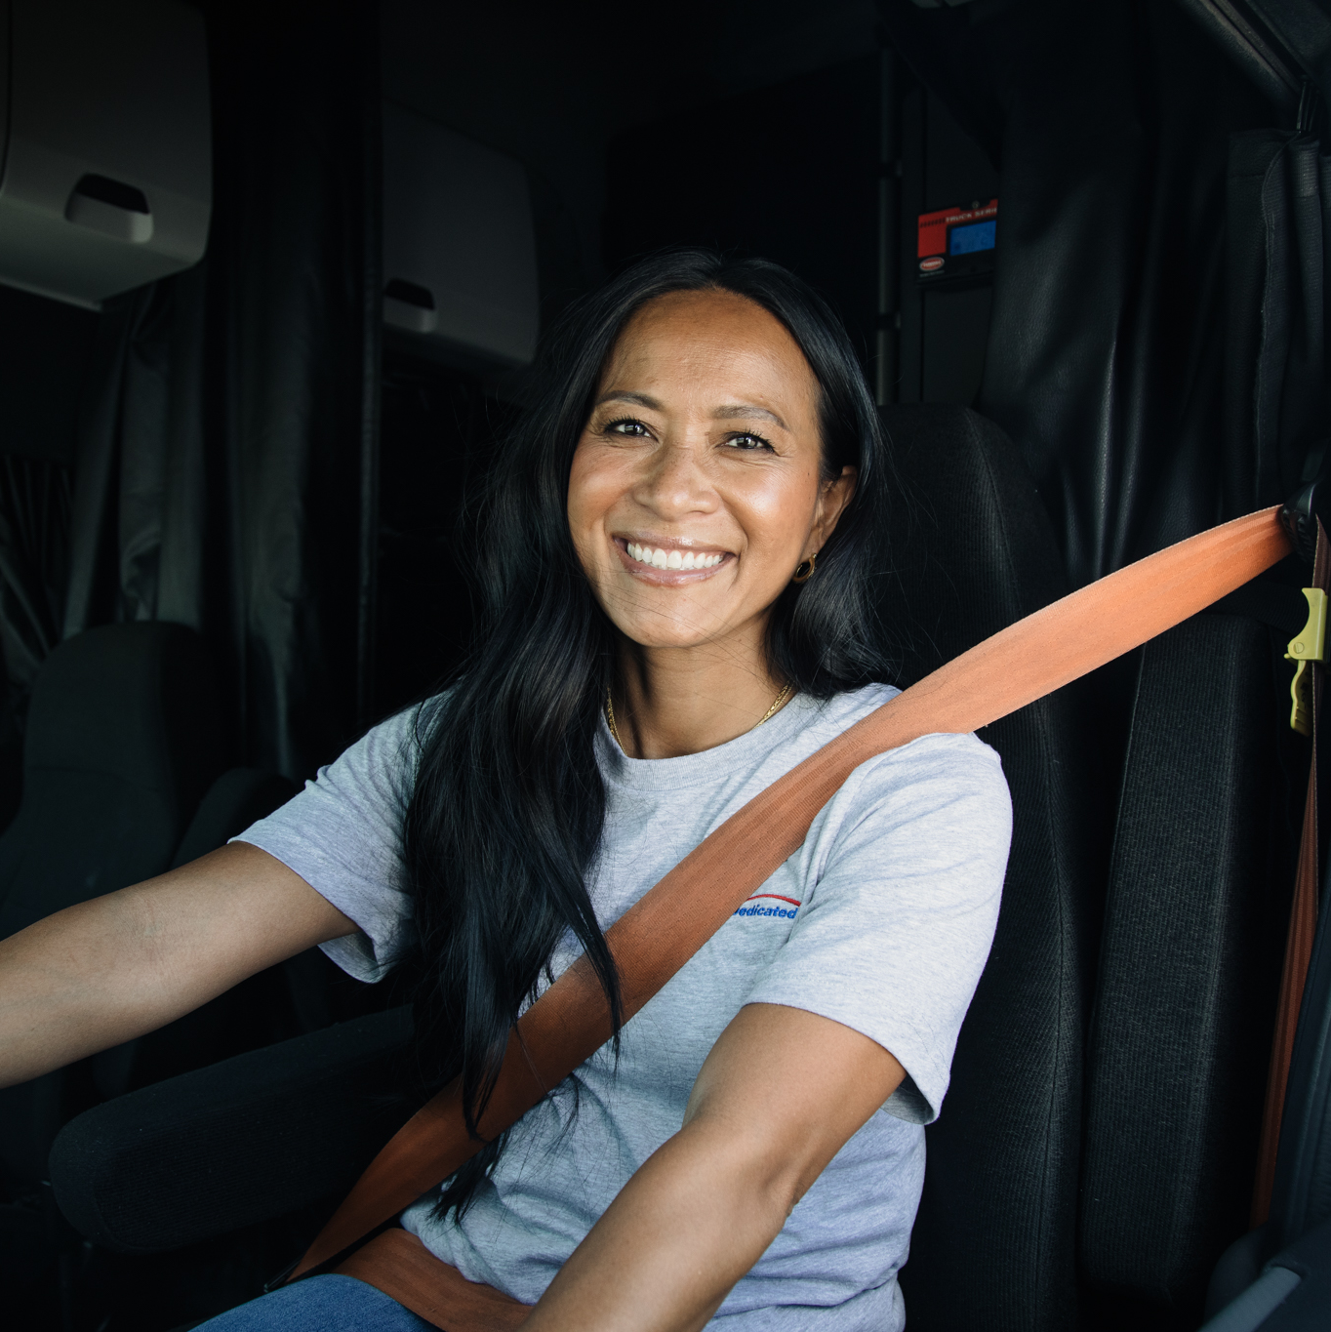
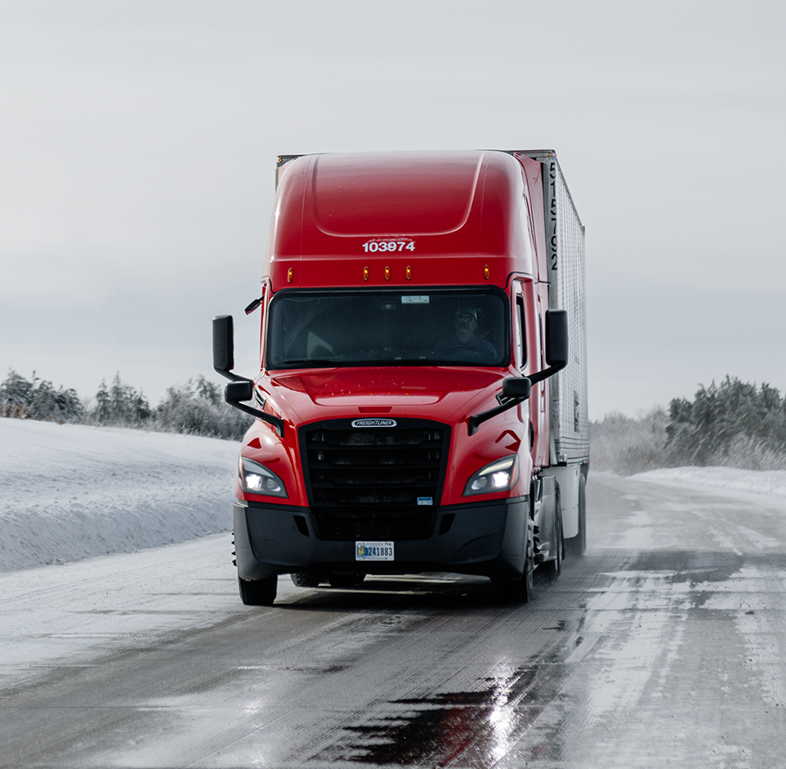
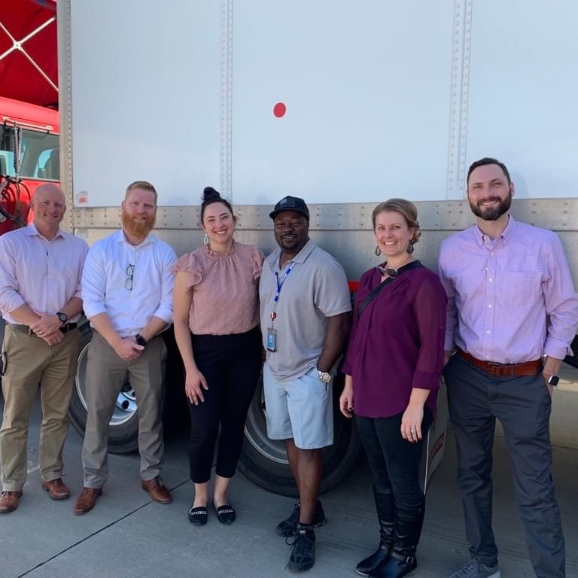
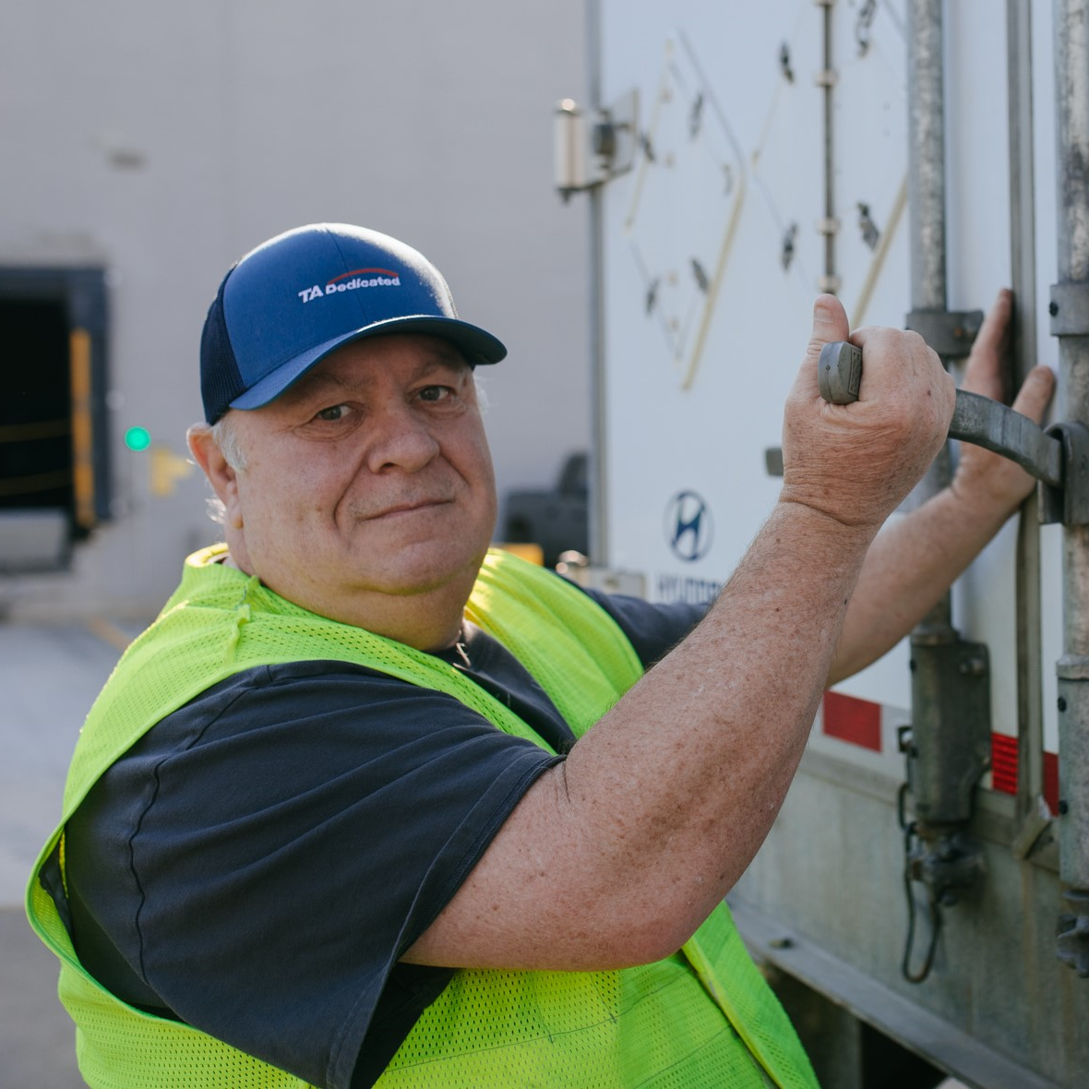
THANK YOU!

Slide 32
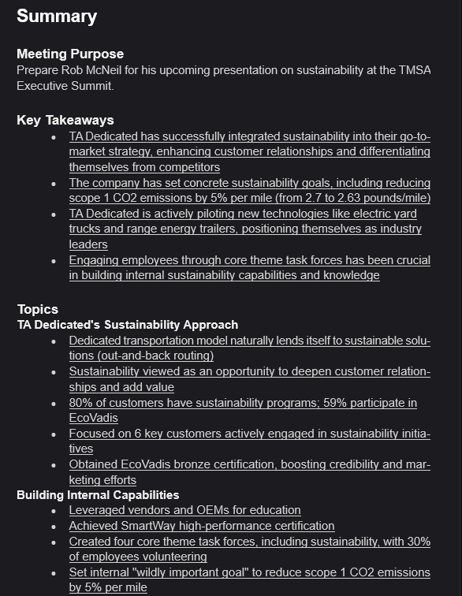
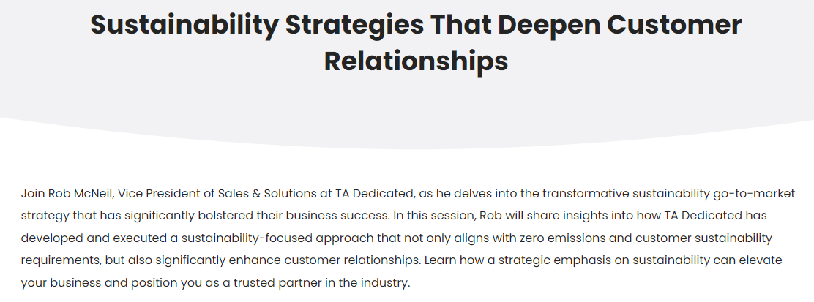
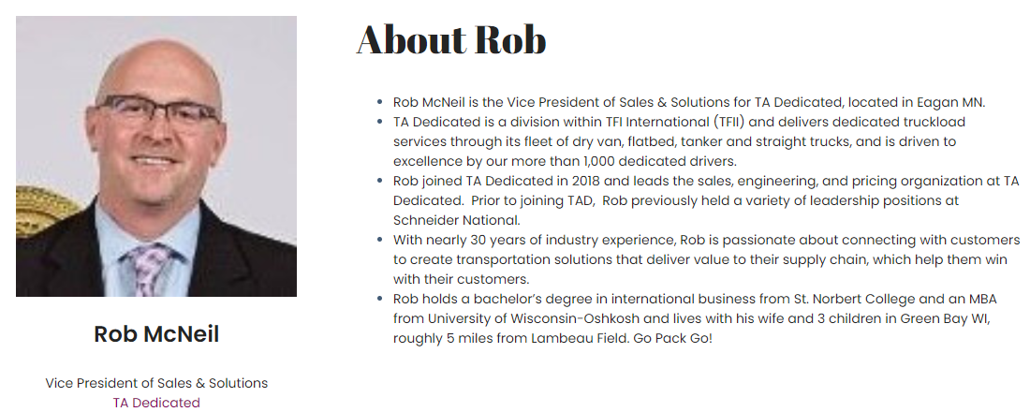
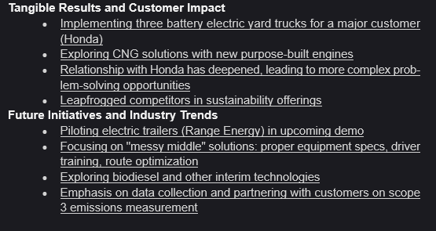
TMSA Sustainability Discussion

