Slide 1


From "No" to Not Yet
Turning Maybes into Momentum
June 8-10, 2025, | Austin, Texas

Slide 2


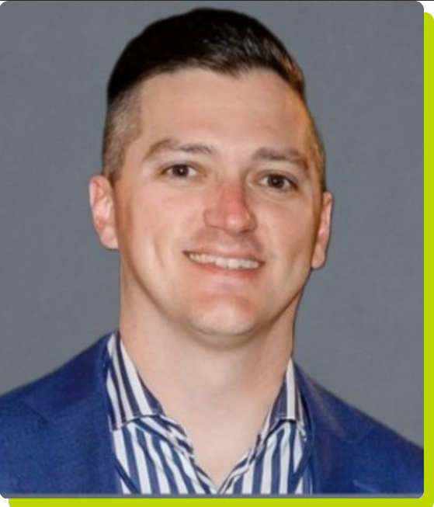
Presenters
2
Lexi Farris
Director of Strategy– Upwell Revenue Software
speaker
Kevin Coomes
EVP of Sales–
Chain
speaker
June 8-10, 2025, | Austin, Texas

Slide 3
Agenda
Identify stalled vs. lost deals
Coach reps to stay relevant without pushing
Build a follow-up strategy
June 8-10, 2025, | Austin, Texas

Slide 4

The Challenge: “Not Now” in a Tough Market
“Not now” instead of “no”, identify a PUSH not a LOSS
Get to the WHY? Budget constraints, timing, trust gaps, value prop
Risk: Losing momentum or being forgotten while we “wait for the market to turn” - HAVE TO STAY (POLITELY) AGGRESSIVE AND CONSISTENT
June 8-10, 2025, | Austin, Texas

Slide 5
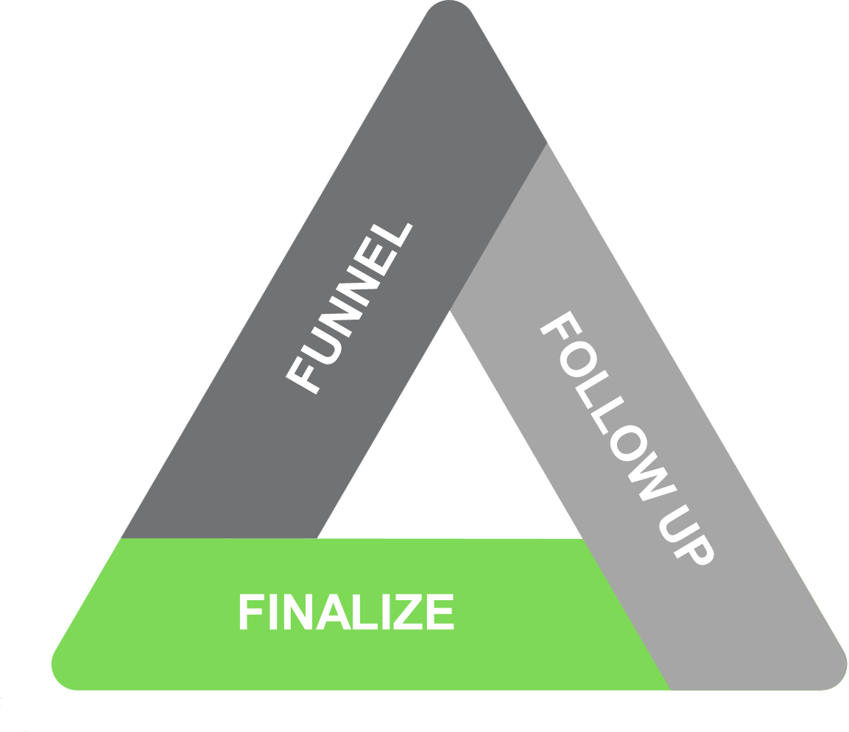
Stalled vs. Lost Deals - STALLED DEALS
Stalled Deals: Timing, trust issues, still viable, value prop alignment, poor relationship
How to Identify:
Ask pointed questions (WHY): “What’s holding you back?”, “When can we move forward?”, “How can we get this done now?”
Listen for: Budget, priorities, or decision-maker hesitancy, identify internal champions
Action: Qualify and prioritize stalled deals - ensure follow up! Build deeper relationships!
June 8-10, 2025, | Austin, Texas

Slide 6
Stalled vs. Lost Deals - LOST DEALs
Lost Deals: Poor fit or firm rejection, awarded to competition, sticker shock
How to Identify:
Clarify (WHY): “Why did we fall short?”, “How could we improve?”, do “exit interview”
Listen for: Loss of buying signals, reluctance to adopt something new/change providers,
Action: Identify learning opportunities, could the sales cycle have gone differently, sometimes a loss isn’t a bad thing
June 8-10, 2025, | Austin, Texas

Slide 7
2 out of 10
Stalled and lost deals are a result of overly complex processes leading to lack of follow up/lost contact - Gartner
80%
Of deals require 5+ touchpoint - Hubspot Research, 2024
DOES THIS RESONATE WITH YOU?
June 8-10, 2025, | Austin, Texas

Slide 8
Coaching Reps to Stay Relevant
Provide Value
Personalize Approach
leverage omni channel communication
FOCUS REPS
Demonstrate expertise, show ROI where relevant, sell on service levels, avoid “selling on price”
Understand customer’s specific business/commodities, look for pain points, create relational rather than transactional selling
Socials (i.e. LinkedIn), Phone, Email, Text (if viable), multiple touchpoints
Sales teams often find themselves getting requests from all over the organization — marketing, ops, training, etc.. Implement processes and tools to keep them selling
June 8-10, 2025, | Austin, Texas

Slide 9

CADENCE
Schedule follow up but don’t overwhelm. No one likes the “gnat at the barbecue” - this can be automated but buyer beware
FOLLOW UP PLAYBOOK
COMMS
Mix outreach between touchpoints: email, call, conference/trade show, text, LinkedIn, in-person visit (if ROI for your company makes sense)
CRM
Yes, CRMs suck for Transportation and Logistics (even in SaaS) but monitoring activity to ensure nothing slips through the cracks is key for “not yet"
CONSISTENCY / CONTINUITY
Monthly, quarterly review specifically on pushed/stalled deals. Identify high priorities that can close and put the others on a cadence
June 8-10, 2025, | Austin, Texas

Slide 10

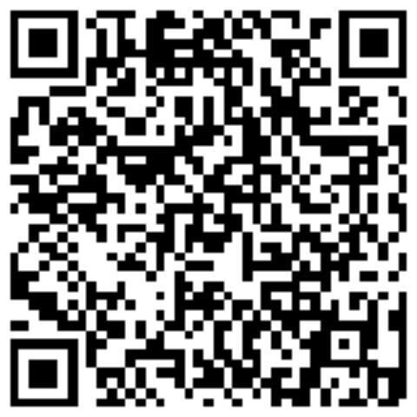
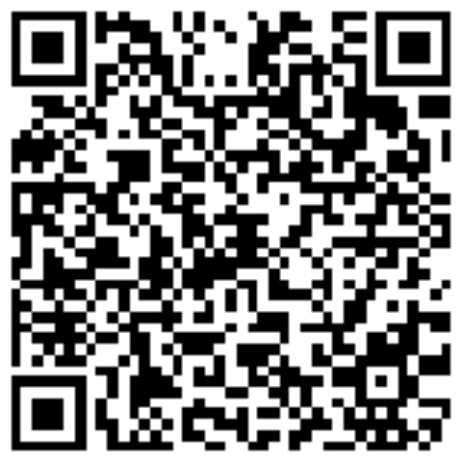
Q&A
Reach out to US
LINKEDIN
LinkedIn
LExi Farris - lexi.farris@upwell.com
KEvin Coomes - kevin@trychain.com
June 8-10, 2025, | Austin, Texas

