Slide 1


15-Minute Chronicles:
Secrets of a trailblazer
June 8-10, 2025, | Austin, Texas

Slide 2



15-Minute Chronicles
2
Congratulations
Bridgenext & saia
Saia’s Rolling Legacy
June 8-10, 2025, | Austin, Texas

Slide 3
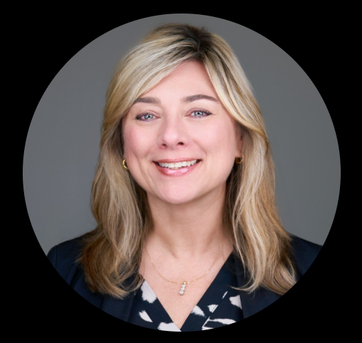

15-Minute Chronicles
3
Mona gore
Senior Director of Marketing & communications
saia
June 8-10, 2025, | Austin, Texas

Slide 4
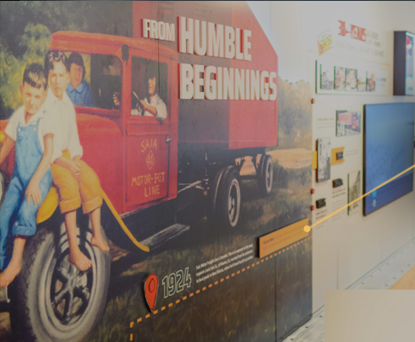

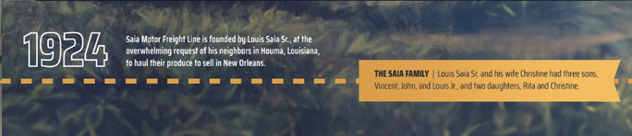


15-Minute Chronicles
4
June 8-10, 2025, | Austin, Texas

Slide 5
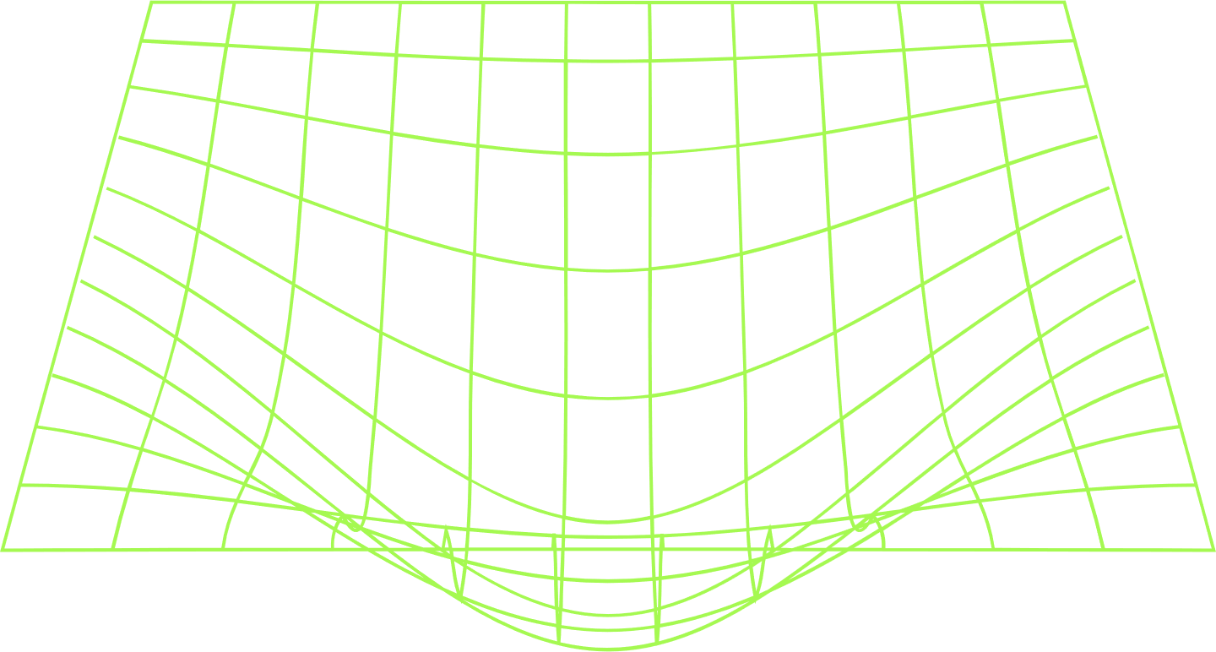
15-Minute Chronicles
Congratulations!
.
June 8-10, 2025, | Austin, Texas

