Slide 1



In a world of trends, don’t forget your foundation – Your website
Presented by:
Jason jimenez-Vanover
Visionary & ceo
June 8-10, 2025, | Austin, Texas

Slide 2

Agenda
Your Foundation – Your Website
SEO & GEO Update
Topics Covered
Tips to improve PERFORMance
The number one thing to know…
June 8-10, 2025, | Austin, Texas

Slide 3



3
You Must Be Digital
66% of B2B buyers start with a Google search, but growing with AIO.
76%- 86% of B2B buyers check a company’s web presence first.
Internal research shows trends above 95%.
June 8-10, 2025, | Austin, Texas

Slide 4


5
Your website is not optional;
you must maintain your SEO
SEO goes hand-in-hand with your website. Clicks are trending down overall with AIO, but AIO are changing.
Buyers will click through in AIO SERP, but only if your content is intriguing.
SEO is table-stakes in B2B. PERIOD.
June 8-10, 2025, | Austin, Texas

Slide 5


6
Local SEO Is the new Source
46% of local searches are local.
78% of local searches convert.
Brands applying SEO prioritizes brand name, geo-modifiers and adding value will find themselves in AIO more often.
June 8-10, 2025, | Austin, Texas

Slide 6

7
Your prospects are judging you…
75% of B2B prospects judge a company by its website design and user-experience.
June 8-10, 2025, | Austin, Texas

Slide 7
9
AI Supports, But shouldn’t replace
Prompt engineering is hard
Agents are still relatively new
You still need time to manage the functions
Hallucinations
Prompt engineering is fine, but you may need you could need hundreds of pages of instructions just to produce reliable results.
AI Agents can help execute when you don’t have specific rules, but they’re evolving.
Take the chance, but don’t give it complete control.
Even with AI agents involved, most companies (60-80%) lack the time to manage them.
AI trained on AI output is more prone to hallucinations. Check every single statistic.
June 8-10, 2025, | Austin, Texas

Slide 8

11
Before you begin…
June 8-10, 2025, | Austin, Texas

Slide 9


10
You Need a marketer in the driver’s seat
Websites are not just a fun thing. They have a clear purpose.
Input is fine, but don’t tell them how to do it.
Always have a OMNICHANNEL STRATEGy That Considers outside influences on your website
Know your limitations.
June 8-10, 2025, | Austin, Texas

Slide 10
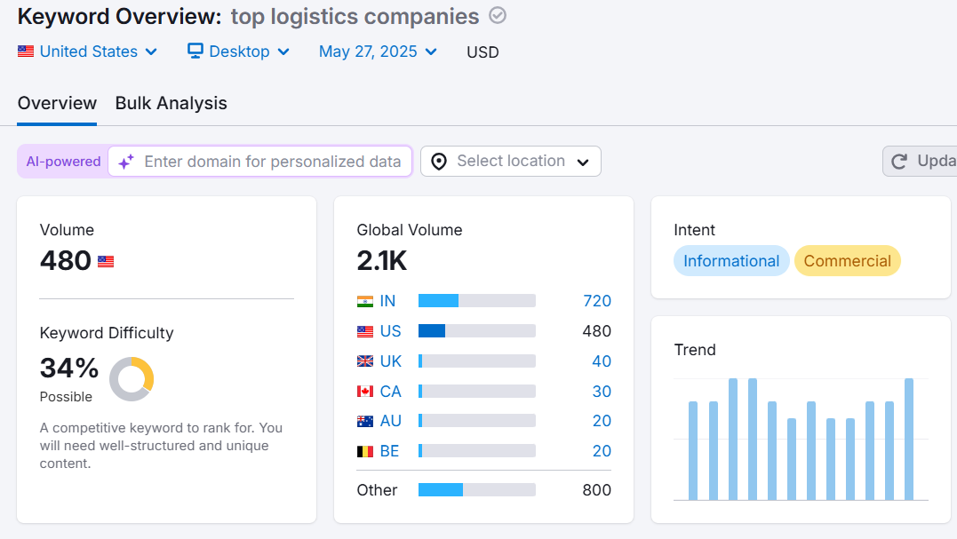
11
Be meticulous in keyword research
June 8-10, 2025, | Austin, Texas

Slide 11
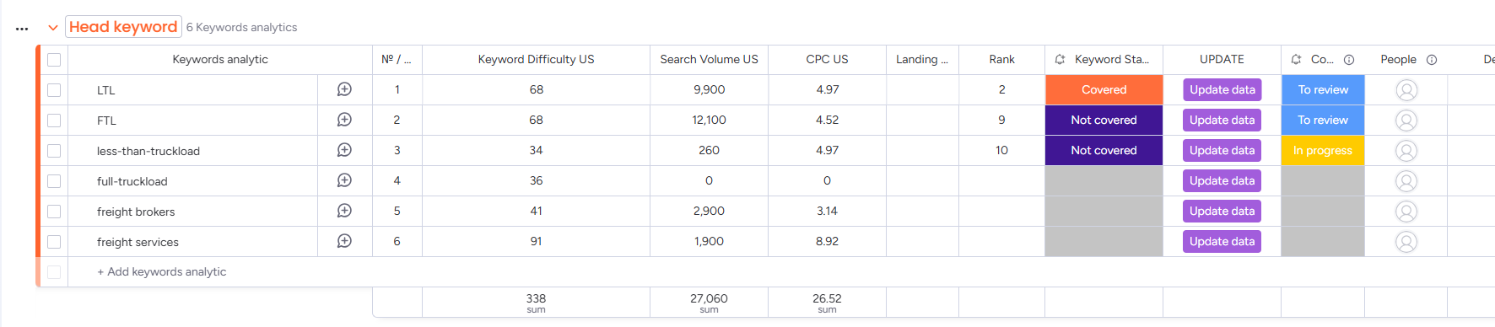
11
PLAN YOUR STRATEGY in writing…
June 8-10, 2025, | Austin, Texas

Slide 12
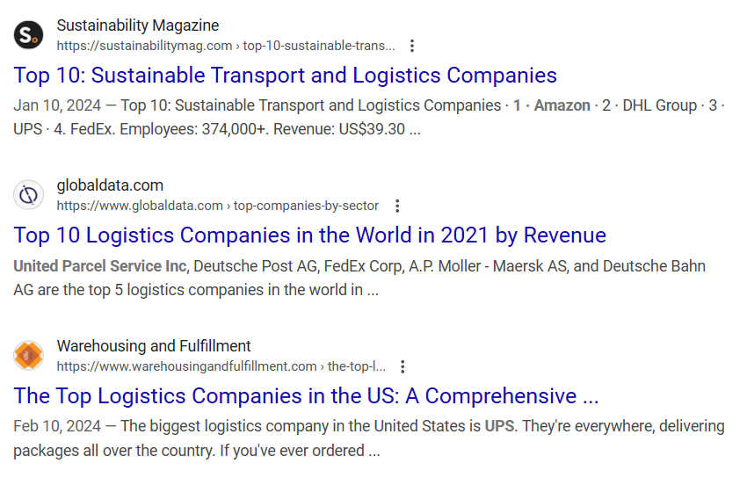
11
Always include META…
Your Meta-title must not be too different from the main title.
The Meta-description is how prospects first understand your content. Use it!
Include your primary keyword in both.
Canonical tags when necessary.
June 8-10, 2025, | Austin, Texas

Slide 13
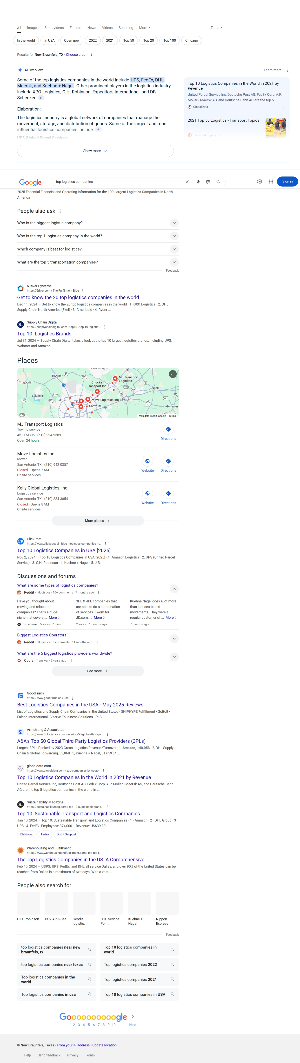
11
Mirror content that ranks…
June 8-10, 2025, | Austin, Texas

Slide 14
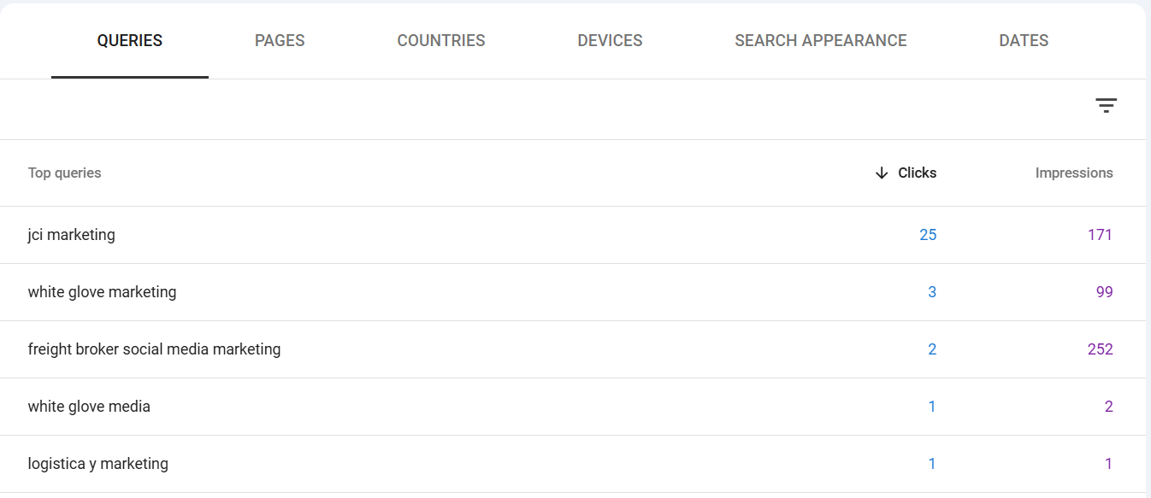
11
Use Free tools to gauge Results
June 8-10, 2025, | Austin, Texas

Slide 15
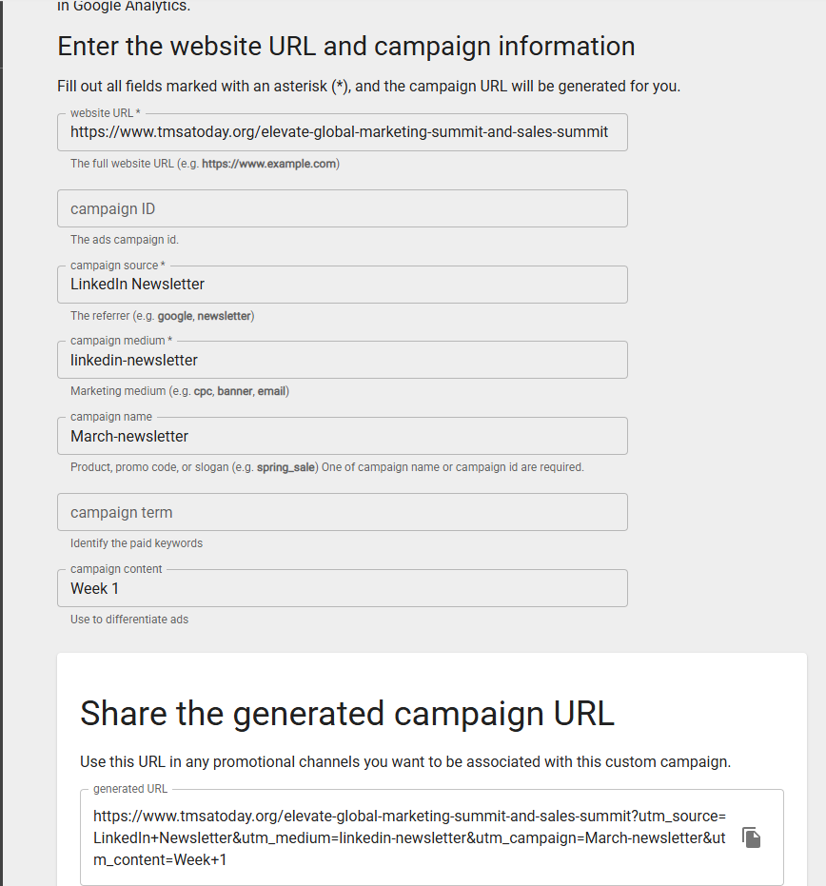
11
Use Google Dev Tools
Any offsite link needs clear tracking parameters, especially on LinkedIn.
June 8-10, 2025, | Austin, Texas

Slide 16
11
ABOVE all else, you must remember one thing…
June 8-10, 2025, | Austin, Texas

Slide 17


11
No website Is ever complete…
It’s merely stable…
for now
June 8-10, 2025, | Austin, Texas

Slide 18



Let’s Keep the conversation going and lift one another up…
Jason@jci-marketing.com
830-743-2948
June 8-10, 2025, | Austin, Texas

