Slide 1



Welcome to the
June 8-10, 2025, | Austin, Texas

Slide 2
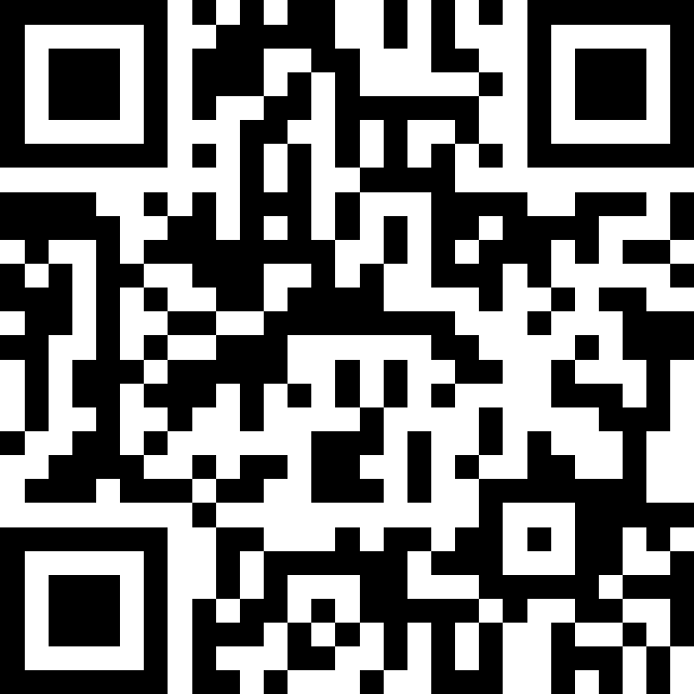

INTERACT LIVE WITH US ON SLIDO
June 8-10, 2025, | Austin, Texas

Slide 3


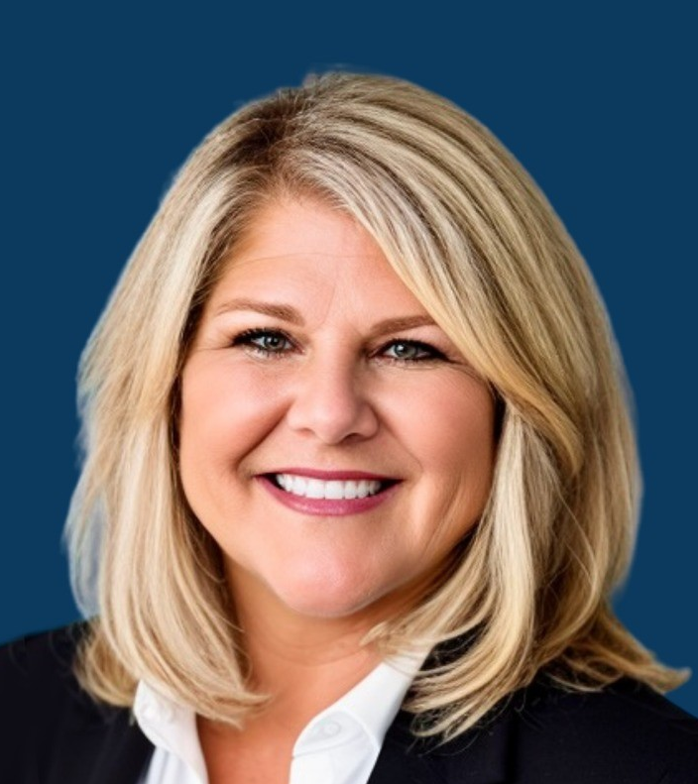
FOUNDERS OF THE LAB
LEIGH HARTMAN SAUTER
BETH POTRATZ
June 8-10, 2025, | Austin, Texas

Slide 4


THE LAB EXPERIENCE
FRICTION
Meet the client and uncover the business challenge
1
SPARK
Experts ask clarifying questions to inform their solutions and approach
2
The experts rapidly brainstorm solutions while scribes record the ideas generated by the consultants in real-time
IGNITE
3
4
FUEL
The client prioritizes 1-2 solutions to explore further
ACT
The client and experts discuss how to put the ideas into action
ACT
5
ACT
June 8-10, 2025, | Austin, Texas

Slide 5
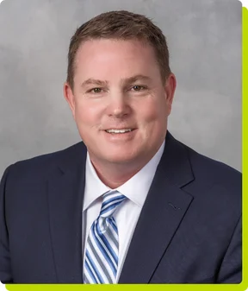
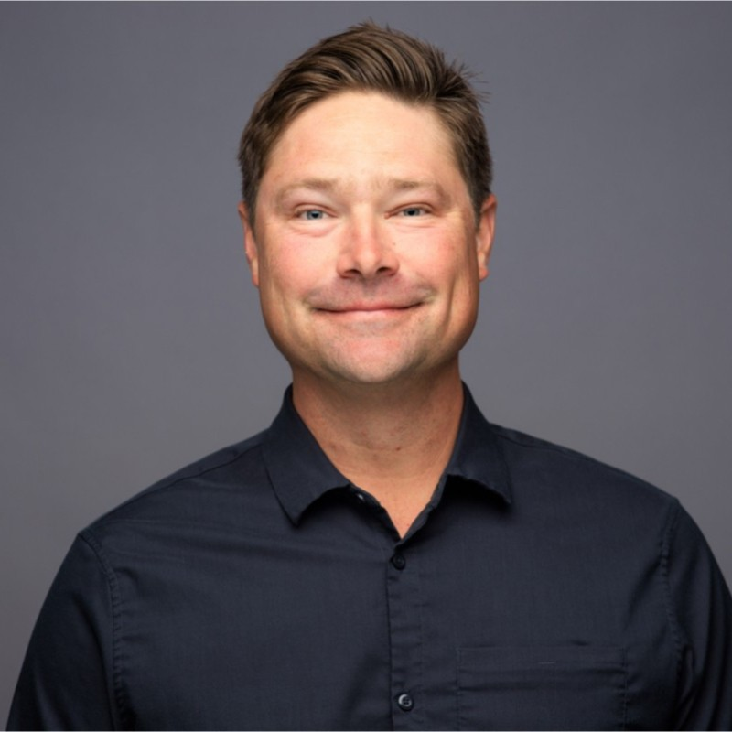


Aligning Brand and Revenue Goals
JIM GILLIS
PACIFIC REGION PRESIDENT
IMC LOGISTICS
JOHNNY MCGEE
ENTERPRISE ACCOUNT EXECUTIVE
PROCORE TECHNOLOGIES
LEIGH HARTMAN SAUTER
FOUNDER
GLASS BALL CONSULTING
CATE WHITMAN
COMMERCIAL MARKETING MANAGER
PAPER TRANSPORT, LLC
June 8-10, 2025, | Austin, Texas

Slide 6
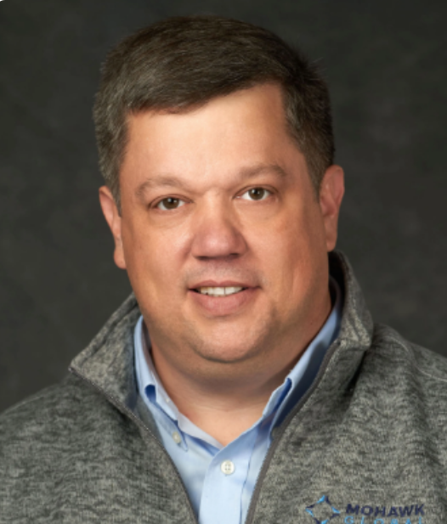
FRICTION - THE CHALLENGE
Sales and marketing are critical to growth—but in many supply chain companies, they are not working together.
Despite strong investment and capable teams, these functions often operate in silos—leading to inconsistent messaging, missed revenue, and underused resources.
How can companies bridge the gap between sales and marketing to drive stronger results?
How can leaders align on shared goals, build trust, deliver unified messaging, and turn two functions into one high-impact growth engine?
ANTHONY PAGNOTTO
VICE PRESIDENT,
GLOBAL SALES AND MARKETING
MOHAWK GLOBAL
June 8-10, 2025, | Austin, Texas

Slide 7
LET’S GET STARTED
June 8-10, 2025, | Austin, Texas

Slide 8

SOLUTION ASSESSMENT CRITERIA
POTENTIAL
ALIGNMENT
CULTURAL FIT
Which idea has the highest potential or impact on addressing your challenge?
Which idea is in alignment with, or a closest fit to your Company’s mission, vision, and values?
Which idea fits best with you Company’s culture?
June 8-10, 2025, | Austin, Texas

Slide 9
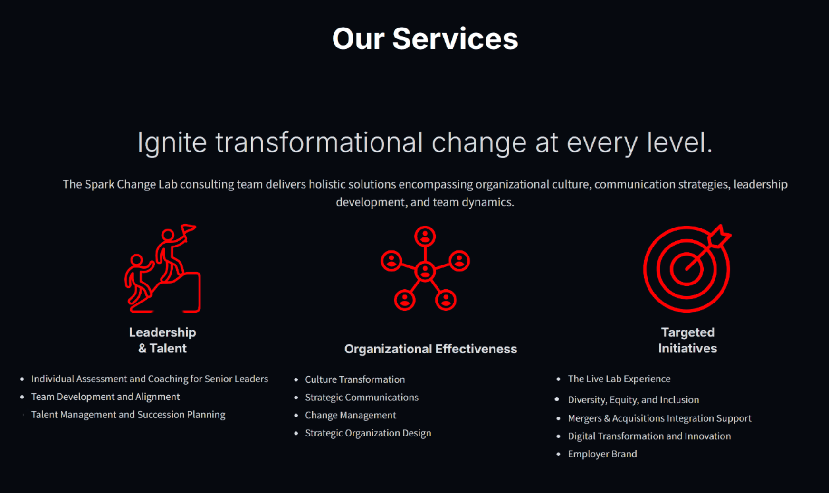
OUR SERVICES
June 8-10, 2025, | Austin, Texas

Slide 10
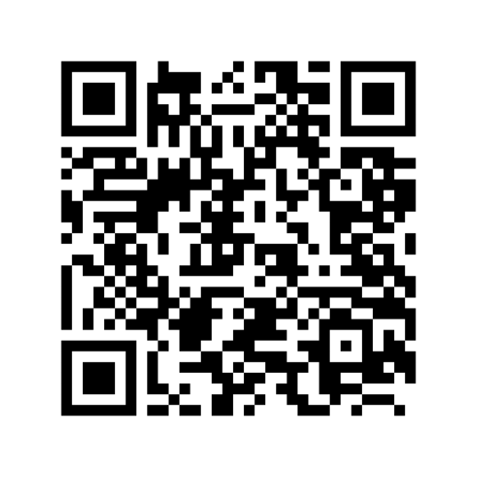
JOIN OUR EMAIL LIST
BE THE FIRST TO RECEIVE THE OFFICIAL GUIDE, BASED ON TODAY’S SESSION:
FROM SILOS TO STRATEGY:
A GUIDE TO SALES & MARKETING ALIGNMENT
June 8-10, 2025, | Austin, Texas

Slide 11
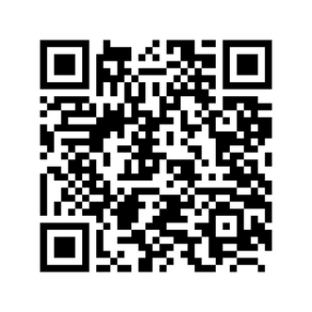
THANK YOU
FOR PARTICIPATING
VISIT SPARKCHANGELAB.COM TO:
Register for upcoming labs
Submit your business challenge
Apply to be an expert
Learn more
HELLO@SPARKCHANGELAB.COM
June 8-10, 2025, | Austin, Texas

