Slide 1


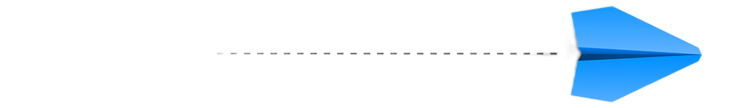
sasdf
Getting ahead
with intent data
Supercharging Sales, Marketing
and Retention in Logistics
June 8-10, 2025, | Austin, Texas

Slide 2




Who Am I?
Clara Flaherty
Head of Growth & Co-founder
CarrierSource
June 8-10, 2025, | Austin, Texas

Slide 3

Who Are You?
June 8-10, 2025, | Austin, Texas

Slide 4
What’s Inside
1
What is intent data
2
Who should use intent data
3
Before you start
4
Intent data in action
5
Workflow examples
6
Wrap up
7
Q&A
June 8-10, 2025, | Austin, Texas

Slide 5

94% of buyers turn to online research when looking for new partners
~Acquity group
June 8-10, 2025, | Austin, Texas

Slide 6


How Shippers search for new partners
Search Engines
Educational Marketing Materials
Customer Reviews
Social Media
Video Content
June 8-10, 2025, | Austin, Texas

Slide 7
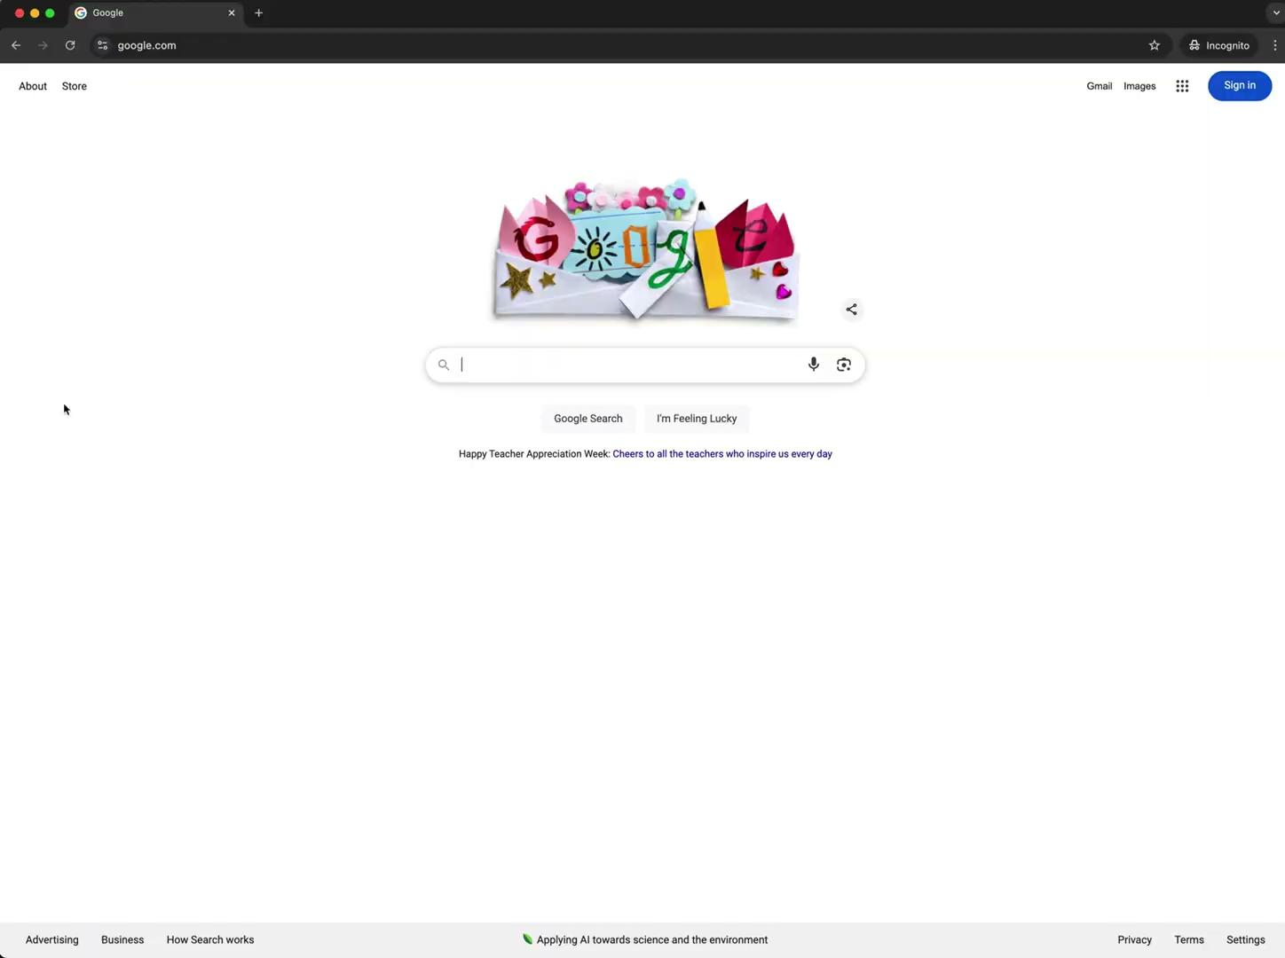
Search example
June 8-10, 2025, | Austin, Texas

Slide 8
Intent data is not contact information
June 8-10, 2025, | Austin, Texas

Slide 9
Understanding intent data
captures specific “signals” that reveal insights into a shipper’s journey, showing not only when they’re researching new services but also their level of engagement with industry content, competitors they might be considering, where they are in the funnel, and more.
June 8-10, 2025, | Austin, Texas

Slide 10


Types of intent data
First-Party
First-party intent data is the information you collect directly from your own audience on your website and other digital platforms.
Example: Tracking email campaigns, website visits, social listening tools, etc.
June 8-10, 2025, | Austin, Texas

Slide 11
Second-party
Second-party intent data consists of first-party data collected by another company that you can access or purchase.
Example: CarrierSource, G2
June 8-10, 2025, | Austin, Texas

Slide 12


Third-party
Third-party intent data comes from companies that specialize in selling data collected from various digital sources, including online behavior, ad impressions, events, and insights across multiple channels
Example: Sixsense, Zoominfo
June 8-10, 2025, | Austin, Texas

Slide 13

Who CAN USE INTENT DATA?
June 8-10, 2025, | Austin, Texas

Slide 14

Marketing
Pinpoint target accounts that are actively searching for new logistics partners so you aren’t wasting time, energy, and money on companies that aren’t currently in market
Refine content strategies by creating and promoting content tailored to the needs of the shippers showing interest in specific services
June 8-10, 2025, | Austin, Texas

Slide 15

Sales
Prioritize high-intent shippers who are actively looking for services you offer
Personalize your outreach for maximum relevance, based on the specific searches shippers are doing
June 8-10, 2025, | Austin, Texas

Slide 16

Customer Support/Account Management
Identify when a customer is exploring other options
Spot gaps in your existing service contracts
June 8-10, 2025, | Austin, Texas

Slide 17
Define your Icp
(Ideal customer profile)
Start with your best customers: Identify who gets the most value, renews, expands, and refers others
Company Demographics: Industry, size, location, revenue, business model, tech stack
Find the right roles: Who buys vs. who uses? Capture job titles, seniority, and departments
Dig Into Pain Points: What challenges are they solving with your product?
June 8-10, 2025, | Austin, Texas

Slide 18
Define your Icp
(Ideal customer profile)
Spot Buying Triggers: Events like funding, growth, new distro centers, regulation changes, new initiatives
Track Behavioral Signals: How do good-fit customers behave before they buy?
Channels: Where do they hang out online? Offline? How can you best reach them?
June 8-10, 2025, | Austin, Texas

Slide 19
Get your house in order
Search Engines
  What do you find when you google yourself? Do you own your Google Business Profile?
  What things might people Google to find you? Common spelling mistakes?
  Top 3 search engines your site gets referral traffic from?
  Do you have Google Search Console set up? https://search.google.com/search-console/about
June 8-10, 2025, | Austin, Texas

Slide 20
Your Website
Social Media
Your Sales Team
  Does your website tell people exactly what you do? Is it made for your ICP?
  What happens when you click “contact” on your website?
  Are all your social media platforms up to date and sharing similar messaging?
  What happens if someone reaches out to you through social media?
  Do your reps have an online presence?
  What happens when you google your sales rep?
June 8-10, 2025, | Austin, Texas

Slide 21
Email deliverability
Yahoogle Requirements - Feb 2024
  Authentication (DKIM, DMARC, SPF)
  Branded Sending Domains
  One-Click Unsubscribe
  TLS Connection
  Unsubscribe Implementation
  Spam Complaint Rate
  Forward & Reverse DNS
June 8-10, 2025, | Austin, Texas

Slide 22
Email deliverability
Check your current sender score - Sender Score and MXToolbox are two good ones
Set up Postmaster Tools for your domain - https://gmail.com/postmaster/
Set up Smart Network Data Service Microsoft’s version of Postmaster - https://sendersupport.olc.protection.outlook.com/snds/
If you are on blacklists or going to the spam folder, don’t panic. There’s hope.
June 8-10, 2025, | Austin, Texas

Slide 23
Email deliverability pt 2
Analyze your existing email program
  Do you have an email marketing program? What are your engagement rates?
    Open Rate, Click-Through Rate, Bounce Rate, Unsubscribe Rate, Conversion Rate
  How many cold emails are going out from your sales team? Do you have different domains set up?
June 8-10, 2025, | Austin, Texas

Slide 24
Finding a provider
Take stock of existing tech stack
If searching for new companies
  Industry-relevant and high-quality data (from trusted sources)
  Comprehensive coverage in your target industries/geographies
  Compliance with data privacy laws
  Customizable reports and analytics tools
  Integrations available?
Check G2: https://www.g2.com/categories/buyer-intent-data-providers
June 8-10, 2025, | Austin, Texas

Slide 25
Define your goals
Define your objectives, examples could be:
  Prioritizing high-intent shippers for your sales team to reach out to
  Personalizing marketing content and campaigns to attract in-market shippers
  Identifying expansion opportunities with existing customers
Be clear about the outcomes you want to achieve and set up a way to MEASURE.
June 8-10, 2025, | Austin, Texas

Slide 26
Align Teams
Decide which teams will use intent data
Hold cross-departmental meetings to discuss
  How intent data will be used by each team
  Types of signals each team should prioritize
    Example: Shippers actively researching competitors for sales
    Example: Prospects engaging with educational content for marketing
  Processes for sharing insights and collaborating on targeted campaigns. What does hand-off look like?
June 8-10, 2025, | Austin, Texas

Slide 27
Develop Actionable workflows
June 8-10, 2025, | Austin, Texas

Slide 28
marketing workflow example #1
Campaign to warm in-market prospects
  Trigger: Your ICP shows intent on a relevant topic to your services
  Actions:
    Auto-enroll them into a targeted email sequence about your services (focused on the pain-points they were researching)
    Show targeted ads (LI, Paid Search) based on their interest topics
    Retarget visitors with case studies or review snippets relevant to their needs
June 8-10, 2025, | Austin, Texas

Slide 29
marketing workflow example #2
Content Personalization Based on Intent
  Trigger: Your ICP searches for a high-intent keyword for example “trucking companies in IL” or “drayage carriers in California”
  Actions:
    Personalize your website experience the next time they visit your website
      Show dynamic content (“Trusted Drayage Partner Since 2015”)
    Serve them industry-specific resources or case studies
    Prioritize them for live chat outreach on your site
June 8-10, 2025, | Austin, Texas

Slide 30
sales workflow
Example #1
Prospect Prioritization and Personalized OUTREACH
  Trigger: Prospect visits your website or CarrierSource profile (For example)
  Actions:
    SDR assigned automatically
    Personalized LI connection request + intro message
    Follow up with a phone call, voicemail, or video referencing their research behavior
    Follow up 3 days later with a case study of a similar company you’ve helped
June 8-10, 2025, | Austin, Texas

Slide 31
sales workflow
Example #2
Cold Calls based on who’s looking
  Trigger: Shippers in your ICP are showing intent but haven’t engaged directly yet
  Actions:
    SDR’s prioritize cold calls based on highest-intent score for prospects
    Call with opening line like: “We’ve been seeing more companies like {PROSPECT COMPANY} exploring options around {TOPIC}. Is that something you’re focused on?”
June 8-10, 2025, | Austin, Texas

Slide 32
Account management
workflow example #1
Retention Risk Alert
  Trigger: Existing customers are showing intent for competitors or related services
  Actions:
    Account Manager receives automated alert
    Immediate check-in email or call to address potential dissatisfaction
    Have leadership join the next meeting to show that they are a priority for the whole company
June 8-10, 2025, | Austin, Texas

Slide 33
Account management
workflow example #2
Expansion Opportunity Signal
  Trigger: Existing customers showing interest in related services you offer
  Actions:
    Account Manager receives automated alert
    At next check in call, Account Manager shares that you offer the services they were searching for
    Marketing sends a targeted email with additional information about those services
June 8-10, 2025, | Austin, Texas

Slide 34
Follow. up.
June 8-10, 2025, | Austin, Texas

Slide 35
Track performance & refine strategy
  Monitor the impact of intent data on your key performance metrics (overall pipeline, lead engagement, conversion rates, time to close)
  Track attribution so you know when intent data is working.
  Regularly review the quality of your data and the effectiveness of your outreach.
  Are the right signals being prioritized? Are leads converting at a higher rate?
  Adjust your workflows and strategies based on the insights you gather to continuously improve the performance of your intent data initiatives.
June 8-10, 2025, | Austin, Texas

Slide 36
Questions?
June 8-10, 2025, | Austin, Texas

Slide 37

Thank you!
Want to talk more? Email me at clara@carriersource.io
June 8-10, 2025, | Austin, Texas

