Slide 1
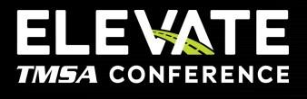

The Modern Marketer’s Playbook:
Rule of 7, Paid Media, Influencer Marketing, beyond
June 8-10, 2025, | Austin, Texas

Slide 2







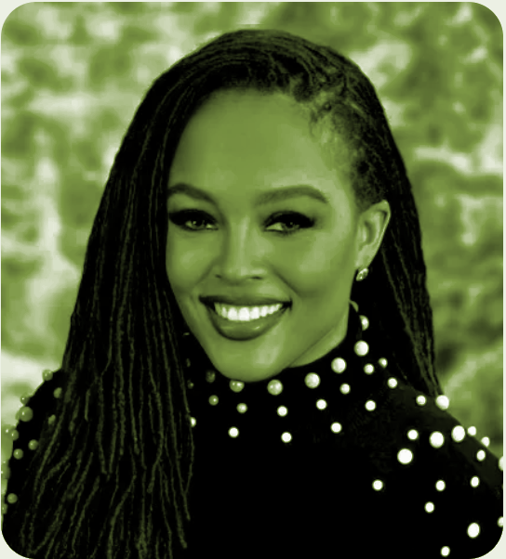





Hi. I’m Madison.
June 8-10, 2025, | Austin, Texas

Slide 3
A case for integration
  Rule of 7
  Paid Media
  Influencer Marketing
A practical parallel (Any runners in the room?)
“Group discussion”
Beyond integration
Wrap
Agenda
June 8-10, 2025, | Austin, Texas

Slide 4
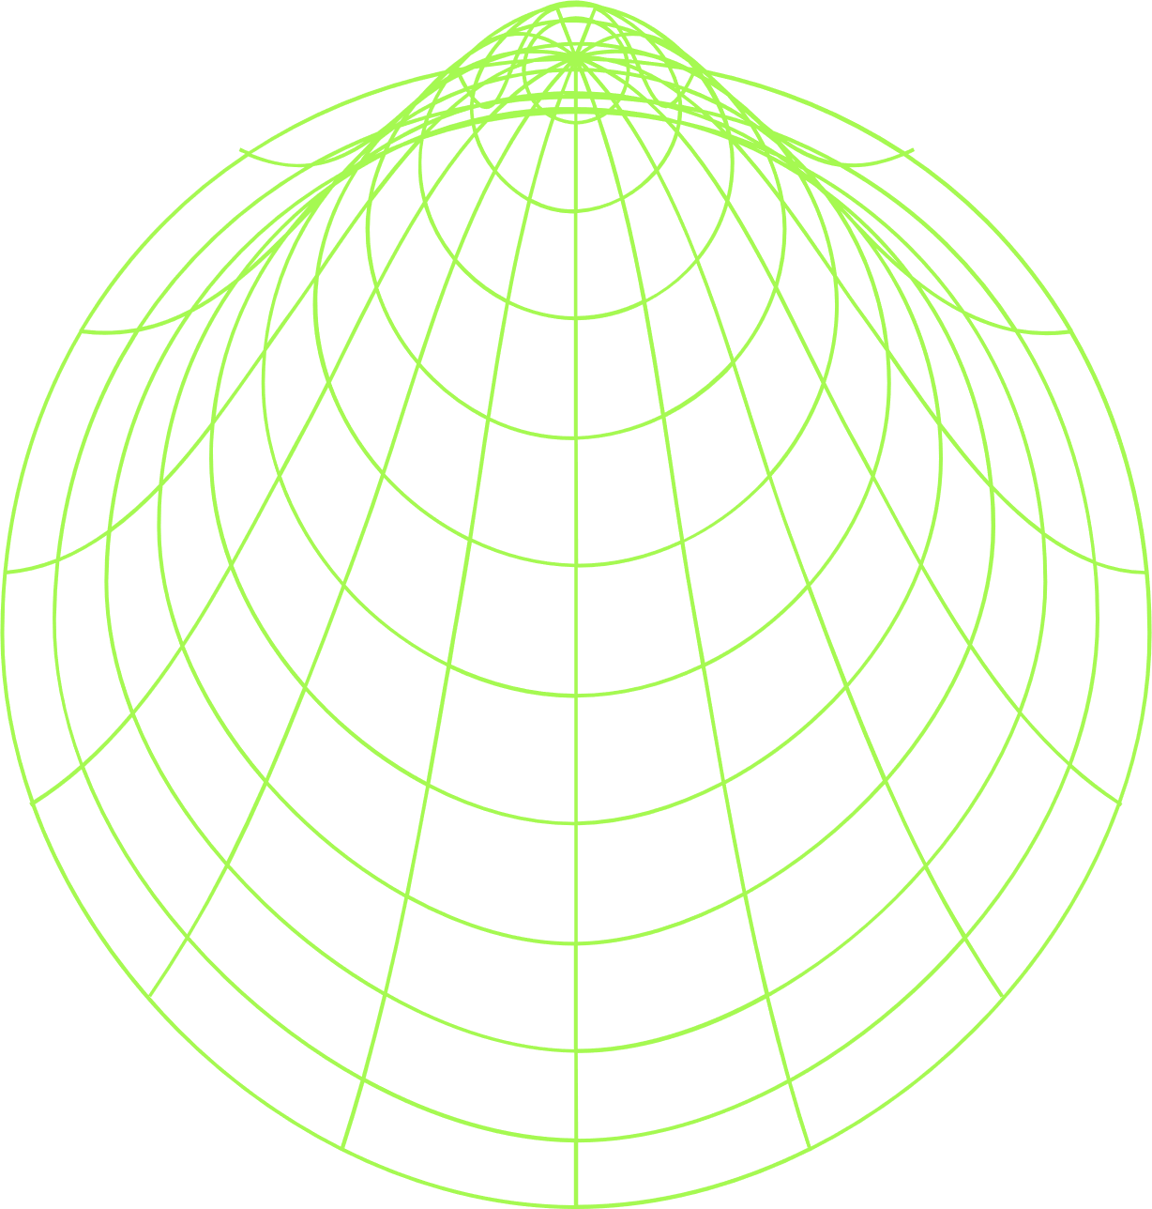

3
But FIRST,
A QUESTION…
June 8-10, 2025, | Austin, Texas
Notes:
How many of you have ever launched a campaign that didn’t quite hit the mark? Maybe it was great creative, but the audience didn’t see it enough. Maybe the right people saw it, but you felt forgotten the next day. No pressure, but anyone in the mood to share the details?

Slide 5
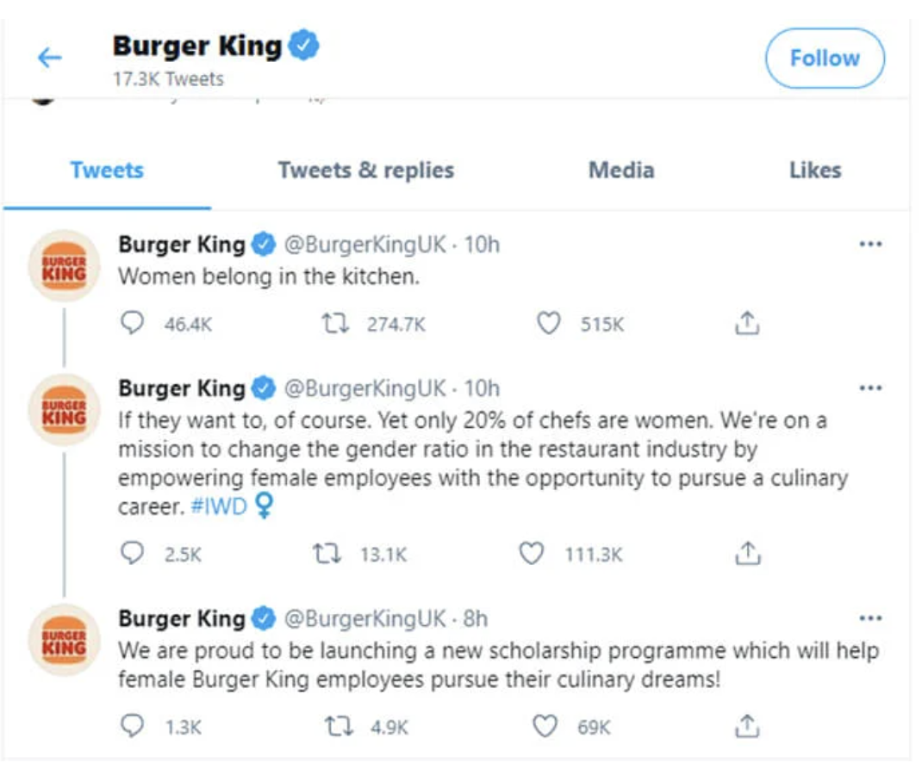
4
You’re not alone.
We all have.
June 8-10, 2025, | Austin, Texas

Slide 6
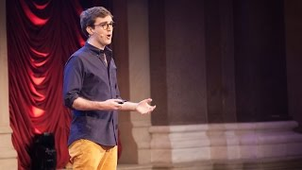

5
Consider This your reminder to loosen up; The magic Is in the how.
June 8-10, 2025, | Austin, Texas
Notes:
This might seem like an odd place for a YouTube link, but bear with me. This is a short, humorous TEDx talk by Will Stephen. He hilariously demonstrates how to sound smart in a presentation even when you have absolutely nothing to say. [Briefly describe some of the techniques he uses, drawing from the bullet points in the video summary, i.e., confident delivery, irrelevant anecdotes, vague intellectual references, meaningless data, thought-provoking stock photos with gibberish, varying tone]. The point is: he looks and sounds impressive, but there's no substance. This is a perfect, satirical illustration of what not to do. In marketing, just like in presentations, the 'how' – the delivery, the style, the channels – is crucial. But it's meaningless without a strong 'what' – a clear, valuable, and strategically integrated message. We can't let style overshadow substance. We need both.

Slide 7
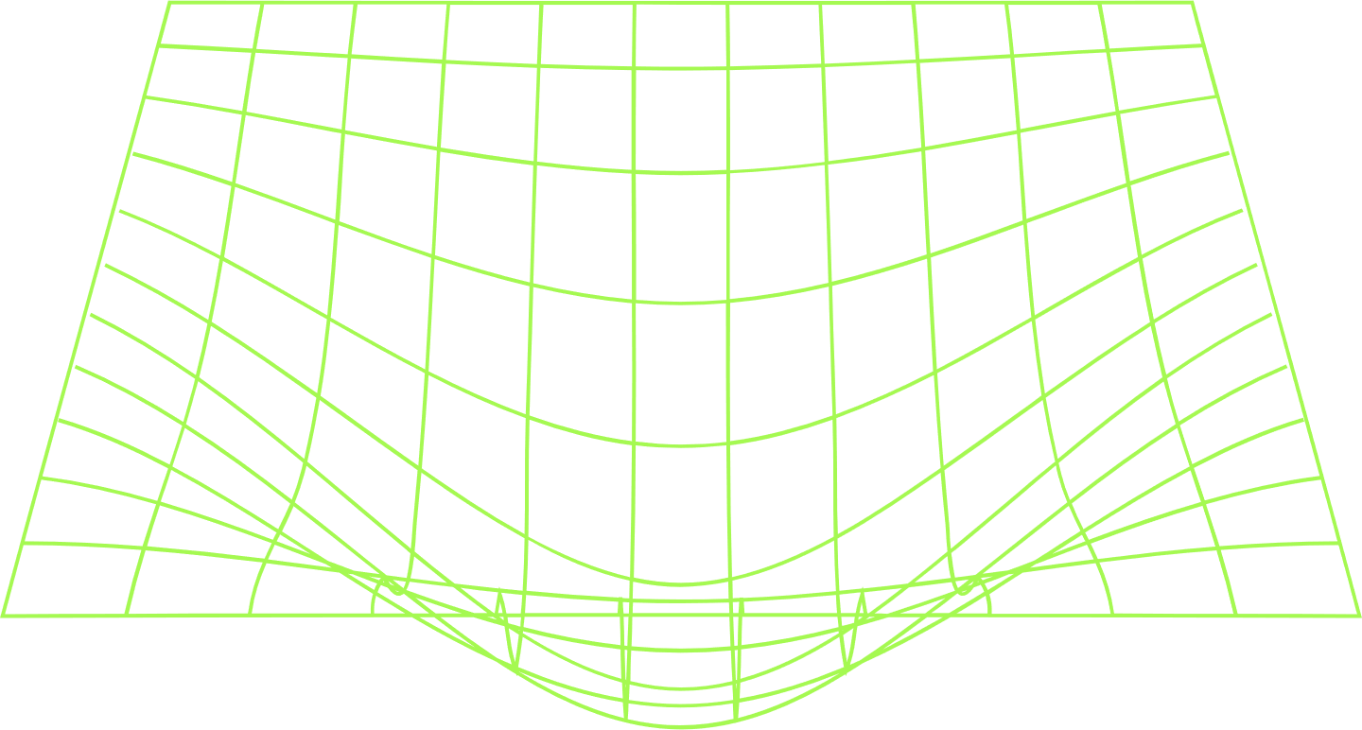
A case for integration
June 8-10, 2025, | Austin, Texas
Notes:
Following our thought on 'the magic being in the how,' and the crucial lesson that style without substance is just noise, let’s now explicitly build 'A Case for Integration.' This is the 'what' that gives all your 'how' – your paid media, your influencer outreach, your Rule of 7 touchpoints – real power and meaning. Why is this holistic approach not just a nice-to-have, but fundamentally crucial in today's competitive and fragmented marketing landscape? Let's explore why integration is the bedrock of effective, substantive marketing.

Slide 8
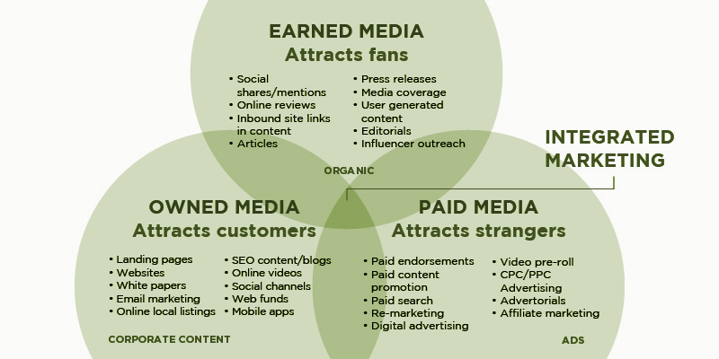
June 8-10, 2025, | Austin, Texas
Notes:
This visual, the classic Venn diagram of Owned, Paid, and Earned Media, beautifully illustrates the foundation of integrated marketing.
Owned Media: This is your home base – your website, blog, social media profiles, email lists. You control this, nurturing your existing audience and providing value.
Paid Media: This is where you pay to amplify your message, reach new audiences, and drive specific actions. Think search ads, social ads, display.
Earned Media: This is the 'holy grail' – when others talk about you organically, through PR, social shares, reviews, and influencer mentions. It's powerful because it's trusted. The goal isn't just to have all three. The magic, the real strategic advantage, happens in the overlap. It’s where these elements work together seamlessly, creating a unified and consistent message across every touchpoint, building deeper trust, and driving stronger, measurable results.
Source pink lemonade

Slide 9

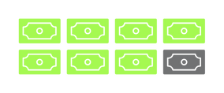

8
Repeat exposure to a thing (brand, logo, jingle, ad) leads to greater preference for that thing, and increases likelihood of recall (Mere familiarity effect)
Repeat info perceived as more truthful than new (Illusory Truth Effect)
Consumers exposed 10+ times were 10x more likely to download/demo/trial, 8x more likely to place order, and 10x more likely to place repeat order
RULE of 7
Paid search ads can lift brand awareness by an average of 80%.
Customers 70% more likely to buy a product when retargeted by display ads
83% of total social media ad spending is to be generated on mobile by 2030
75% of people say paid ads make it easier to find what they need
The average ROAS for paid social campaigns is 4:1
PAID MEDIA
91% of B2B purchase decisions are influenced by word-of-mouth
For every dollar spent on influencer marketing, brands earn $5.20
75% of B2B marketers budget for influencer marketing; 93% will up their spend
The top influencer marketing goals = brand awareness (67%) and build trust (54%).
3/5 B2B marketing teams use an "always-on" influencer marketing approach
INfluence
June 8-10, 2025, | Austin, Texas
Notes:
Let's put some numbers behind these concepts. These aren't just theories; they're backed by powerful data:
The Rule of 7: Psychologically, repeated exposure (the Mere Exposure Effect) increases liking and recall. The 'Illusory Truth Effect' shows repeated information is perceived as more truthful. And in real-world examples, consistently exposed customers are significantly more likely to convert.
Paid Media: Paid search ads alone can lift brand awareness by an average of 80%. Retargeting ads make customers 70% more likely to purchase. And overall, for every dollar spent on paid social campaigns, the average return on ad spend is a strong 4:1. Digital ad spending continues to climb, showing its pervasive reach, especially on mobile.
Influencer Marketing: This is where trust is currency. For B2B, word-of-mouth influences a staggering 91% of purchase decisions. Brands see an average of $5.20 back for every dollar spent. Most B2B marketers are actively using it, and nearly all plan to increase their budget, primarily to build brand awareness and, crucially, trust and credibility. The 'always-on' approach is gaining favor because consistent engagement with trusted voices yields better results.
Important Considerations (The Downside of Repetition):
Wear-Out Effect / Ad Fatigue: While repetition is powerful, excessive or unvaried repetition can lead to ad fatigue, annoyance, and even a decline in positive brand perception or purchase intent. For example, one study found that while brand recall peaked at 92% after six exposures to the same ad in an hour, annoyance also increased by 48% over average, and purchase intent declined by 16%.
Optimal Frequency: There's no single "magic number" for optimal exposure. It varies based on audience segment, product category, creative quality, and brand maturity. For general audiences, ad recall may maximize at 10 to 15 exposures, but for in-market customers, purchase intent can improve after just four exposures. New brands may drive recall at lower frequencies initially, but impact can drop after only two exposures if creative isn't varied.
Creative Variation: To prevent wear-out, it's crucial to employ repetition with variation. Presenting core messages in different formats or with varied creatives can maintain engagement and showcase different aspects of the brand, leading to increased ad recognition and relevance.

Slide 10
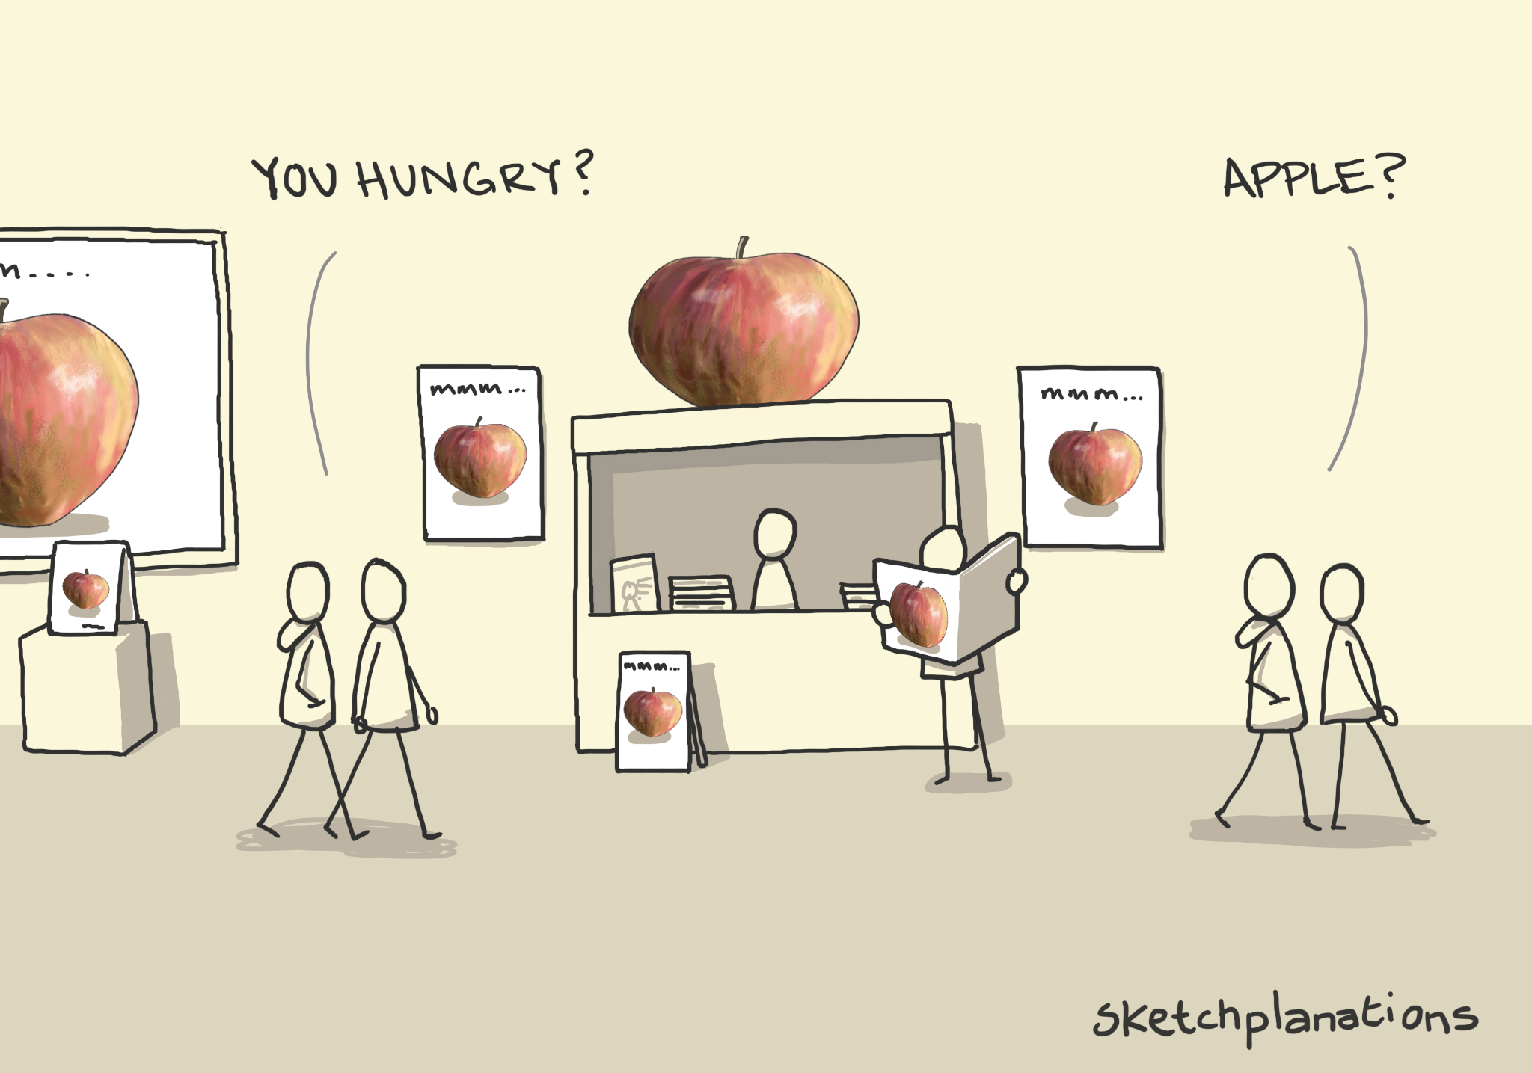
9
The rule of 7:
June 8-10, 2025, | Austin, Texas
Notes:
This 'Sketchplanations' comic brilliantly visualizes the essence of the Rule of 7. It's not about bombarding someone. It's about subtle, consistent presence. [Point to comic panels as you speak] You see the Apple just enough times, in different contexts, that it becomes familiar. It registers. And then, when the need arises – when you’re 'hungry' – the immediate, almost unconscious, thought is 'mmm... apple.' That's the power of the Rule of 7: building familiarity and preference so your brand is the default choice when the need arises.

Slide 11
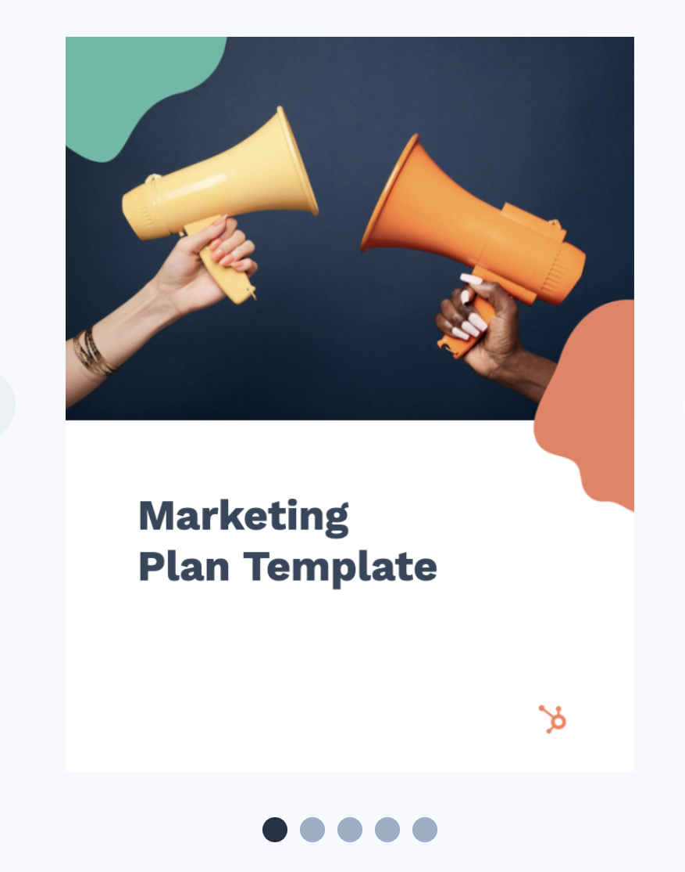
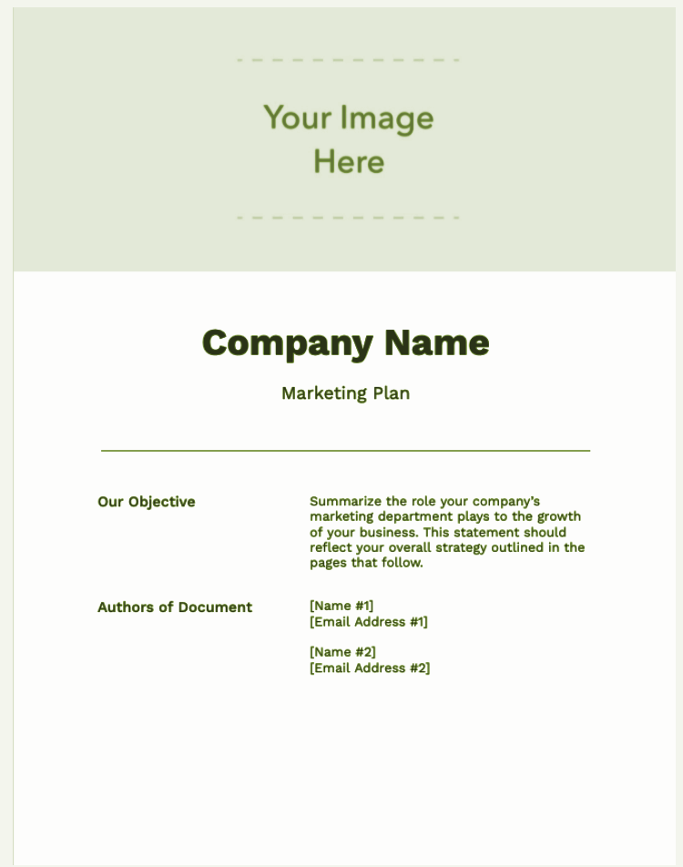
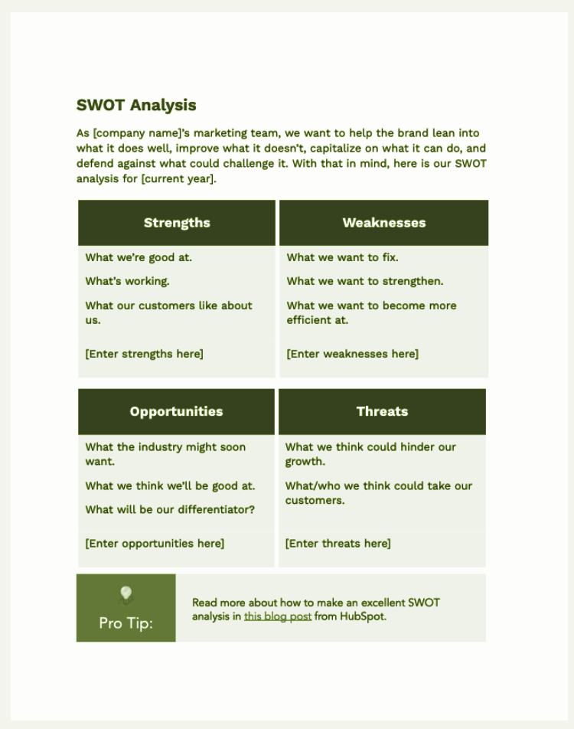
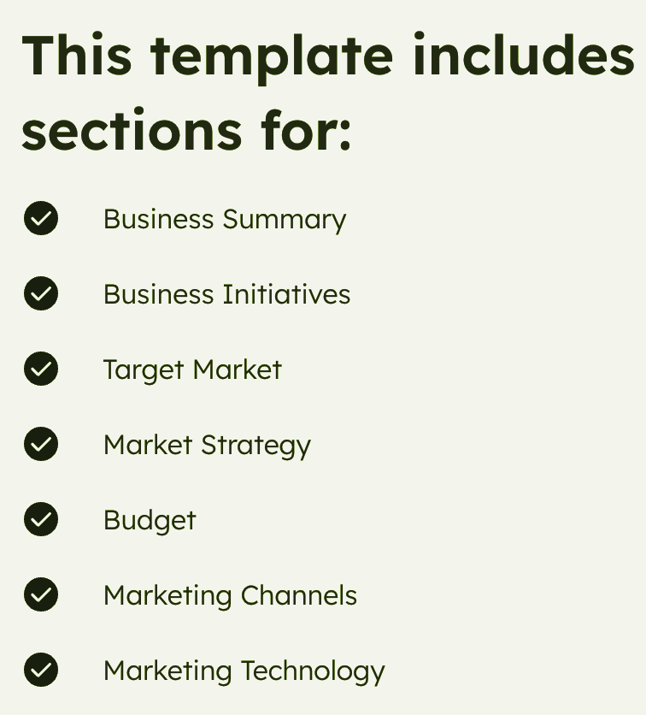
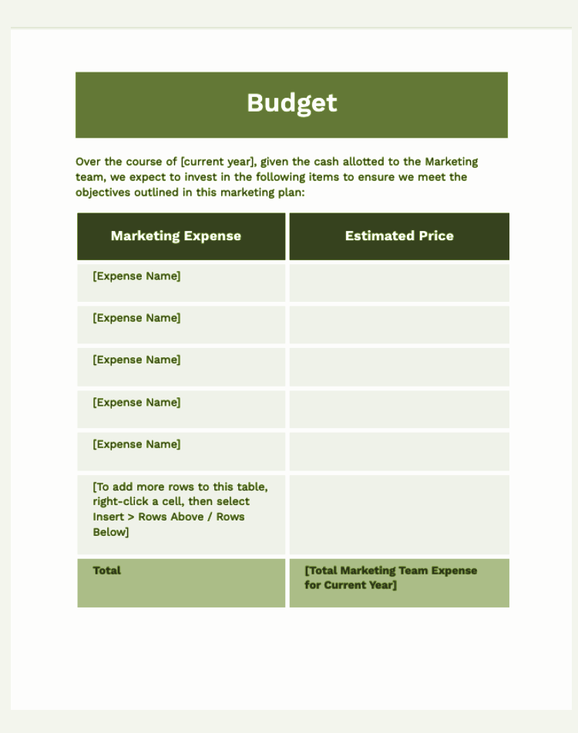
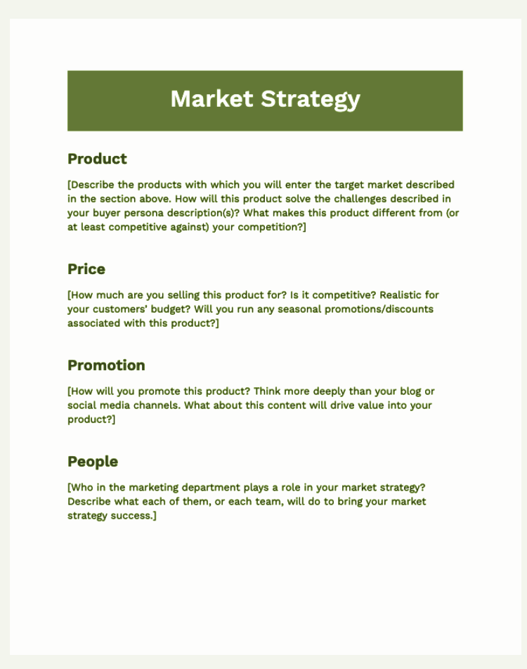
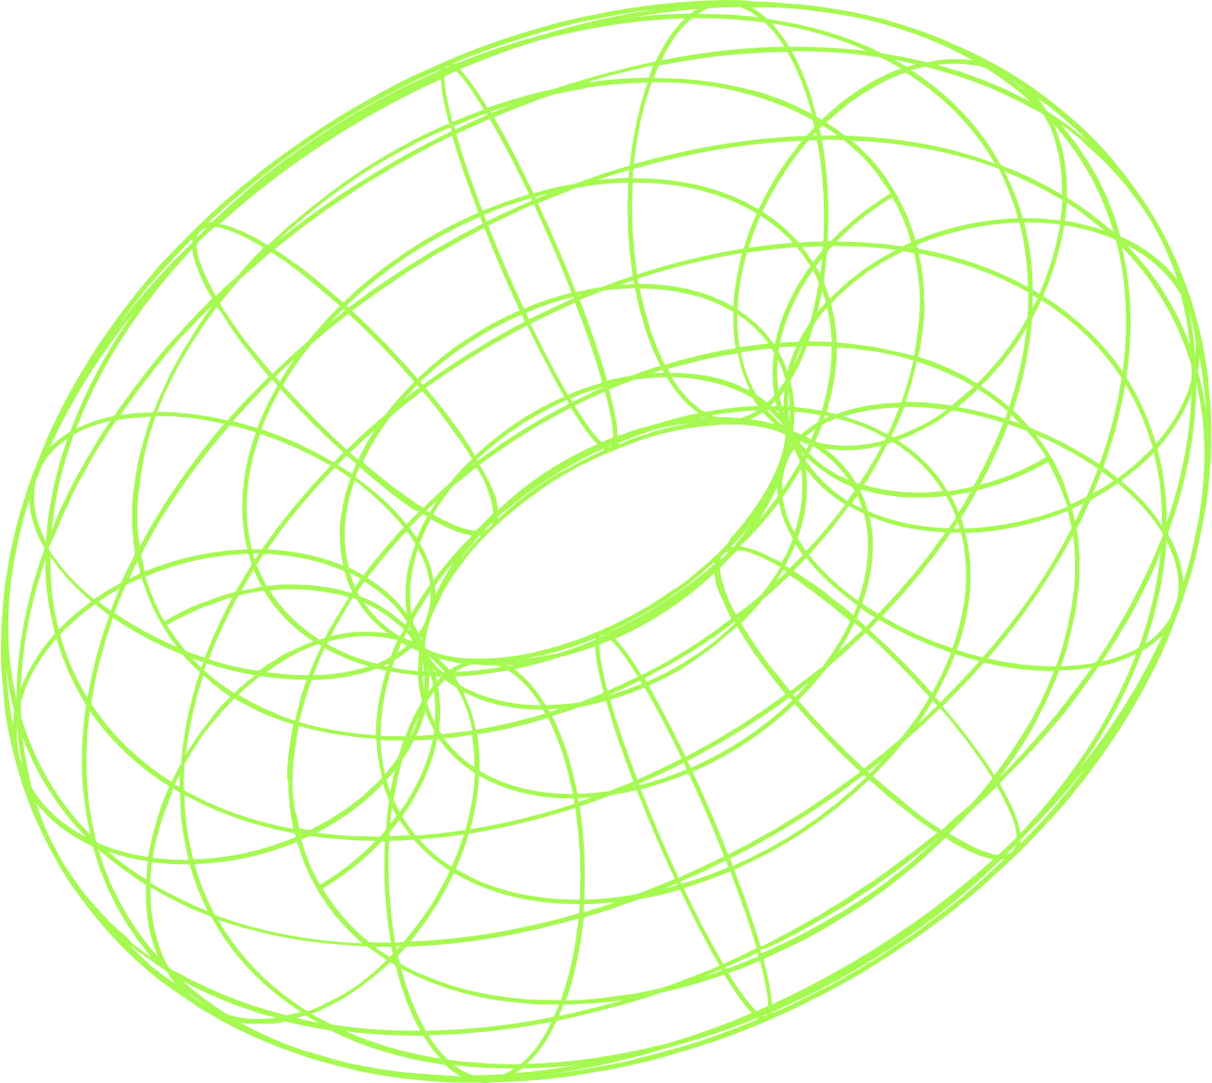
10
Paid media:
Your MEGAPHONE,
not your strategy
June 8-10, 2025, | Austin, Texas
Notes:
Next, paid media. It's a powerhouse, but it's crucial to understand its true role. Think of paid media as your megaphone. [Gesture towards megaphones]. It allows you to project your message far and wide, to reach specific audiences with incredible precision. But you can't just shout into a megaphone without a clear message. Your megaphone amplifies your strategy. [Point to marketing plan template]. It starts with defining your business, your target market, your market strategy, your budget. Paid media then becomes the tool to effectively scale and target that well-defined message. Without a solid strategy, you're just making noise; with one, you're commanding attention and driving action.
Goal: B2B paid media aims for high-quality lead generation, improved conversions, and increased marketing's contribution to the sales pipeline.
Key Channels:
Social Media Advertising: While platforms differ from B2C, social media is a top paid content marketing measure, with 73% of B2B content marketers allocating budget to it. LinkedIn Ads are particularly effective, with 65% of B2B organizations acquiring clients through them.
PPC (Pay-Per-Click): Remains strong, with 64% of B2B content marketers using it. Search engines offer B2B businesses an average close rate of 14.6%, significantly higher than traditional methods.
Video Marketing: Gaining significant momentum, with 69% of B2B marketers planning to increase investment in video content in 2024.
Digital Display Ads: Used by 62% of B2B content marketers.
Mobile Growth: Mobile accounted for nearly 48% of B2B ad spending in 2023 and is expected to surpass 50% by the end of 2025.

Slide 12
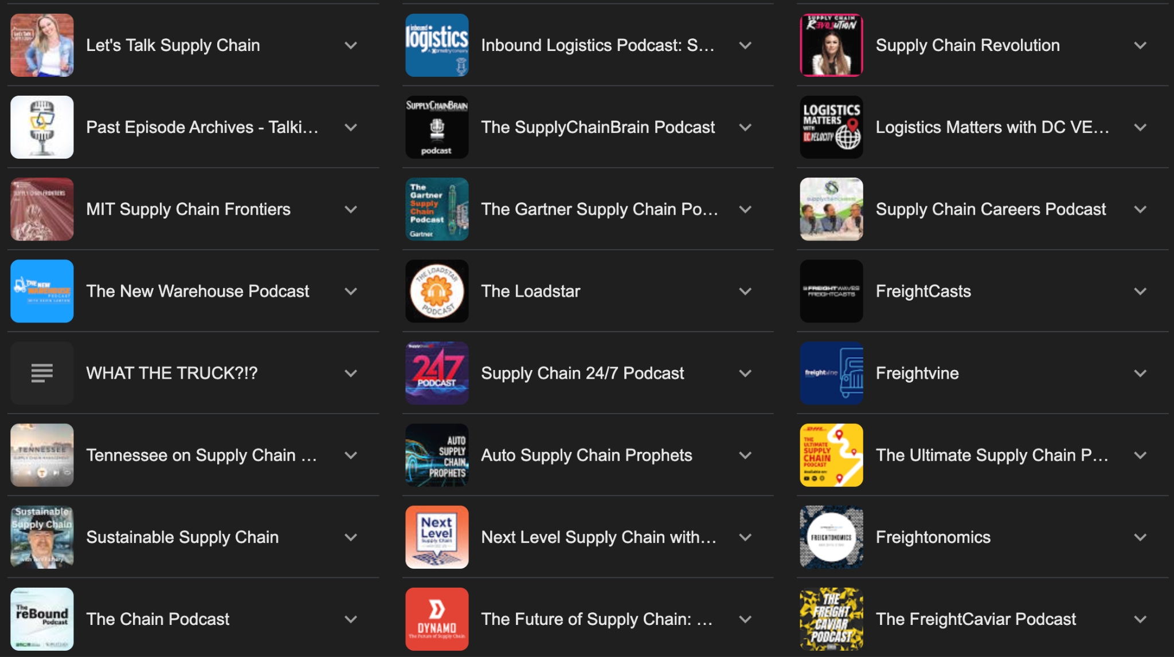
11
Influencer mktg:
the “options” will appear “endless,” but there is a best fit for you.
June 8-10, 2025, | Austin, Texas
Notes:
Now, influencer marketing. If you’ve started exploring this space, you know that the sheer volume of options can feel endless and overwhelming. From massive social media stars to highly specialized niche experts. But the critical takeaway here is: there is a best fit for your brand, for your audience, and for your specific marketing goals. Look at the example on this slide: niche podcasts focused purely on the supply chain industry. These are the B2B influencers. They may not have millions of followers, but they have the deep trust and attention of your exact target audience. The strategy is to ID those individuals or platforms who already have the trust and ear of your ideal customer, whose values align with yours, and then collaborate authentically to reach highly engaged, pre-qualified audiences
Key Point: In B2B, trust = currency. And trust is often built by people, not brands.
Story: Share how “Women in Supply Chain” or “Blended” featured a guest who saw a spike in inbound leads after sharing their episode—proof that influence is measurable.
Actionable Insight: Don’t chase celebrity. Choose micro-influencers who are relevant, consistent, and respected in your niche.
50 Best Procurement Pod https://procurementsoftware.site/blog/procurement-podcasts/

Slide 13
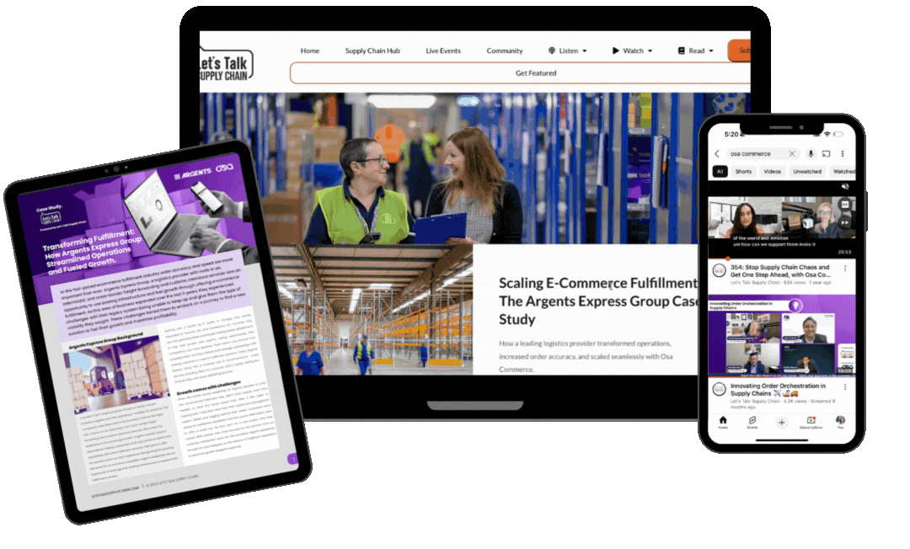
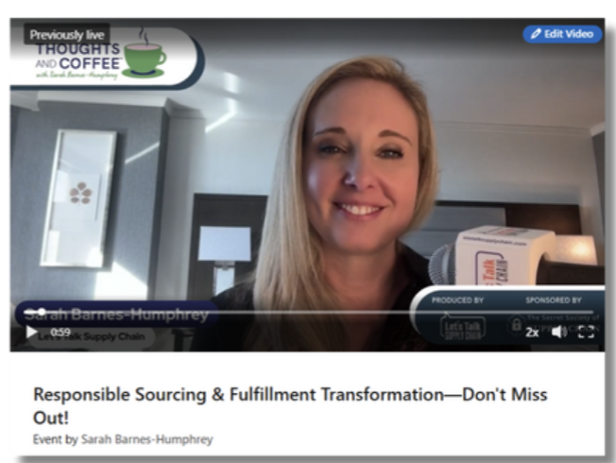
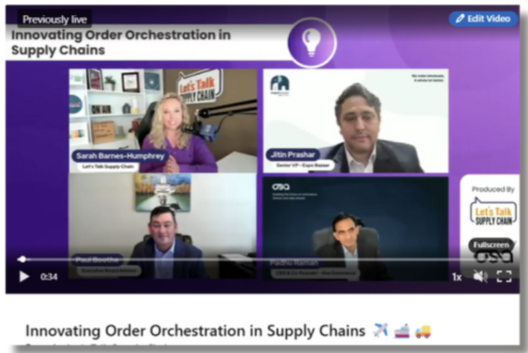
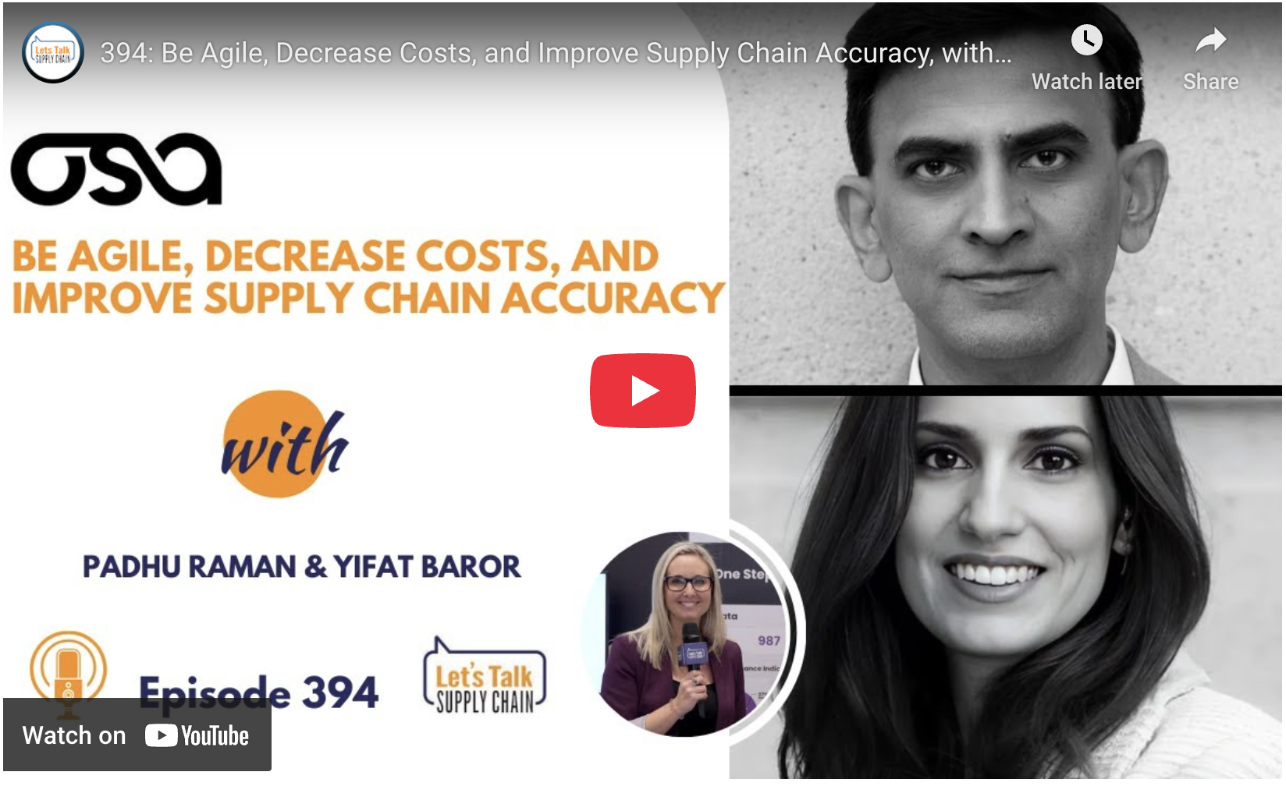
12
Putting
it all together
June 8-10, 2025, | Austin, Texas
Notes:
So, we’ve discussed the individual power of the Rule of 7, Paid Media, and Influencer Marketing. Now, let’s talk about the true game-changer: putting it all together. How do these distinct, powerful pieces interact to form a cohesive, unstoppable force that elevates your marketing efforts?

Slide 14
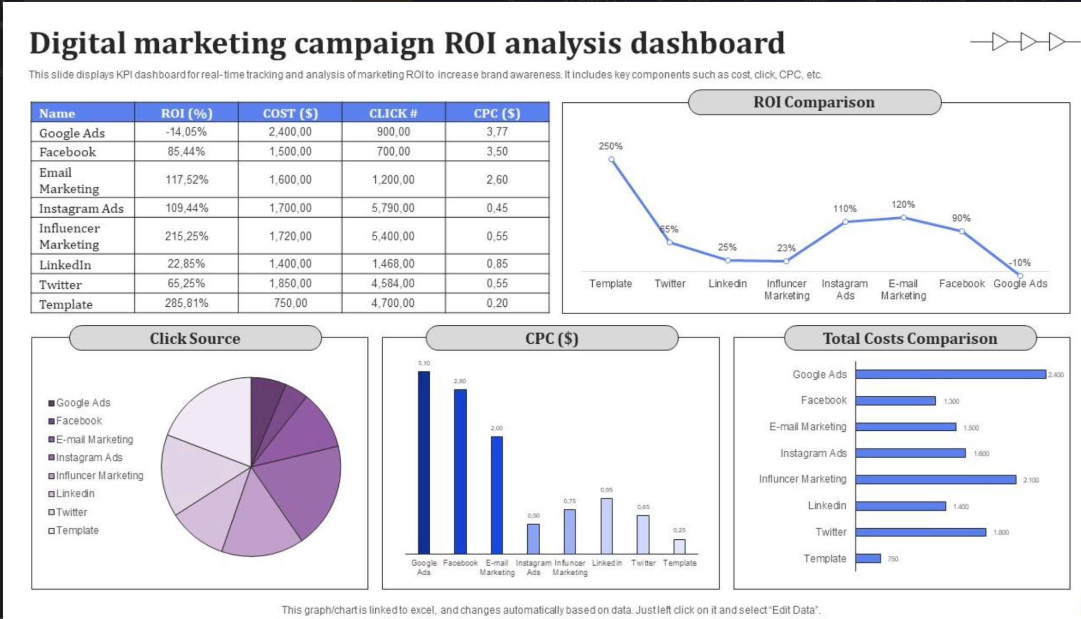
Roi analysis is table stakes,
but requires collaboration beyond vanity metrics
June 8-10, 2025, | Austin, Texas
Notes:
In today’s data-driven world, ROI analysis is no longer a luxury; it’s absolutely table stakes. If you're investing resources, you must know what you're getting back. However, the true value of ROI analysis goes far beyond tracking vanity metrics like likes or impressions. It demands deep collaboration – between marketing, sales, and even operations – to truly track conversions, understand pipeline contribution, measure customer lifetime value, and link marketing efforts directly to overall business impact. We need to look beyond surface-level numbers and understand the authentic, measurable value generated by our integrated efforts.

Slide 15
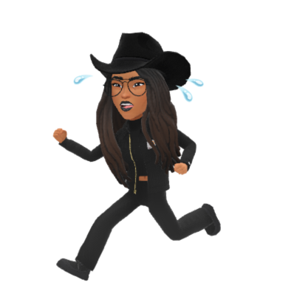
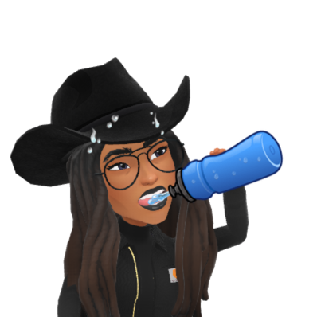
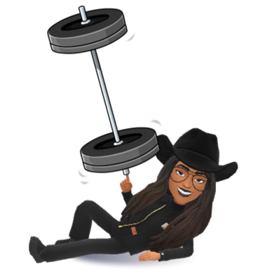
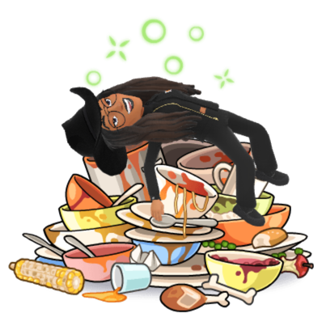

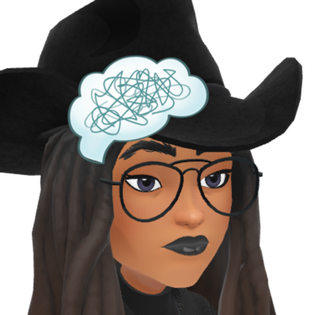
14
A practical example: “Race” “Training”
MILAGE
ENergy intake
hydration
cross-training
Rest / recovery
mentality
Base
Tempo
Speed
Blah
Blah
Whole foods
Gels
Chews
Blah
Blah
Water
Electrolytes
Blah
Blah
Blah
Weights
Yoga
Mobility
Blah
Blah
Sleep
Foam roller
Massage gun
Cold plunge
Blah
Visualization
Perspective
Affirmations
Blah
Blah
June 8-10, 2025, | Austin, Texas
Notes:
Let's ground this with a practical, personal example: preparing for a race, like a marathon. If you’re training, you wouldn't just focus on 'mileage,' would you? [Pause, look for nods]. No, you need proper hydration, strategic cross-training to build strength and flexibility, carefully planned mileage progression, disciplined energy intake, adequate rest and recovery to prevent injury, and a strong mental game. Each of these components, while distinct disciplines, is absolutely essential and interconnected for peak performance on race day. You can't truly debate which one is most important; they all contribute to the overall goal of finishing strong and performing your best.

Slide 16
We don’t debate the essentials when it’s personal. It’s all essential.
So, don’t debate the essentials when it’s business. It’s all essential.
June 8-10, 2025, | Austin, Texas
Notes:
And this leads to our core message today. When it's personal, when it's our health, our fitness, or a deeply important goal, we instinctively understand that all the essential elements must work together. We don’t debate if hydration is more important than mileage. They’re all essential. So, why do we sometimes debate the essentials when it comes to business? In marketing, the Rule of 7, paid media, influencer marketing, your content, your analytics – they are not standalone tactics. They are interconnected, essential pillars of a truly successful, integrated strategy. Embrace the 'all essential' mindset for your business.

Slide 17
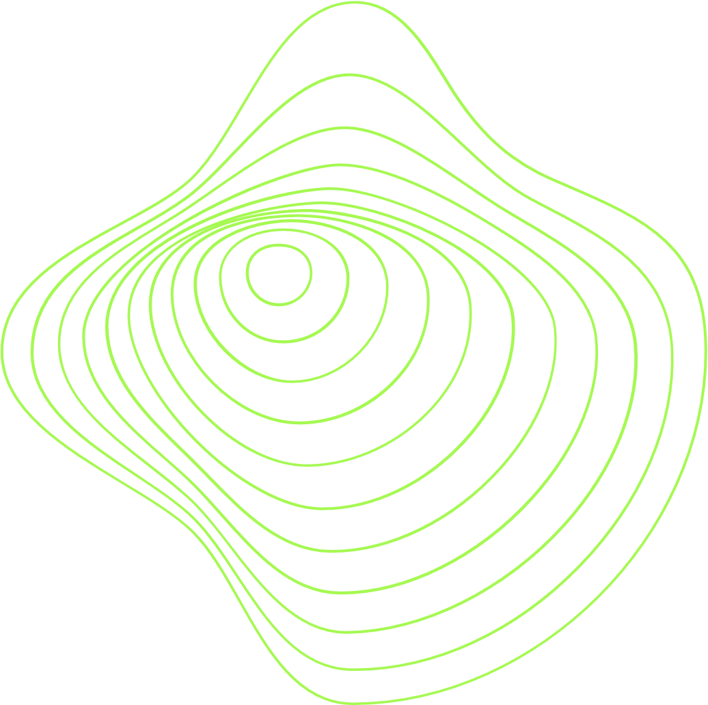
15
ID your most impactful marketing channel today.
Brainstorm 1-2 specific, measurable tactics (i.e., a precise retargeting campaign, a micro-influencer product review) you could implement to strategically amplify its reach
Name a defined objective (i.e., increase leads by X%, boost brand awareness among a new segment) using either paid media or an influencer partnership.
“GROUP DISCUSSION”\
June 8-10, 2025, | Austin, Texas
Notes:
Think about what's working well now, and how you can inject more power and precision into it. What specific paid ads or types of influencers could truly move the needle for that particular channel and a specific goal?

Slide 18
15
Pinpoint a specific stage or 'bottleneck' in your buyer's journey where prospects frequently 'drop off.'
Brainstorm 2-3 distinct, value-driven touchpoints (i.e., a personalized case study email, an interactive tool, a series of educational videos, a direct sales outreach with relevant content) you could implement to re-engage them and provide value (aiming for that '7+' principle) at that critical juncture.
“GROUP DISCUSSION”\
June 8-10, 2025, | Austin, Texas
Notes:
This is about being strategic with your touchpoints. Where are you losing people, and how can you proactively deliver value multiple times to bring them back into the fold? Think beyond just 'more emails' – consider different content types and channels.

Slide 19
16
ID 1-2 specific entities or individuals (i.e., industry associations, complementary technology providers, renowned academics, specific industry media outlets) who already hold significant trust with your target audience.
Brainstorm 1-2 concrete collaboration or co-creation ideas (i.e., co-hosting a webinar on a shared challenge, a joint research paper, a mutual guest blogging series) that would mutually benefit both parties and enhance your brand's credibility and reach.
“GROUP DISCUSSION”
June 8-10, 2025, | Austin, Texas
Notes:
This pushes beyond simply paying for endorsements. Who else is already a trusted voice in your space, and how can you genuinely partner with them to leverage that trust for mutual gain and to reach new, highly relevant audiences?

Slide 20
16
Select one piece of your existing, high-performing content or a recent campaign.
ID three distinct channels (i.e., your blog, LinkedIn, a podcast, email newsletter, Instagram/TikTok Shorts, a concise infographic) where you could repurpose this asset.
Briefly discuss how you would adapt the format and messaging for each channel to maximize its impact and reach different segments of your audience, demonstrating the 'all essential' principle.
“GROUP DISCUSSION”
June 8-10, 2025, | Austin, Texas
Notes:
This is about working smarter, not harder. You've already invested in creating great content. How can you strategically break it down, reformat it, and distribute it across different platforms to ensure it gets the '7+ touches' it deserves and reaches new audiences in their preferred formats?

Slide 21
17
Integration is essential, start with what you have
The Rule of 7+ isn’t myth, it’s cerebral
Paid media = megaphone once strategy is in place
Influencers come a dime a dozen, invest the time to ID YOUR best fit, the ROI is high.
Analytics & insights > Metrics
recap
June 8-10, 2025, | Austin, Texas
Notes:
Let's bring it all back together with a quick recap of our core takeaways from today:
Integration is essential: Don't work in silos. Start by connecting what you already have.
The Rule of 7+ isn’t myth; it’s cerebral: It's about the psychological impact of consistent, value-driven presence, not just a simple number.
Paid media is your megaphone: It effectively amplifies your message and strategy once you have a solid one in place.
Influencers are abundant, but choose wisely: Invest the time to ID the best fit for your brand and target audience – the ROI when you do this strategically can be incredibly high.
Analytics & insights trump vanity metrics: Always focus on what truly drives business results and strategic decision-making, not just superficial numbers.

Slide 22
Visibility without strategy is noise.
Strategy without visibility is nonexistence.
The sweet spot?
An integrated plan with repeatable, human-centered touchpoints.
An integrated plan where every facet is ESSENTIAL.
That’s your modern playbook.
June 8-10, 2025, | Austin, Texas
Notes:
Let's conclude with this powerful thought that really encapsulates our session today: Visibility without a clear strategy is just noise – you're seen, but not understood, and not effective. And equally, a brilliant strategy without any visibility is nonexistence – it’s a great plan that no one ever sees. The sweet spot, the true essence of 'The Modern Marketer’s Playbook,' is an integrated plan. A plan built with repeatable, human-centered touchpoints. A plan where every single facet, from your owned content to your targeted paid ads to your authentic influencer collaborations, is absolutely essential and works together in perfect harmony. This is how we move from just doing marketing to truly elevating our impact and building sustainable success.

Slide 23
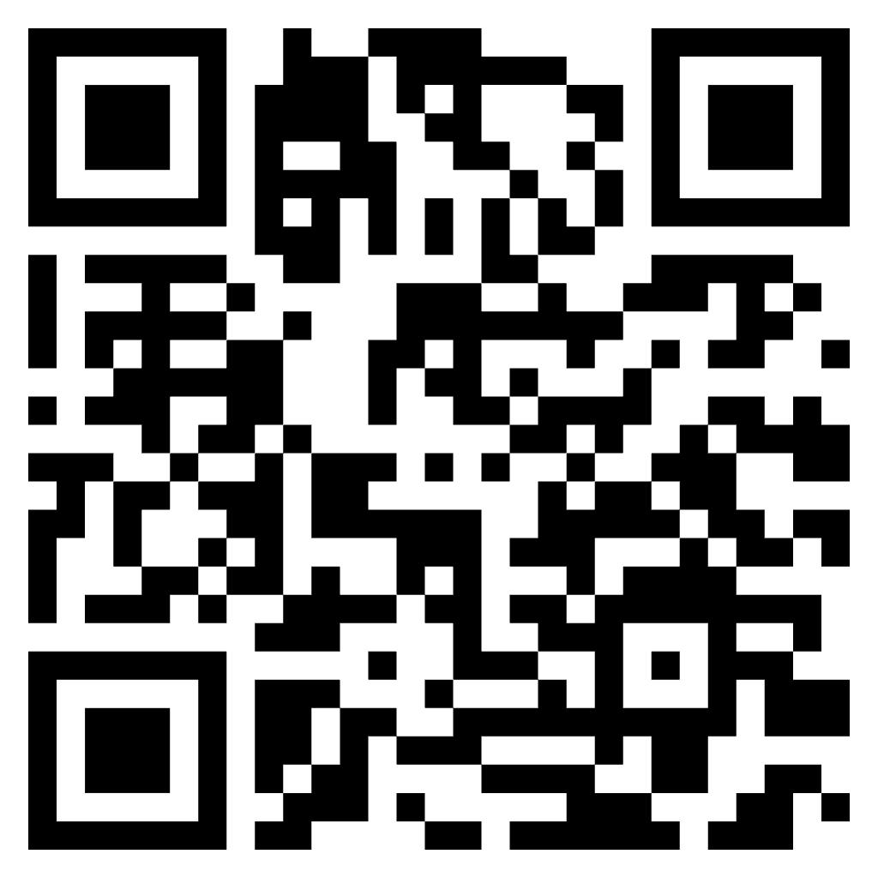
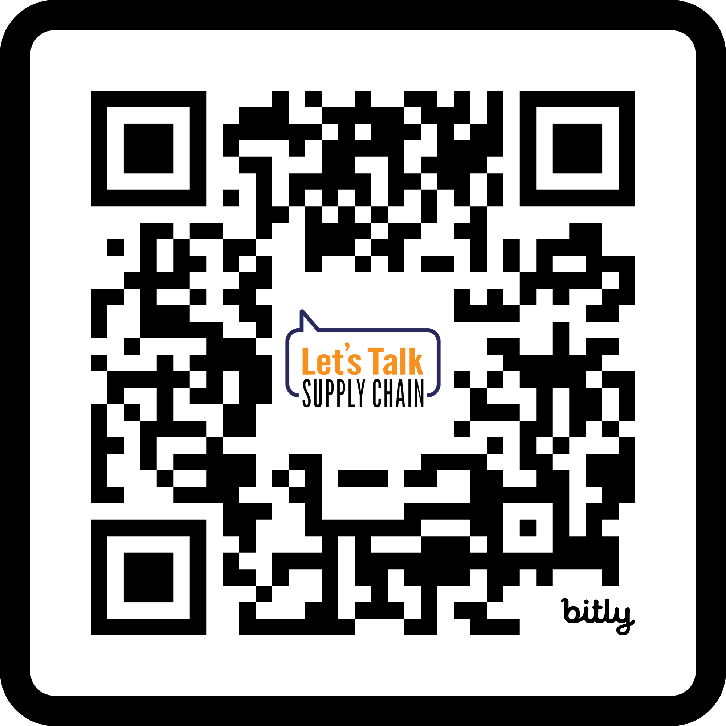
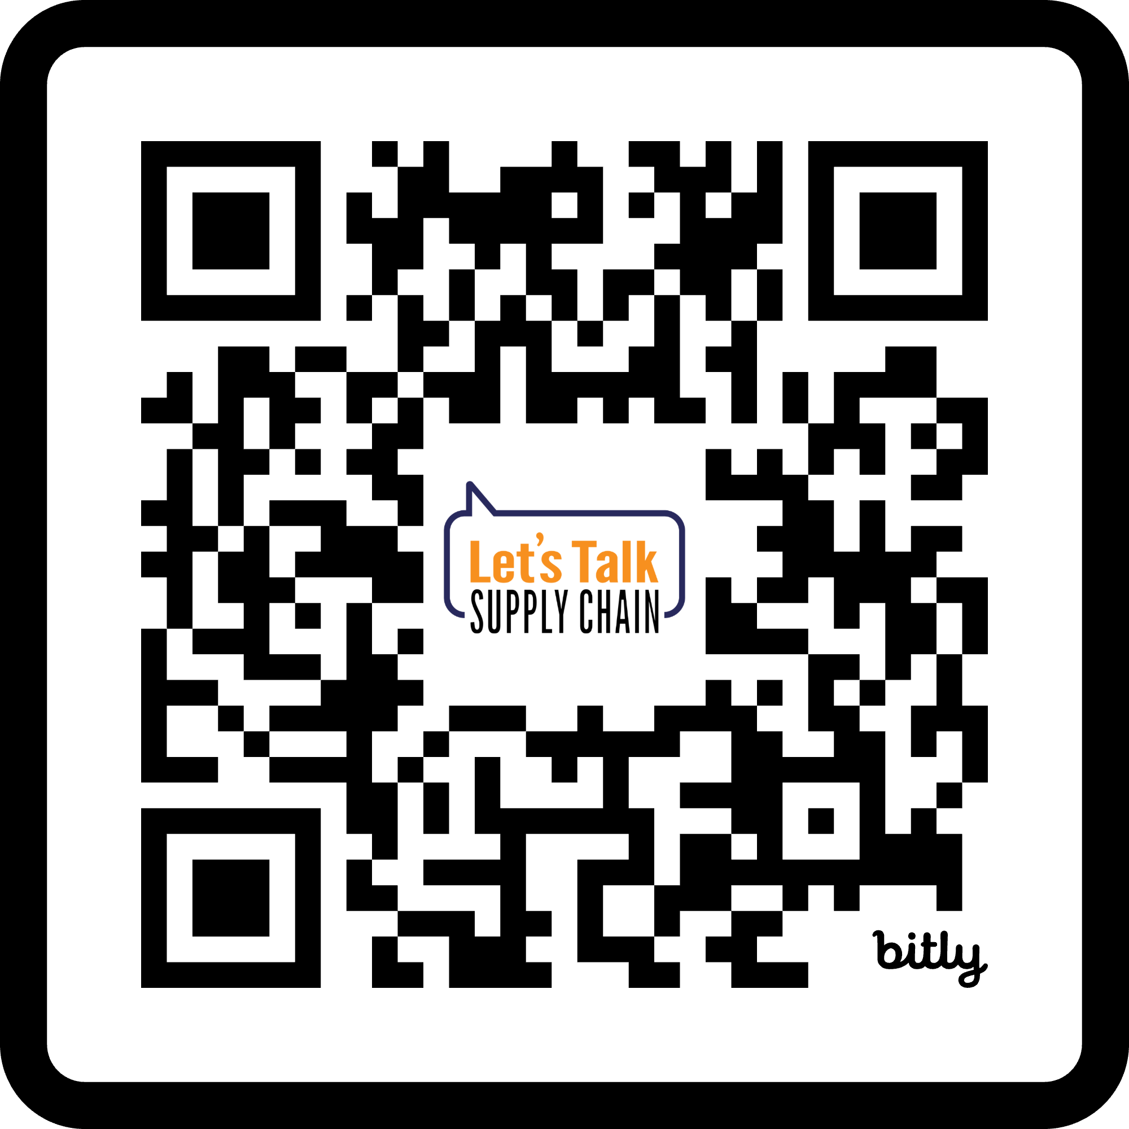
Marketing Plan Template
“7 Touchpoint Checklist”
“Content repurposing template” (use to turn one piece of content into multiple assets)
BONUS Tools you can use
June 8-10, 2025, | Austin, Texas
Notes:
As a thank you for your incredible engagement and participation today, we've put together some bonus tools to help you immediately put these concepts into action. You'll have access to a comprehensive marketing plan template, a '7 Touchpoint Checklist' to help you map out your customer journey, a content repurposing template to maximize your assets, and a real-world case study showing how a supply chain brand successfully turned one live show into over 10 different content pieces across various channels. These resources are designed to help you start building your modern playbook today.
Case study: How a supply chain brand turned one live show into 10+ content pieces across channels.

Slide 24
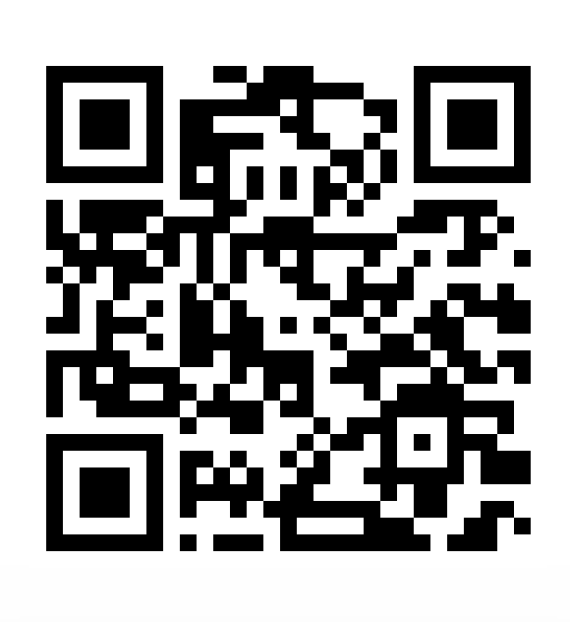
Thanks y’ALL!
June 8-10, 2025, | Austin, Texas
Notes:
Thank you all so much for your time, your insights, and your active participation today! I hope you found this session valuable and leave feeling inspired and equipped to elevate your marketing efforts through integration. Please feel free to connect with me afterward if you have any further questions or want to discuss these concepts further. Enjoy the rest of TMSA Elevate 2025!

