Slide 1


TMSA Member meeting
June 8-10, 2025, | Austin, Texas

Slide 2
Agenda
TMSA vision and mission (Jen)
TMSA Current status (BETH)
Topics Covered
Tmsa board of directors slate (David)
A look to the future (jen)
June 8-10, 2025, | Austin, Texas

Slide 3
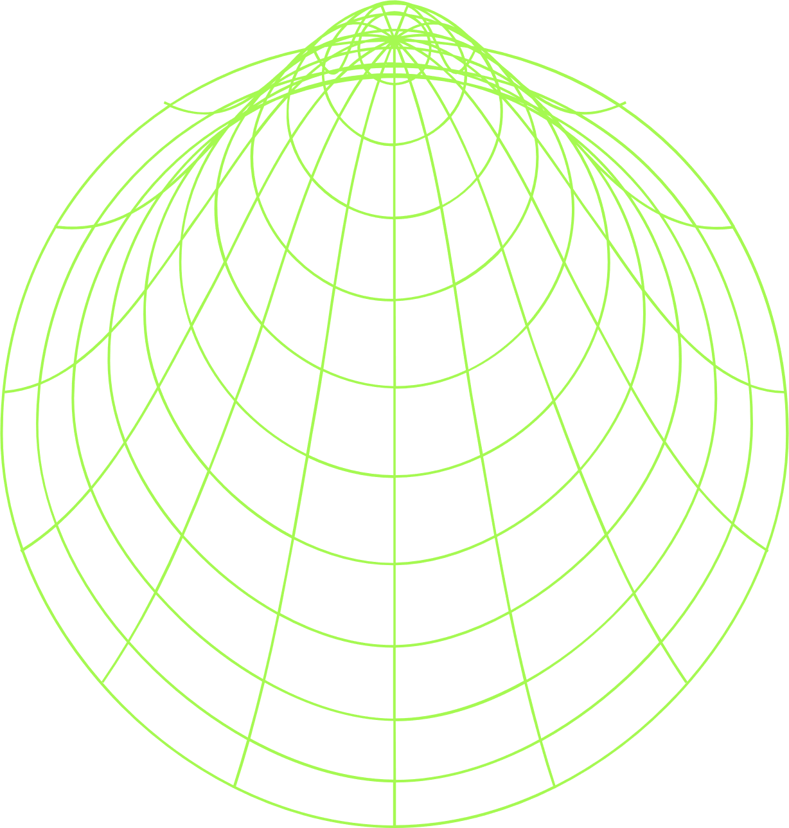
vision
mission
TMSA's vision is to be the pre-eminent non-profit sales and marketing association that transportation and logistics professionals turn to for industry-specific education, connections and resources.
TMSA’s mission is to enable sales and marketing professionals to learn and give back to the transportation and logistics industry through education, connections and resources, ultimately strengthening their individual development, their businesses and the industry-at-large.
June 8-10, 2025, | Austin, Texas

Slide 4
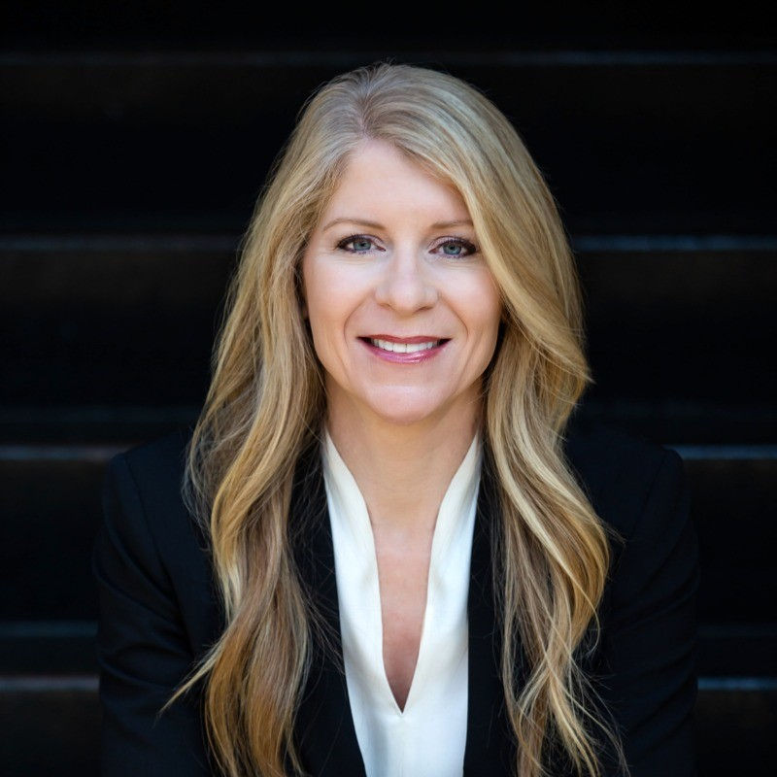

TMSA presidential update
Beth Malik
President, TMSA
Senior Director of Marketing, SMC³
June 8-10, 2025, | Austin, Texas

Slide 5

THANK
YOU!
June 8-10, 2025, | Austin, Texas

Slide 6



Thank you sponsors!
Gold sponsors
SILVER sponsor
bronze sponsors
June 8-10, 2025, | Austin, Texas

Slide 7



Thank you sponsors!
Corporate sponsors
Supporting sponsors
Media Partners
June 8-10, 2025, | Austin, Texas

Slide 8
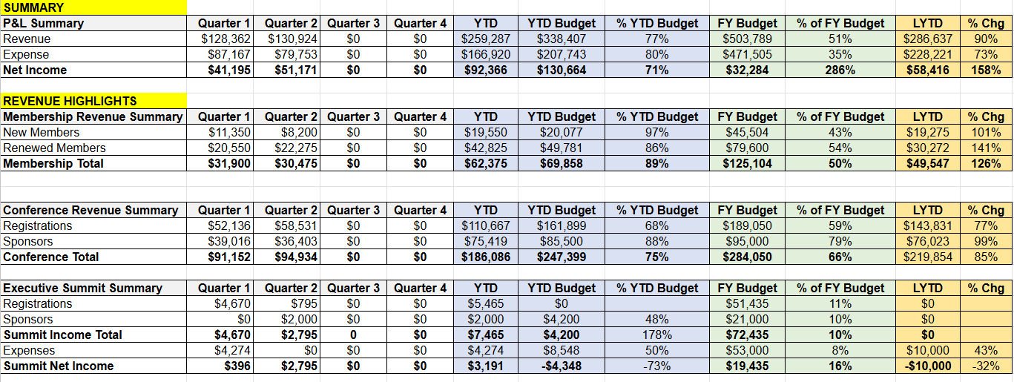
$221,328.50
TMSA financials
Total Liabilities & Equity: $221,328.50
Accounts Receivable: $0
June 8-10, 2025, | Austin, Texas

Slide 9
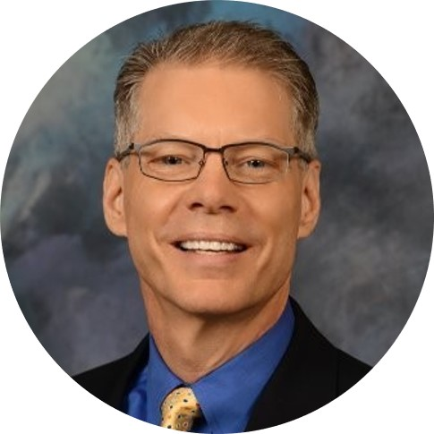
TMSA board slate
David Hoppens
^{VP Sales & Marketing}
Momentum Transportation – Landstar Agent
^{TMSA Succession Chair}
June 8-10, 2025, | Austin, Texas

Slide 10
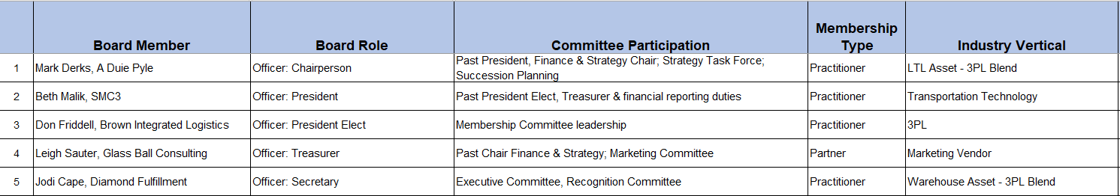
TMSA board: Executive team
June 8-10, 2025, | Austin, Texas

Slide 11
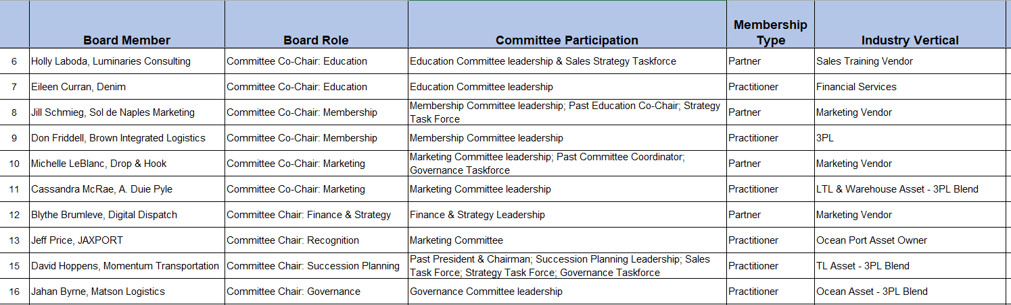
TMSA board: committee chairpersons
June 8-10, 2025, | Austin, Texas

Slide 12
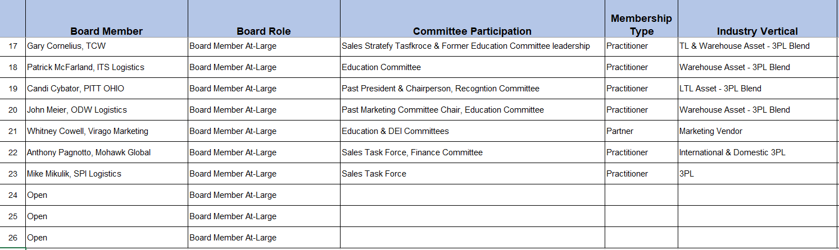
TMSA board: at-large positions
June 8-10, 2025, | Austin, Texas

Slide 13
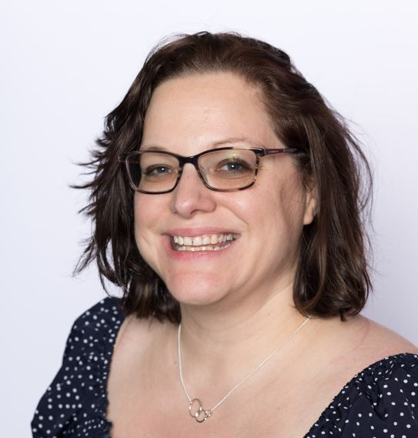
TMSA: an Update
Jennifer Karpus-Romain
^{Executive Director}
^{TMSA}
June 8-10, 2025, | Austin, Texas

Slide 14

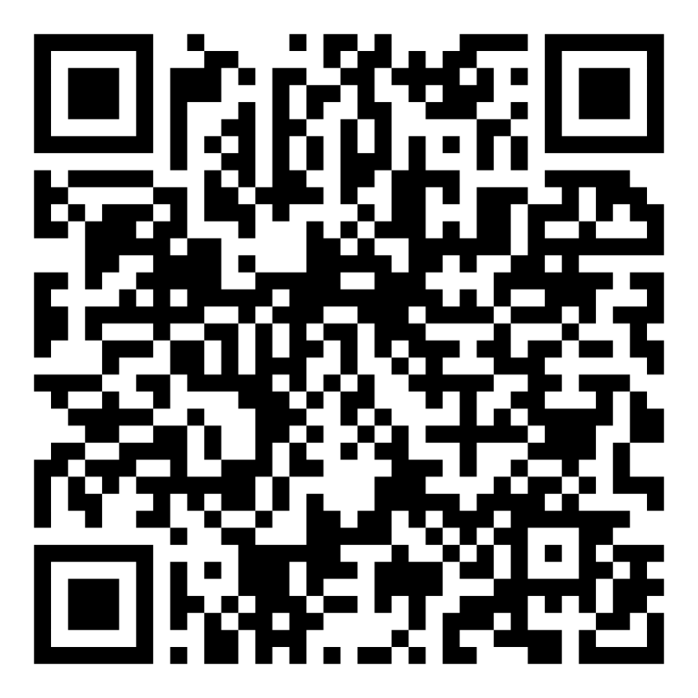
Interested in hearing from the president elect?
June 8-10, 2025, | Austin, Texas

Slide 15
Looking to get more
involved?
June 8-10, 2025, | Austin, Texas

Slide 16
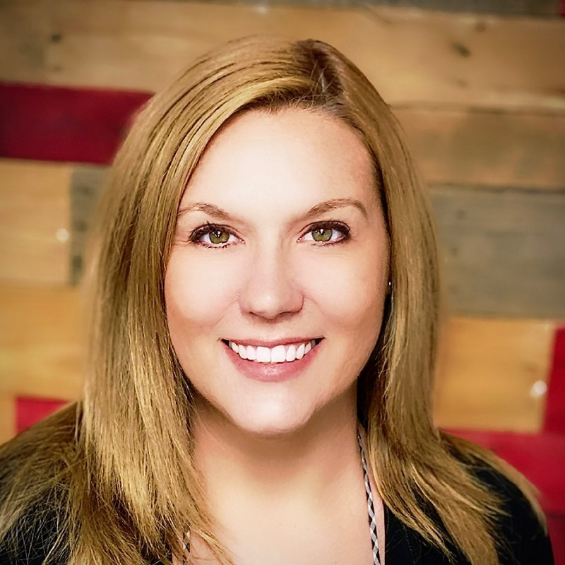

TMSA staffing update
Jennifer Karpus-Romain
^{Executive Director}
^{TMSA}
Eileen Dabrowski
Programs and Membership Director
^{TMSA}
Morgan Vertner
Marketing Coordinator and Podcast Producer
^{TMSA}
June 8-10, 2025, | Austin, Texas

Slide 17
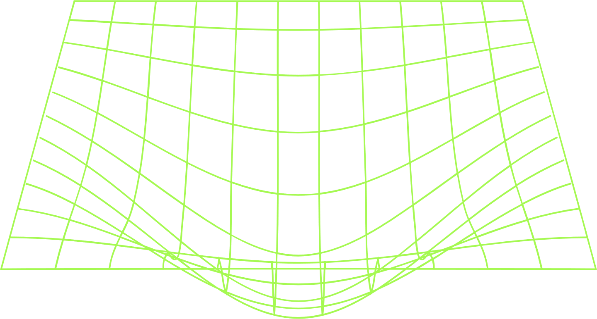
TMSA: The Past year
Centennial in the books
On the move celebrated its one-year anniversary
Launched the 2024 edition of its benchmarking study
Launched Future Forward Volunteer Program
Expanded partner relationships within the industry
Member portal improvements
June 8-10, 2025, | Austin, Texas

Slide 18
What’s Next?
June 8-10, 2025, | Austin, Texas

Slide 19

workshop
June 8-10, 2025, | Austin, Texas

Slide 20
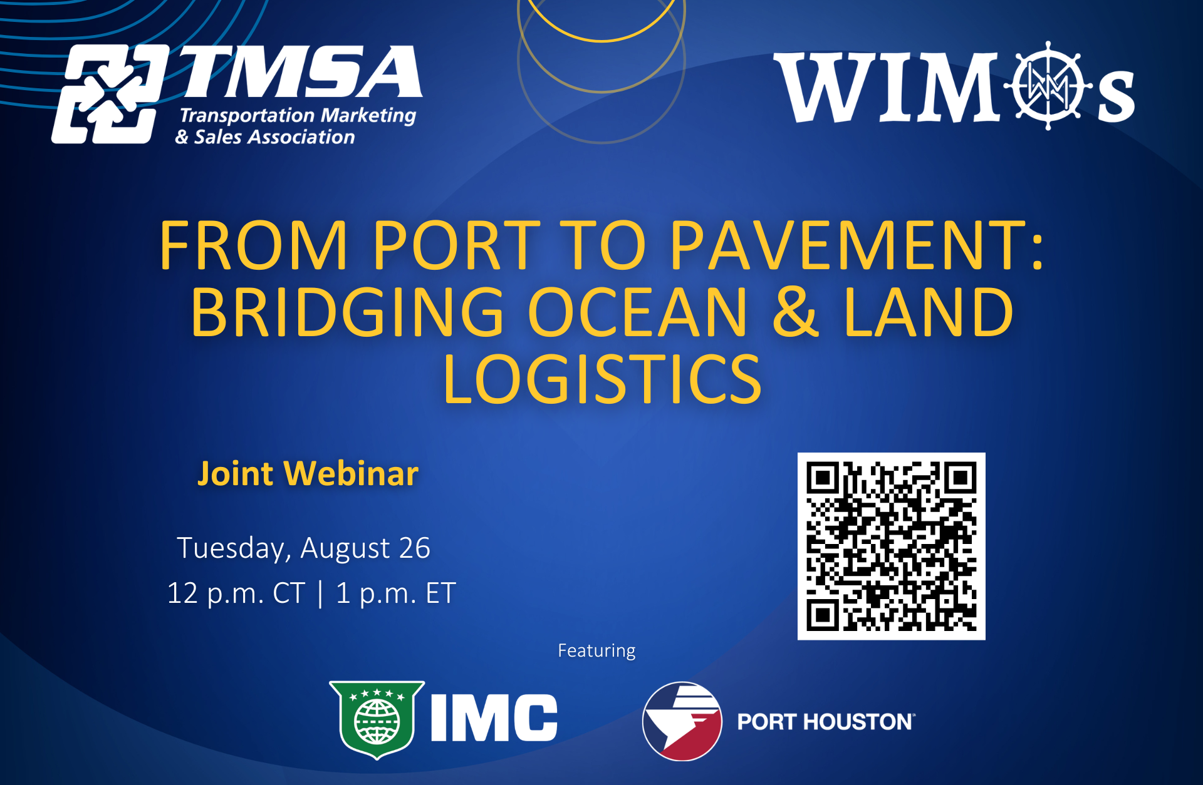
Port to pavement webinar
June 8-10, 2025, | Austin, Texas

Slide 21
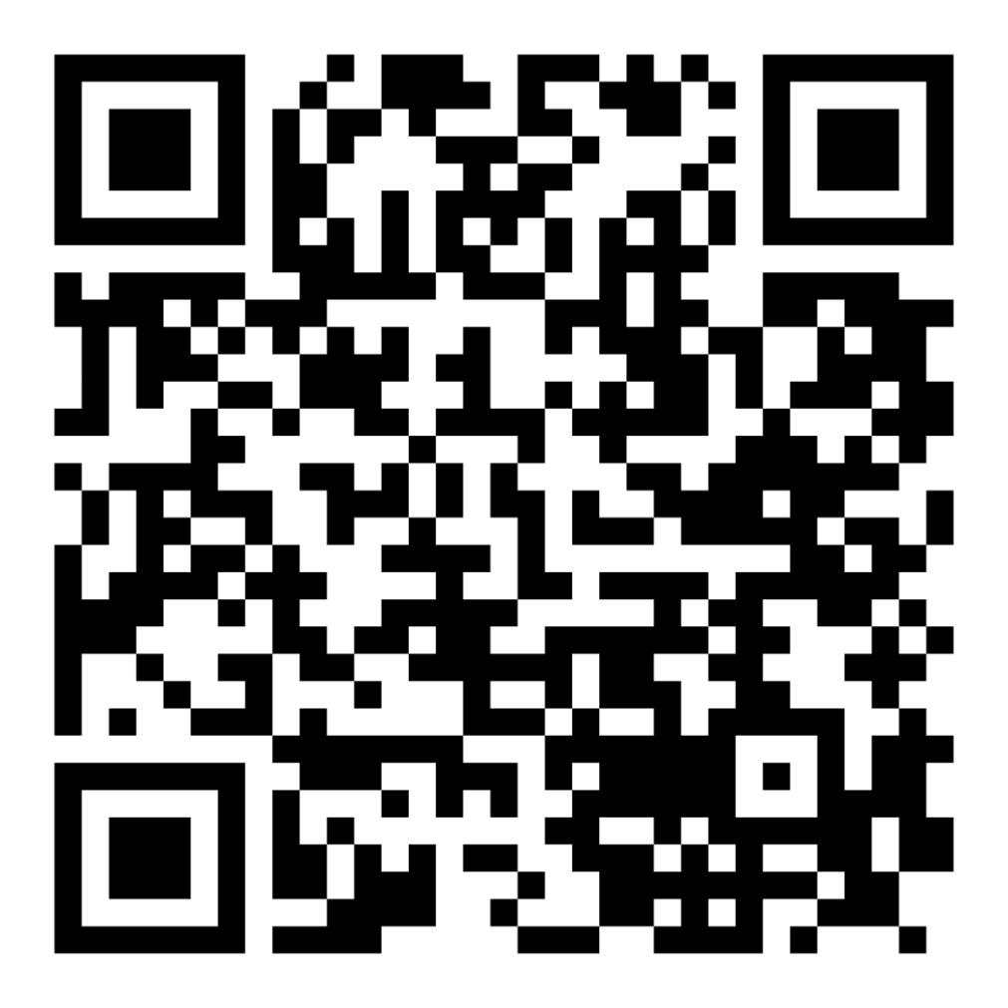
2025 TMSA executive summit
chicago | October 22-23, 2025
Early Bird pricing
June 8-10, 2025, | Austin, Texas

Slide 22
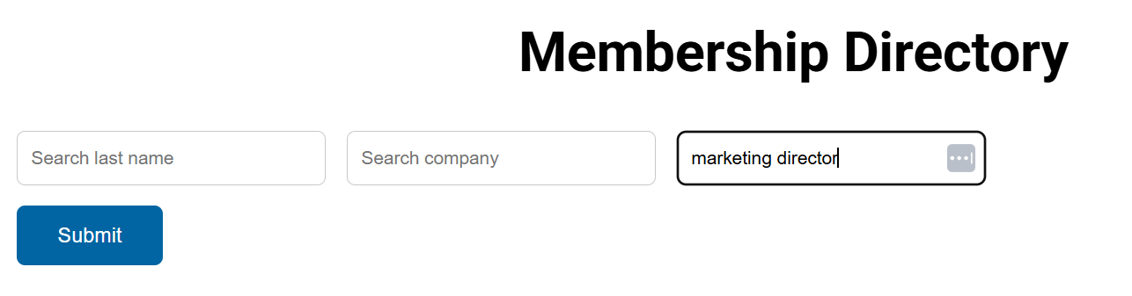
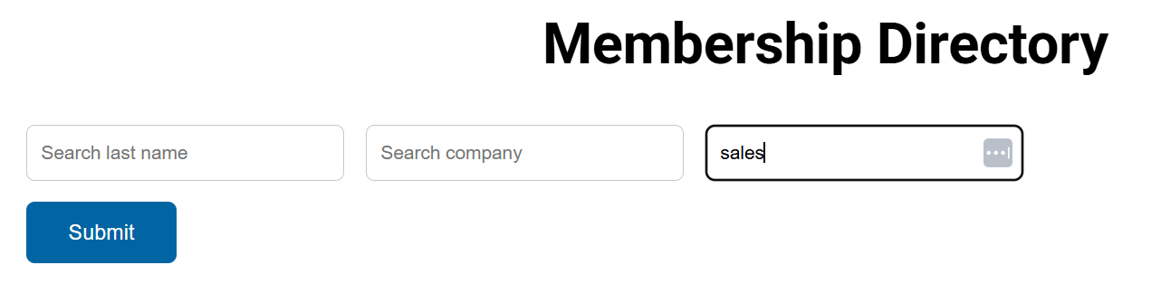
Resource
improvements
June 8-10, 2025, | Austin, Texas

Slide 23
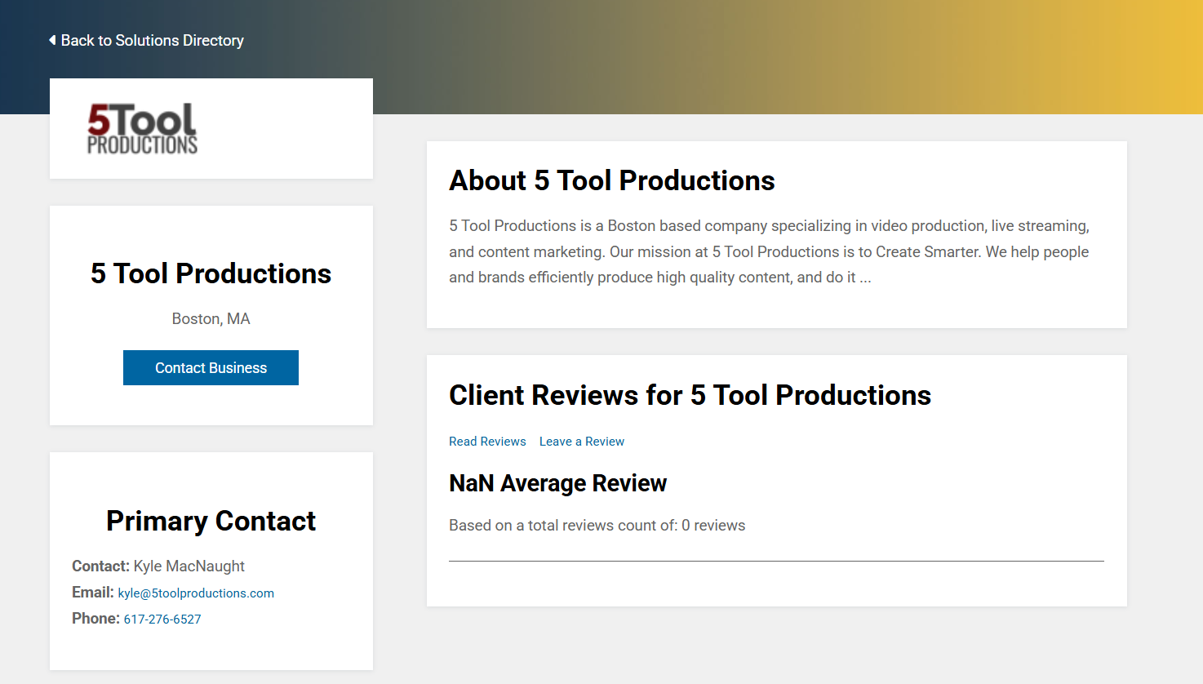
Resource
improvements
June 8-10, 2025, | Austin, Texas

Slide 24
Where is tmsa
headed in 2026?
June 8-10, 2025, | Austin, Texas

Slide 25

2026 TMSA elevate
Denver, Colorado | June 5-7, 2026
June 8-10, 2025, | Austin, Texas

Slide 26
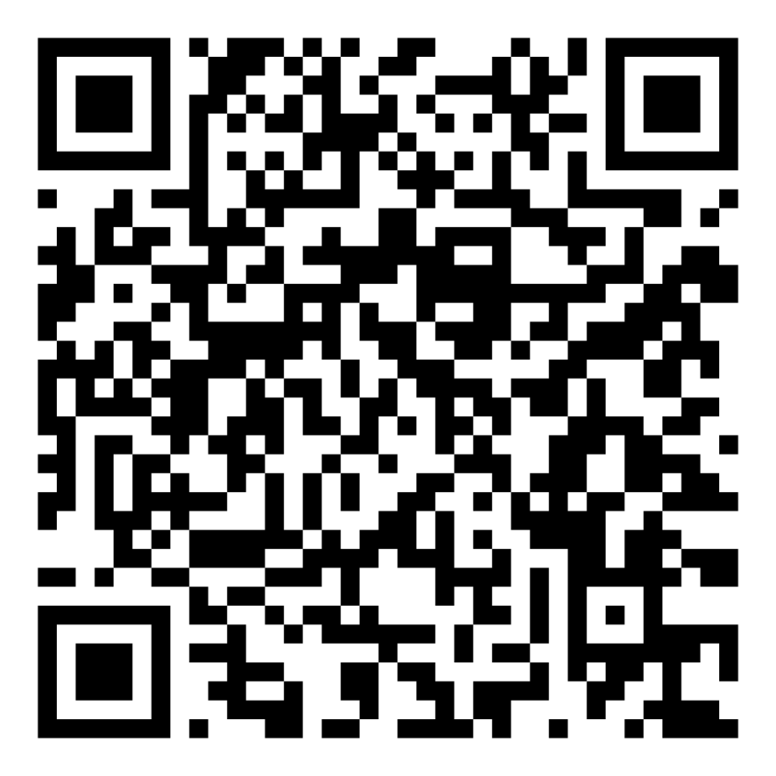
2026 TMSA elevate
Denver, Colorado | June 5-7, 2026
FLASH SALE
June 8-10, 2025, | Austin, Texas

Slide 27
Thank you!
June 8-10, 2025, | Austin, Texas

