Slide 1


The Science OF Cold Outreach
June 8-10, 2025, | Austin, Texas

Slide 2


6
Former Broker
Started off at NTG
Why Listen To Me?
Top Salesman At Challenger Motor Freight
Sold $5.9M in freight spend
Head Of Sales For A VC Startup
Figured how to sell an entirely new product category
Co-Founder ImportYeti
Over 200K customers
June 8-10, 2025, | Austin, Texas

Slide 3
Agenda
Why use data?
Starting Metrics
Topics Covered
Finding Your StrengthS
Taking Action
June 8-10, 2025, | Austin, Texas

Slide 4


4
Why Use Data?
So you can know your strengths and capitalize on them
June 8-10, 2025, | Austin, Texas

Slide 5


5
Casinos
June 8-10, 2025, | Austin, Texas

Slide 6
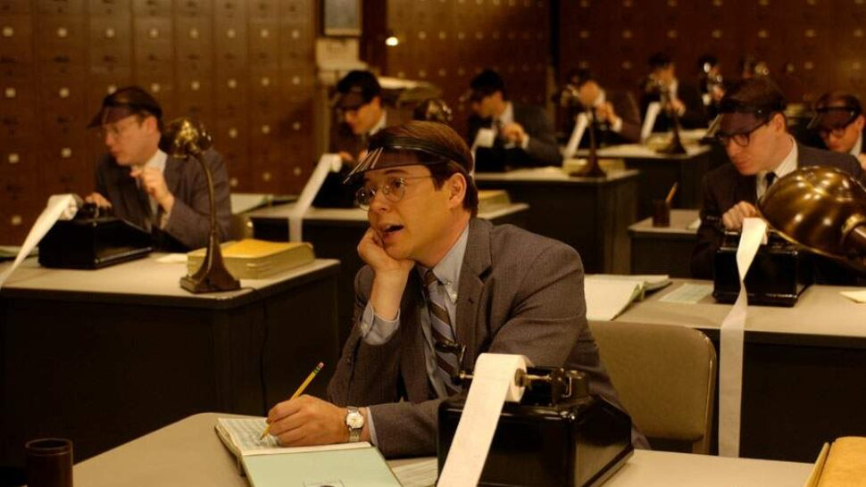
6
Variance
Basics Of Statistics
Smaller sample sizes cause larger swings in outcomes
Edge
The advantage an outcome has of occurring over other outcomes
Correlation
How much do two events effect the other
Significance
How much does the data point matter
June 8-10, 2025, | Austin, Texas

Slide 7

7
Starting Metrics
The easiest ways to breakdown if you are succeeding in cold outreach
June 8-10, 2025, | Austin, Texas

Slide 8
8
Outreach
Meetings
Quotes
June 8-10, 2025, | Austin, Texas

Slide 9
9
Outreach Per Meeting
How many calls do we need per meeting?
Understanding How Your Inputs Lead TO Deal
Meetings Per Quote
How many meetings do we have before we get a quote?
Quotes Per Deal
How many quotes do we need to land a deal?
June 8-10, 2025, | Austin, Texas

Slide 10
10
So What Does THis Look Like?
Outreachs Per Meeting
Meetings Per Quote
Quotes Per Deal
Outreachs Per Deal
17
3
5
255
June 8-10, 2025, | Austin, Texas

Slide 11
11
Average Deal Size
Outreach Per Deal
$ Per Outreach
June 8-10, 2025, | Austin, Texas

Slide 12
12
$20,000
255
$ 78.43 Per Outreach
June 8-10, 2025, | Austin, Texas

Slide 13
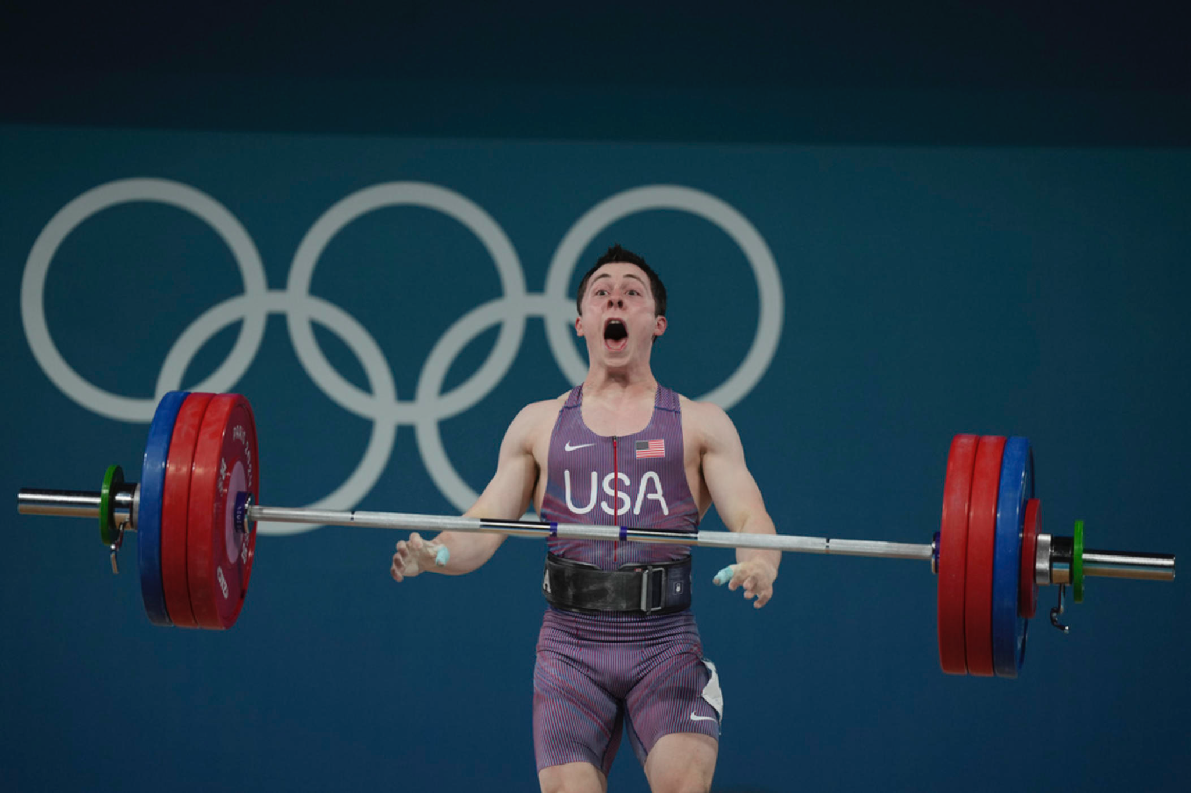
13
Finding YOur Strengths
Where are we winning the most?
June 8-10, 2025, | Austin, Texas

Slide 14
14
Getting Better From Our Data
Analyze our copy
Experiment
Diving deeper
Always Improve
What forms of outreach do we get the most responses from?
Try different verbiage and see what gets the most responses
There’s data within the data… dataception
You’ve bumped response rates to 20% now let’s get to 25%
June 8-10, 2025, | Austin, Texas

Slide 15
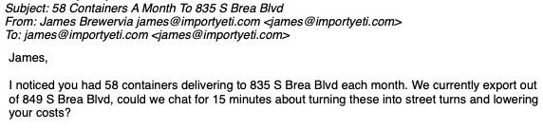
15
Where do People Respond
Analyzing Our Copy
First and last emails most responded
Polling
Chat with potential decision makers
Subject Over Body
Emails with longer Subjects get more responses
June 8-10, 2025, | Austin, Texas

Slide 16

16
A/B Testing
Experimenting
Which words work better
Trying New Forms of media
Snail mail, videos and more!
Challenge Norms
Does your outreach actually stand out
June 8-10, 2025, | Austin, Texas

Slide 17
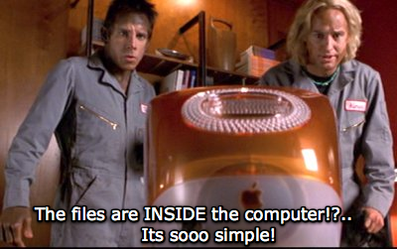
17
Read Time
Diving Deeper
How long does someone view your marketing material
End Point
Where do users leave your marketing material
Open Rate
Is your email grabbing their attention?
June 8-10, 2025, | Austin, Texas

Slide 18
18
Improving
June 8-10, 2025, | Austin, Texas

Slide 19
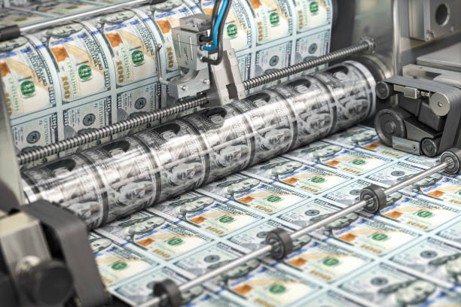
19
Taking Action
How we change data into dollars
June 8-10, 2025, | Austin, Texas

Slide 20
20
Making Money From Our Data
Find Our Edge
Capitalize On It
Automate It
Scale It
More capacity, higher service, lower rates. Whatever it is know it!
Once you have a winning strategy remove variance
Leave the human tasks to the humans
Use this data to prove to leadership you can scale
June 8-10, 2025, | Austin, Texas

Slide 21

21
Get BIll Gates Rich
June 8-10, 2025, | Austin, Texas

Slide 22
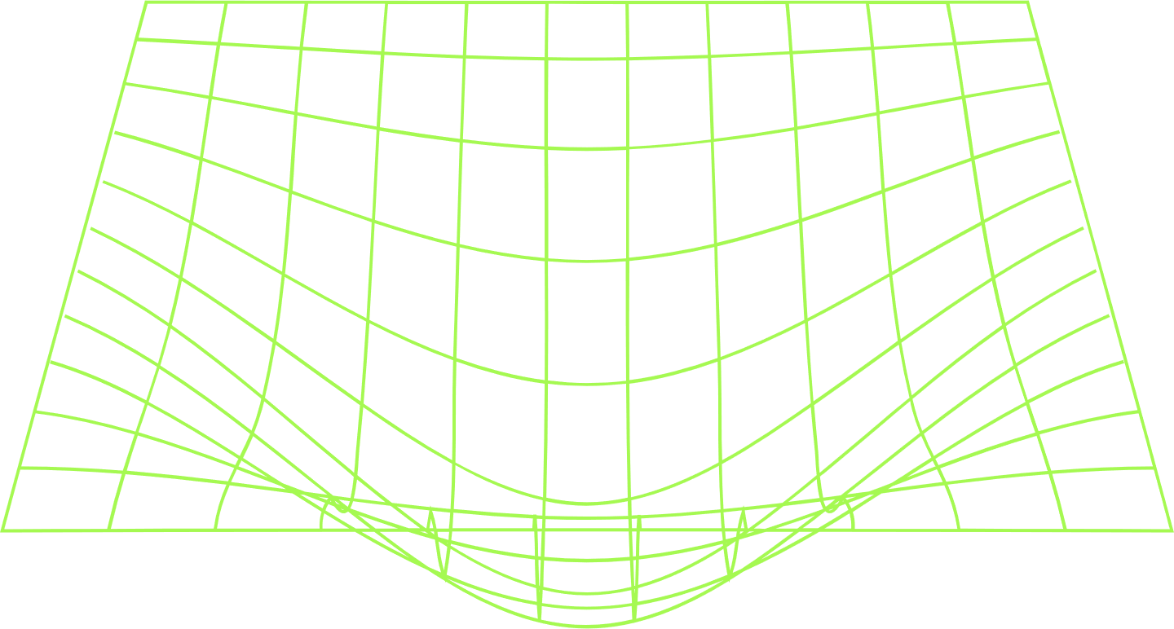
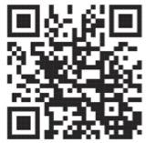
Thank you!
James@importyeti.com
650-941-2685
June 8-10, 2025, | Austin, Texas

